Slide 1
Be prepared for tomorrow
The main motive of this file is to not be fussy about result date and to stay positive.
Presentation by Ayyswariya RG

Slide 2

1
Whatever we have written, we will be awarded for that. So no worries

Slide 3
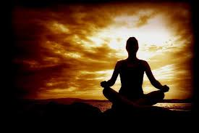
2
At this point of time, what we need is peace of mind. For this, doing meditation or visiting any temple will help you a lot

Slide 4
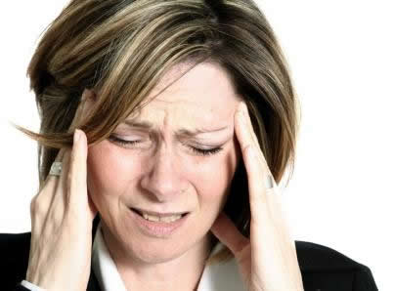
3
Unnecessary guessing of the pass percentage and about the result is waste of time at this moment. we just need to wait for THE day for knowing the result. We waited for so many days. So keep your mind stress free.

Slide 5
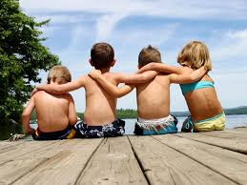
4
Spend time with your friend if you feel frustrated

Slide 6
5
If you have given both the groups, then plan for you are your career, the area in which you are going to work.
If you have given both the groups, then plan for you are your career, the area in which you are going to work.

Slide 7

6
Keep in mind that whatever the result may be, don’t give up. Be prepared to accept for whatever result you have got. We have taken up this profession for becoming a future CA. so we have to take up all steps to attain it.

Slide 8

7
Let god be with all of us. Lets hope for the best results. Leave the result in the hands of god. ALL THE BEST

Slide 9

Quote

