Slide 1

CA Surendra Kumar Rakhecha, Surat carakhecha@yahoo.com
Mobile : 98252 34165
Budget Highlights on
Direct Taxes :
NO RESTROSPECTIVE EFFECTS
PROSPECTIVE EFFECT OF GAAR PROVISIONS

Slide 2

Broad Measures to Collect Major Amount of Tax
1. Farm House situated near municipal limits are now covered under Wealth Tax due to change in Definition of Agricultural Land
2. Tax on Buyback of Shares of Unlisted Domestic Co. - 22.66%
3. Fee on Technical Services raised to 25% (10%)

Slide 3
Broad Measures to Collect Major Amount of Tax
4. Tax on Mutual Fund for Income distribution increased : 25 % (old 12.5%)
5. TDS of 1% on Transfer of Immovable Property:Rs.50L
6. Super Rich Surcharge : 10%
7. Commodity Transaction Tax @ 0.01%

Slide 4

Broad Tax Reforms Likely to Come in Direct Taxes
1. Set up of a
TAX ADMINISTRATION REFORM COMMISSION
2. Fifth Large Tax Payer Unit at Kolkata
3. Refund banker system for more than Rs.50,000
4. Central Processing Cell-TDS at Ghaziabad (commenced)
5. DTC Bill before the end of the Budget Session

Slide 5

Clause 3 : Amendment of Sec.2 : Agricultural Land
Municipal Limits :
Population as per last PUBLISHED CENSUS
+10,000 – 1,00,000 -> 2 km
+1,00,000 –10,00,000 -> 6 km
+10,00,000 ->8 km
( aerial distance; not the road as is at present)
What if the population is less than 10,000?

Slide 6

Clause 4 :Amendment of Sec. 10(10D) :
Life Insurance Policy of Persons suffering from Severe Disability
If paid during the year upto 15% of sum assured, exempt.
Keyman Policy
if assigned during the term of the policy; with or without consideration-
not exempt
in the hands of keyman.

Slide 7

Clause 5 : Insertion of Sec.32AC : Investment Allowance
15% of P & M
Investment More than 100 Cr.
In New Plant & Machinery ( Not to be sold for 5 years)
1-4-13 to 31-3-14
1-4-14 to 31-3-15
What if investment is only Rs.95 cr. upto 31 03 2014?

Slide 8

Clause 6 :Amendment of Sec. 36
Recently, the Hon’ble Supreme Court in the case of Catholic Syrian Bank Ltd. (343 ITR 270) held that the proviso to section 36(1)(vii) applies only to provision made for bad and doubtful debts relating to rural advances.
Thus, it has been interpreted that both the deductions
u/s 36(1)(vii) and u/s 36(1)(viia) are independent and separate deductions.

Slide 9

Clause 7 : Amendment of Sec. 40
The Bill proposes to amend section 40 of the Income-tax Act by inserting clause (iib) to provide for disallowance of any amount:
(A) paid by way of royalty, licence fee, service fee, privilege fee, service charge or any other fee or charge, by whatever name called, which is
levied exclusively on; or
(B) which is appropriated, directly or indirectly, from,
a State Government undertaking by the State Government. Example->>>>

Slide 10

Clause 8 : Insertion of Sec. 43CA
Provisions of Section 50C extended to cover immovable property held as stock in trade
This amendment will supersede the following judicial rulings:
(a) CIT v. Kan Construction and Colonizers (P) Ltd. [2012] 208 Taxman 478 (All.)
(b) K.R. Palanisamy v. UOI [2009] 180 Taxman 253 (Mad.)

Slide 11
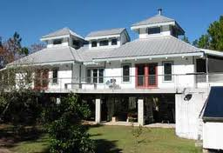
Clause 9 : Amendment of Sec. 56 : Taxability of immovable property received for inadequate consideration
The above amendment will override the following judicial decisions:
(a) CIT v. Khoobsurat Resorts (P) Ltd.
[2012] 211 Taxman 510 (Del.)
(b) DCIT v. Suzaina Foods (P) Ltd.
(ITA No.2731/Ahd/2010)

Slide 12
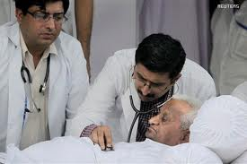
Clause 10 : Amendment of Sec. 80C
Insurance premia proposed to be allowed upto 15% of sum assured
Person with disability
Suffering from disease or ailment defined u/s 80DDB

Slide 13
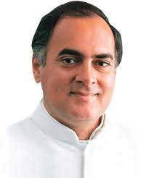
Clause 11 : Amendment of Sec. 80CCG :
Rajiv Gandhi Equity Scheme
First Time Investor
Acquired Listed Equity Shares as per Sec 10(38)
Maximum Rs.50,000
Deduction 50%
Listed Units of an Equity Oriented Fund (inserted)
Total Income Rs.12L (Rs.10L)

Slide 14
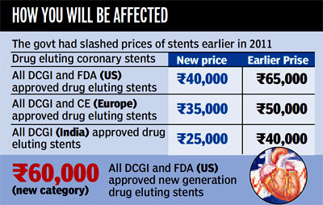
Clause 12 : Amendment of Sec.80D
Present :
Central Government Health Scheme
Proposed :
To add :
“or such other scheme as notified by CG”

Slide 15

Clause 13 : Insertion of Sec.80EE
Claim this exemption for
One Time (upto Rs.1 Lac)
Don’t own Any House ☹
Buy a house upto Rs.40 Lacs
Loan upto Rs.25.00 Lacs from Financial Institutions
Anamolies :
Loan only upto 60% of the Cost of House?
Is Balance Rs.15 Lacs “owned”by an “affordable” person so easily?

Slide 16

Clause 14 : Amendment of Sec. 80G
Donation to
NATIONAL CHILDREN FUND
100% Exemption

Slide 17

Clause 15: Amendment of Sec.80GGB
Indian Co.
Contributing to Political Party
Deduction available only if contributions made otherwise than CASH.

Slide 18
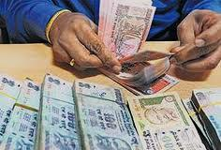
Clause 16: Amendment of Sec.80GGC
Other person (excluding Indian Co & local authrority and artificial juridical person)
Contributing to Political Party
Deduction available only if contributions made otherwise than CASH.

Slide 19

Clause 17 : Amendment of Sec. 80IA : Extension of sunset date for tax holiday for power sector : 1 Year
The existing provisions provide for 100% deduction for 10 years, in respect of profits and gains derived by an undertaking set up for the generation and distribution of power which starts transmission or distribution by laying a network of new transmission or distribution lines and undertakes substantial renovation…

Slide 20

Clause 18 : Amendment of Sec.80JJAA : 30% Deduction of Wages paid to New REGULAR workmen
Indian company
Industrial undertaking
Deduction for 3 years
Not set up by splitting up or reconstruction of an existing undertaking or amalgamation with another industrial undertaking
Now only FACTORY is eligible to claim such deduction

Slide 21

Clause 19 & 20 :Amendment of Sec. 87 and Insertion of Sec. 87A
“Grand” Benefit of
Rs.2,000/-
in Tax !!
“Simple” Condition:
Earn only upto Rs.5 Lacs

Slide 22
Clause 21 :Amendment of Sec.90
Provisions related to GAAR
Amended: Newly introduced Chapter X-A applicable even if not beneficial to the assessee
Effective wef
1-4-2016

Slide 23
Clause 22 :Insertion/Amendment of Sec.90A
Any specified association in India
enters into an agreement with
Any specified association;
Specified Territory outside India
CG may notify DTAA
May not be beneficial to the assessee
still applicable w.e.f.
1-4-2016

Slide 24


Clause 23 : Omission of Chapter X-A relating to General Anti Avoidance Rule

Slide 25

Clause 24 :Insertion of New Chapter X-A : 1-4-2016
Meaning of Impermissible Avoidance Agreement :
An arrangement, “the main purpose” of which is to obtain a tax benefit.
One inclusive definition of “connected person” to be provided.
Approving Panel : 1 Judge of High Court 2. CIT 3. Scholar or Academician (Accountant)
The direction of the Approving Panel will be binding on the assessee as well as the income-tax authorities

Slide 26
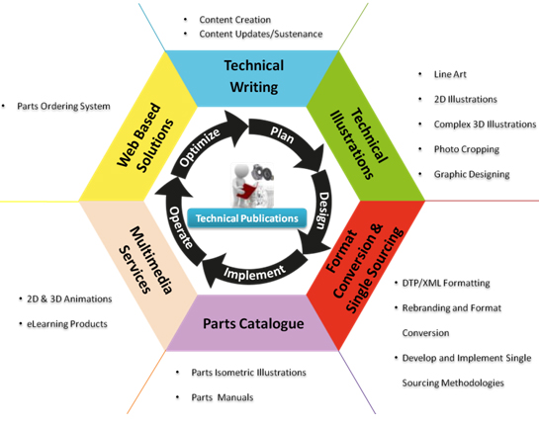
Clause 25 : Amendment of Sec.115A
Tax rate on income in nature of Royalty or Fees for Technical Services (FTS) increased to 25% of the gross amount received.
However, whenever the DTAA provides a lower rate below 25%, then the same (i.e. the lower rate) shall apply.
Logic given – DTAA with
84 countries allow higher taxation

Slide 27

Clause 26 : Amendment of Sec.115BBD (Finance Act, 2011 & Extended by Finance Act,2012) : Extended for 1 more year
Gross dividends received by an Indian company from a foreign company in which it has shareholding of 26% or more, is taxable @ 15% (instead of normal tax rate of 30%) if such dividend was included in the total income for the Financial Year 2011-12 and 2012-13.
The said section has been introduced to encourage Indian Holding Companies to repatriate the profits of their foreign subsidiaries into India.

Slide 28

Clause 27 : Amendment of Sec.115O
Removal of cascading effect of Dividend Distribution Tax (DDT)
15%
Domestic Company Holding more than 50% shares in Foreign Co.
If tax ( 15% ) is paid by Domestic Co. u/s 115BBD on dividends received from foreign Co.
No tax if to that extent dividend is distributed in the same year.

Slide 29

Clause 28 : :Insertion of New Chapter XII-DA :
Special Provisions on Tax on Distributed Income of Domestic Company for Buy-Back of Shares
The proposed provisions will overcome the AAR ruling in case of
Armstrong World Industries Mauritius Multiconsult Ltd. (210 Taxman 303)
where it was held that a resident of Mauritius was not liable to tax on gains on buy-back of shares by an Indian company in the absence of material to conclude that it was a scheme of avoidance of tax.

Slide 30

Clause 30 : Insertion of New Chapter XII-EA :
Special Provisions on Distributed Income by
Securitization Trusts
On Income distributed to its investors.
The rate of additional tax will be as
under:
(a) where recipient is an individual or a HUF @ 25%
(b) other recipient @ 30%.
The income in the hands of Recipient is exempt from tax

Slide 31

Clause 29 : Amendment of Sec.115R
With a view to make the tax rates uniform for all types of funds, other than equity oriented fund, it is proposed to increase the rate of tax on distributed income from 12.5% to 25% in all cases where distribution is made to an individual or a HUF.

Slide 32

Clause 30 : Insertion of New Chapter XII-EA
Maximum marginal tax u/s 161 on Trusts doing business
Proposed :
Income Exempt of:
SECURITISATION TRUSTS :
1. Regd. With SEBI or RBI
2. Income Distribution Tax :
  Ind & HUF 25%
  Others 30%
  Income exempt in the hands of recipients.

Slide 33
Clause 31 : Amendment of Sec.132B (w.e.f. 1-6-2013)
The Bombay High Court in the case of
Jyotindra B. Mody (Appeal No. 3741 of 2010) and in
Pandurang Dayaram Talmale (187 CTR 625) have taken a view that the term “existing
liability” includes advance tax liability of the assessee, which is not in
consonance with the intention of the legislature.
Clarification : Existing liability does not include advance tax payable.
In favour of the assessee

Slide 34

Clause 32 : Amendment of Sec.139
File return with Self Assessment Tax;
otherwise it is invalid.
No notice is now required from the Assessing Officer to make correct the defect.

Slide 35

Clause 33 : Amendment of Sec. 142(2A) : Special Audit
The expression “nature and complexity of the accounts” relating to special audit, has been interpreted in a very restrictive manner by the Delhi High Court in the case of Delhi Development Authority.
Proposed :
At any stage of the proceedings before him,
Nature and complexity of the accounts,
Volume of the accounts,
Doubts about the correctness of the accounts,
Multiplicity of transactions in
The accounts or specialized nature of business activity of the assessee, and the
Interests of the revenue (CIT approval)

Slide 36

Clause 34 : Omission of Sec. 144BA
Impermissible Avoidance Agreement - AO to CIT
CIT to examine
Assessee if does not furnish any objection in prescribed time
CIT- matter to approval panel if not satisfied
Approval Panel –Directions
Before such: opportunity to AO and the Assessee

Slide 37
Clause 35 :Insertion of new Sec. 144BA : GAAR
Reference to the CIT in likely cases of GAAR
Referred by AO
Notice to Assessee to object within 60 days
If not satisfied: Approving Panel
If satisfied: Writing to AO
AO is bound : chapter X A
Approving panel to direct the matter within 6m
Directions binding on Assessee
One or more approving Panels
Term 1 yr:extended 3 yrs.
W.e.f. 01 04 2016

Slide 38
Clause 36 : Amendment of Sec.144C
Dispute Resolution Panel
Order passed by AO with the approval of CIT shall not apply
Wef
01 04 2016

Slide 39

Clause 37 : Amendment of Sec.153
Exclusion of time in computing the period of limitation for completion of assessment and reassessment :
i. Audit Period
ii. Reference for exchange of information in Sec. 90 & 90A

Slide 40
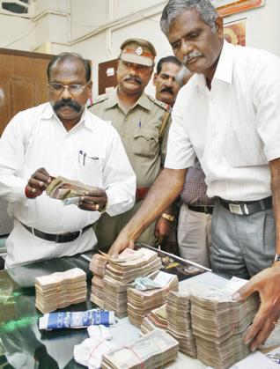
Clause 38 : Amendment of Sec.153B
Exclusion of time in computing the period of limitation for completion of
Search assessment

Slide 41
Clause 39 : Amendment of Sec.153D :
Search or Requisition
Present : Prior approval of JC
Proposed:
In case of provisions of Sec. 144BA (GAAR) are applicable; the above condition of approval of JC is not applicable
GAAR cases are handled separately:
1. AO
2. CIT
3. Approving Panel

Slide 42

Clause 40 : Amendment of Sec.167C
Proposed :
Tax Due includes –
Penalty
Interest
Any other Sum
Payable under the act

Slide 43
Clause 41 : Amendment of Sec.179
Directors’ liability in case of private limited companies:
Tax includes penalty, interest and any other sum paid under the Act.
You are no more Director to give Directions;
It is the Income Tax Department
which will give you Directions !

Slide 44

Clause 42 : Insertion of New Sec.194 IA
TDS on Land and Building (other than Agricultural land)
Rs. 50 Lacs and above
Only 1%

Slide 45
Clause 43 : Amendment of Sec.194LC
1. Non-Resident or a Foreign Co.
2. Foreign Currency
3. Deposited in the Designated Bank
4. Converted into Rupee
5. Bond is issued
6. By specified Company
Long Term
Infra-bond
Concessional Rate of Tax 5%

Slide 46

Clause 44 : Amendment of Sec. 245N
Authority on Advance Ruling
Impermissible Avoidance Agreement
Any person whether resident or non-resident

Slide 47
Clause 45 : Amendment of Sec.245R
Procedure on receipt of application
By
Authority for advance ruling
On
Impermissible Avoidance Agreements

Slide 48
Clause 46 : Amendment of Sec. 246A
Appealable Orders
Before CIT
On Impermissible Avoidance Agreement
GAAR related clauses in the budget:
21 -22-23-24-34-35-36-37-38-39-44-45-46-47-49 (15)

Slide 49
Clause 47 : Amendment of Sec.253
Assessment passed with the approval of CIT on Impermissible Avoidance Agreements

Slide 50

Clause 48 : Substitution of new section 271FA
Section 285BA : Filing of AIR Return
Penalty for
Non-Filing of
Annual Information Return
Present Rs.100 per day
Proposed Rs.500 per day
High Value Transactions ->>>>

Slide 51
Clause 49 : Amendment of Sec.295
Power to make Rules on GAAR related issues

Slide 52

Clause 51 : Amendment of Sec.2 Wealth Tax
Urban Land
Population
Distance

Slide 53

Clause 52 : Insertion of New Sec. 14A and 14B (WT)
Insertion of New Sec. 14A and 14B (WT)
E Filing of Wealth Tax Cases without any annexure

Slide 54

Thoughts of Politicians Thoughts of Public on Taxes
People see the budget from taxation point only
Hence easy to “allocate” funds
to the “desired” areas
Example :
Total Budget Exp.Rs. 16,65,297 cr
Gender Budget : Rs. 97,134 cr.
Rural Develop : Rs. 80,194 cr.
SC/ST Budget : Rs. 66,159 cr.
Child budget : Rs. 77,236 cr.
Drinking Water : Rs. 15,260 cr.
National Skill Development:
              Rs.1000 cr.☹

Slide 55

The Difference between the “Needs” of
Two Different Persons on the Same Issue
Notes:
CA Surendra Kumar Rakhecha, Surat Mobile : 98252 34165 e-mail : carakhecha@yahoo.com

Slide 56
Latest Development To Know About
Thank You
CA Surendra Kumar Rakhecha
(M) 98252-34165
E-mail : carakhecha@yahoo.com
E-Invoicing :
Next Step for
New Age CFOs

