Slide 1


Good Kharma
This is a nice reading, but short . Enjoy! This is what the Dalai Lama has to say for 2008. All is takes is a few seconds to read and think over. Do not keep this message. The mantra must leave your hands within 96 hours. You will get a very pleasant surprise. This is true for all ~ even if you are not superstitious ~ of whatever religious belief……………Faith……..

Slide 2
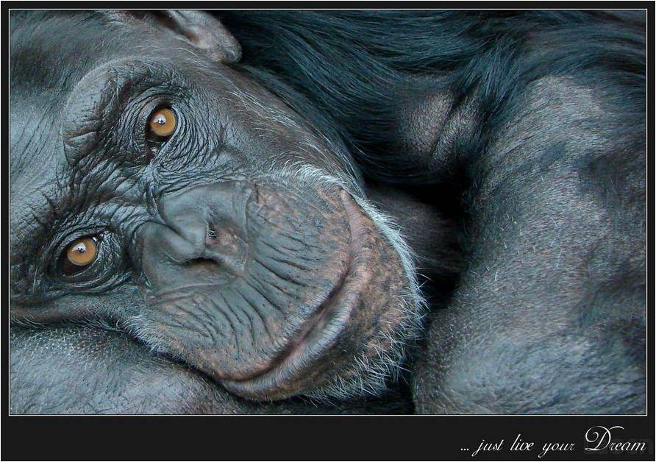
Take into account that great love and great achievements involve great risk.

Slide 3

When you lose,
don’t lose the lesson………….

Slide 4
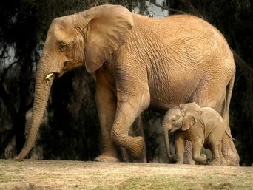
Follow the three R’s:
Respect for Self,
Respect for Others and
Responsibility for all your Actions.

Slide 5
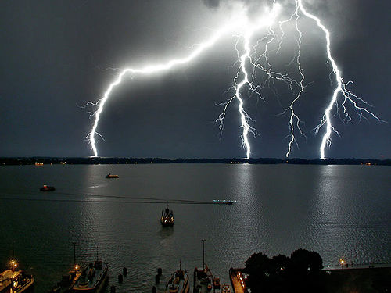
Remember that not getting what you want is sometimes a wonderful stroke of luck.

Slide 6

Learn the rules so you know how to break them properly.

Slide 7

Don’t let a little dispute injure a great relationship.

Slide 8

When you realize you’ve made a mistake, take immediate steps to correct it.

Slide 9

Spend some time alone every day.

Slide 10
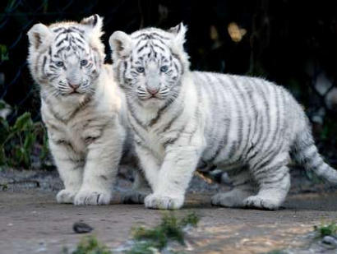
Open your arms to change, but don’t give up your values.

Slide 11

Remember that silence is sometimes the best answer.

Slide 12
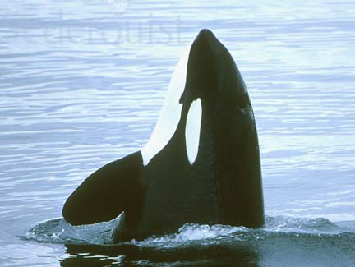
Live a good, honorable life. Then when you get older and think back, you’ll be able to enjoy it a second time.

Slide 13
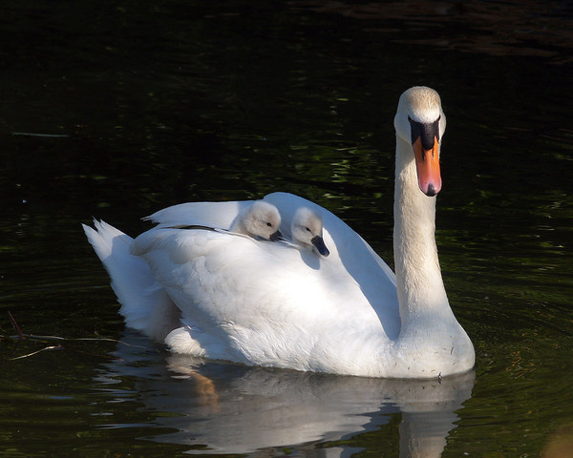
A loving atmosphere in your home is the foundation for your life.

Slide 14

In disagreements with loved ones, deal only with the current situation. Don’t bring up the past.

Slide 15

Share your knowledge. It is a way to achieve immortality.

Slide 16

Be gentle with the Earth.

Slide 17

Once a year, go some place you’ve never been before.

Slide 18
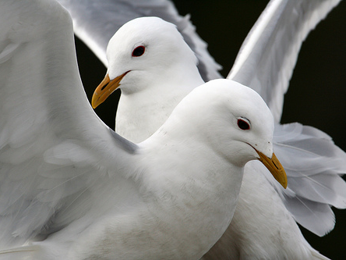
Remember the best relationship is one in which your love for each other exceeds your need for each other.

Slide 19

Judge your success by what you had to give up in order to get it.

Slide 20

Approach love and cooking with reckless abandon.

Slide 21

Thank You….

