Slide 1
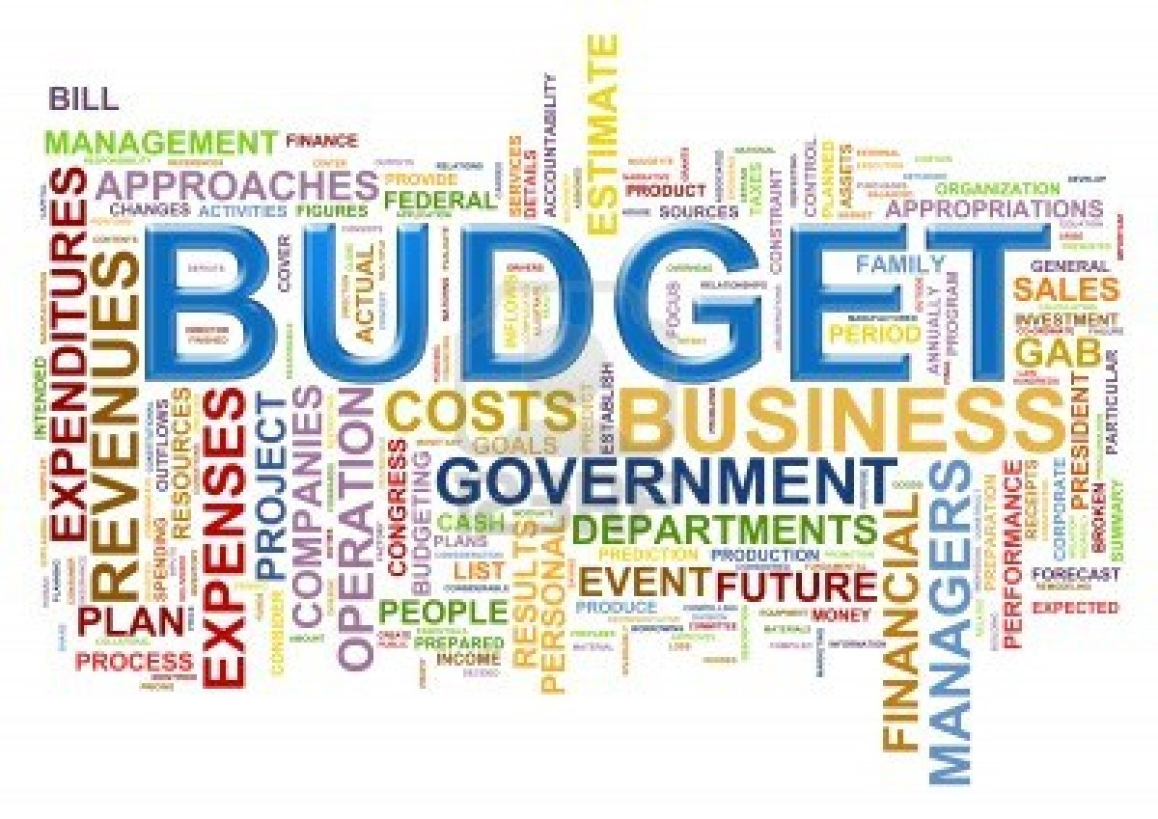
A LOOK AT THE BUDGET 2014

Slide 2
PREFACE
Fiscal deficit estimated revised to 5.2% of GDP
Short Term borrowing revised to 457 billion rupees
Revenue deficit revised at 3.9% of GDP
12th plan total expenditure revised to 14.31 trillion rupees
Current account deficit high on gold, coal and oil imports ( Export, import amount to 43% of GDP ).

Slide 3
INDEX
PERSONAL TAX
COPORATE
DIRECT TAX
DEDUCTIONS
INDIRECT TAX
TAX REFORMS
EXPECTATIONS
BY Hitesh Jindal

Slide 4
PERSONAL TAX
No case to revise either tax slabs or rates
Personal income tax slabs unchanged FY14
Some relief to tax payers in Rs 2 lakh to Rs 5 lakh bracket
Tax credit of 2,000 rupees for incomes of upto 5 lakh rupees
Surcharge of 10% on people with income over 10 Million in rupees
Surcharge on high income tax payers only for one year
Only 42,800 tax payers with income over Rs10 million, this will generate the revenue of Rs 120 million
Education cess to continue at 3%

Slide 5
CORPORATE TAX
10% surcharge on cos with income above 100 million rupees
Dividend distribution surcharge raised to 10% vs 5%
GAAR modified provisions seen effective Apr 1, 2016
20% withholding tax on profits distributed by unlisted companies
Tax holiday for power plants extended to Mar 2014
Sops for power projects to continue for 1 year
15% tax on dividend from overseas arms to continue
Financial institutions securitization trust exempted from tax
Transaction tax on equity futures cut to 0.01% vs 0.017%

Slide 6
DIRECT TAX
Direct tax proposals to yield 133 billion rupee FY14
To introduce DTC Bill before end of Budget Session
Tax on MF redemption, purchase on exchanges cut to 0.001%
Increase surcharge from 5 to 10 percent on domestic (in case of foreign companies 2 to 5 percent ) companies whose taxable income exceed10 crore.
Agricultural land exempt from TDS on property deals
Royalty to overseas parents to attract 25% tax vs 10%
No income tax on investor protection fund of depositaries
1% TDS on immovable property transfer of over 5 million rupee

Slide 7
DEDUCTIONS
Companies investing 100 crore or more in plant and machinery during the period 1.4.2013 to 31.3.2015 will be entitled to deduct an investment allowance15 per cent of the investment.
Additional 1Lac deduction available u/s 24b on the borrowing of Rs. 25 Lac or more for purchase of 1st home.
Contributions made to schemes of Central and State Governments similar to Central Government Health Scheme, eligible for section 80D of the Income tax Act.
Donation to national children fund to get 100% tax relief

Slide 8
SERCIVE TAX
No change in standard rate of service tax
To impose service tax on all air-conditioned restaurants
Films exhibited in cinema halls to have no service tax
Moots voluntary compliance encouragement plan for service tax
Vocational courses exempt from service tax
Farm produce testing service included in negative list

Slide 9
TAX REFORMS
To set up tax administration reform commission
Little room to raise taxes in constrained economy
Need for state and central govts to pass a GST law
Draft bill on GST in Parliament in next few months
2 additions to service tax negative list
Include vocational courses in negative list
One-time amnesty scheme for service tax due from 2007
Allocates 90 billion rupee as CST compensation to states
To encourage voluntary compliance to boost service tax collection

Slide 10
EXPECTATIONS
To bring down fiscal deficit to 3% by FY 16-17
To bring down revenue deficit to 1.5% by FY 16- 17
To encourage foreign investments

