Slide 1
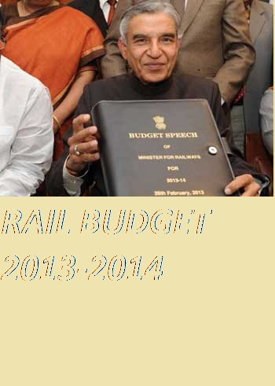
RAILWAY BUDGET 2013-14

Slide 2
Train budget
COSTS

Slide 3
REVENUE
Rs.1.26 Lakh Crore is 2012-13 revenue ,short by Rs.6,872 Crore

Slide 4
TATKAL
Charges up between Rs.15 to 100
Reservation Fee hiked for AC and First Class
FUEL ADJUSTMENT
Diesel price hike nullified January increase in ticket costs
In future ticket, charge may be indexed to fuel price

Slide 5
Freight Fare
MONEY
Ticket fare 20 % Hike in January2013
Yearly hike of 5 5 proposed for 10 years
In April, freight tariff will be adjusted to fuel prices
Rail tariff authority proposal prepared and sent for consultation

Slide 6
SECURITY

Slide 7
ACCIDENT
Train protection warning in automatic signaling systems
Trials of train collision avoidance system
FIRE
Comprehensive fire and smoke detection systems in coaches
Fire extinguisher in select wagons

Slide 8
Women’s Safety
Four all-women RPF companies to be set up
10% of all RPF vacancies reserved for women
Disabled-friendly
179 escalators and 400 lifts in A-1 stations earning over Rs.60 crore
Braille stickers on coaches more wheel chairs

Slide 9
COMFORT

Slide 10
Ticketing
Internet booking open from 00:30 to 22:30 Hours
More automatic ticket vending machines
1.2 Lakh users can log in to ticketing website , up from 40,000 now.
Lounge
Executive lounge at 7 more stations such as Vizag,Patna,Banglore
Helpline for companies about cleanliness

Slide 11
WIFI
Free wireless internet to attract young and the well heeled on select trains
SMS alerts on reservation status
Anubhuti
Coaches in select trains providing good ambience and latest facilities
Booking through mobile phones.

Slide 12
EXPANSAION

Slide 13
No. of Trains
67 New Express train will be introduced.
26 New Passenger train will be introduced.
VACANCIES
1.5 Lakh vacancies will be filled this year. One third reserved for disabled and weaker sections.

