Slide 1
☺SMILE☺
☺ ITS A SIGN TO COMMUNICATE ,IT’S A FEELING TO ENJOY,IT’S A SYMBOL OF JOY AND HAPPINESS ☺

Slide 2

☺SMILE SMILE SMILE WHAT A NICE WORD WHILE READING THE WORD ITSELF WE CAN LOOK A SMILE ON OUR FACE LIKE THIS☺

Slide 3
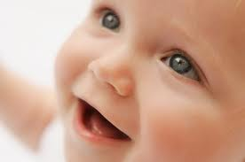
☺HEY GUYS SHELL WE MOVE ON TO KNOW WHAT IS SMILE ????☺
☺HERE IT IS :
A SMILE IS A FACIAL EXPRESSION FORMED BY FLEXING THE MUSCLES NEAR BOTH ENDS OF THE MOUTH.
SOME SMILES INCLUDE CONTRACTION OF MUSCLES AT THE CORNER OF THE EYE.☺
LIKE THIS:

Slide 4

☺ITS AN EXPRESSION DENOTING PLEASURE, SOCIABILITY,HAPPINESS,
AMUSEMENTS☺

Slide 5

☺HAHA…. A CUTE SMILE TRAIN☺

Slide 6
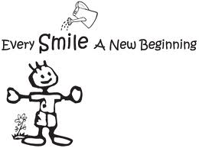

Slide 7
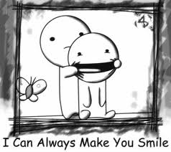
☺MAKING SOMEONE TO SMILE IS VERY DIFFICULT ITS AN ART☺

Slide 8
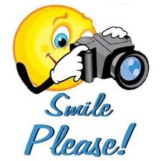
☺A SMILE IS A CURVE THAT SETS EVERYTHING STRAIGHT☺

Slide 9
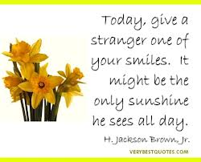

Slide 10


Slide 11
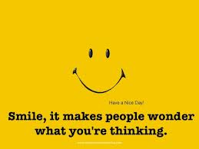

Slide 12
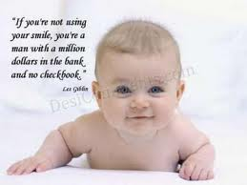

Slide 13


Slide 14
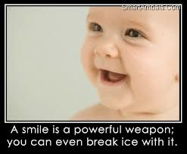

Slide 15
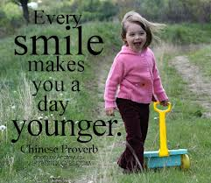

Slide 16


Slide 17
☺EVERY HEART HAS A PAIN…ONLY THE WAY OF EXPRESSION IS
DIFFERENT..SOME HIDE IT IN EYES WHILE SOME HIDE IN THEIR SMILE☺
☺

Slide 18

☺“SMILE!!! LET EVERYONE KNOW THAT TODAY YOU ARE A LOT STRONGER THAN YOU WERE YESTERDAY…..AND YOU WILL BE.”☺

Slide 19

☺TELLING THE TRUTH AND MAKING SOME ONE CRY IS BETTER THAN TEKKING THE LIE AND MAKING SOMEONE SMILE☺

Slide 20
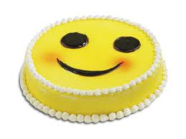
☺THE MOST BEAUTIFUL SMILE IS THE ONE THAT STRUGGLES THROUGH TEARS☺

Slide 21
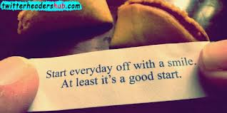

Slide 22

☺GUYS ALWAYS KEEP SMILING ON YOUR FACES AND FACE ANY PROBLEM WITH CONFIDENCE☺
KEEP SMILING ALWAYS…. ☺☺☺☺☺☺☺☺☺☺☺☺☺☺☺☺☺☺☺☺☺☺

