Slide 1
MONEY LAUNDERING
MADE BY:- UTTMA SHUKLA

Slide 2
WHAT IS MONEY LAUNDERING
Illegal / Dirty Money
Legal / white Money
Conversion
Definition: 'Money Laundering' is the process by which illegal funds and assets are converted into legitimate funds and assets.

Slide 3
Money Laundering as per section 3 of the Prevention Money Laundering Act:-
“Whosoever directly or indirectly attempts to indulge or knowingly assists or knowingly is a party or is actually involved in any process or activity connected with the proceeds of crime and projecting it as untainted property shall be guilty of offence of money laundering.”
As per Sub - Committee on Narcotics and Terrorism of US Senate Foreign Relations Committee:-
“Money Laundering is the conversion of profits from illegal activities into financial assets which appear to have legitimate origins.”

Slide 4
Money Laundering generally refers to ‘washing’ of the proceeds or profits generated from:
Kidnapping
Prostitution
Extortion
Drug
Trafficking
Criminal
Activities
Bribery
& Corruption
Smuggling
(arms, people,
goods)‏
Gambling,
Robbery,
Cheating
Counterfeiting
& Forgery
Terrorist Act

Slide 5
Money Laundering Cycle:
1.
Predicate Crimes
Corruption and Bribery
Fraud
Organized crime
Drug and human trafficking
Environmental crime
Terrorism
Other serious crimes…
2. PLACEMENT
Initial introduction of criminal proceeds into the stream of commerce
Most vulnerable stage of money laundering process
4.
INTEGRATION
3.
LAYERING
The last stage in the laundering process.
Occurs when the laundered proceeds are distributed back to the criminal.
Creates appearance of legitimate wealth.
Involves distancing the money
from its criminal source:
  movements of $ into different accounts
  movements of money to different countries
Increasingly difficult to detect.

Slide 6
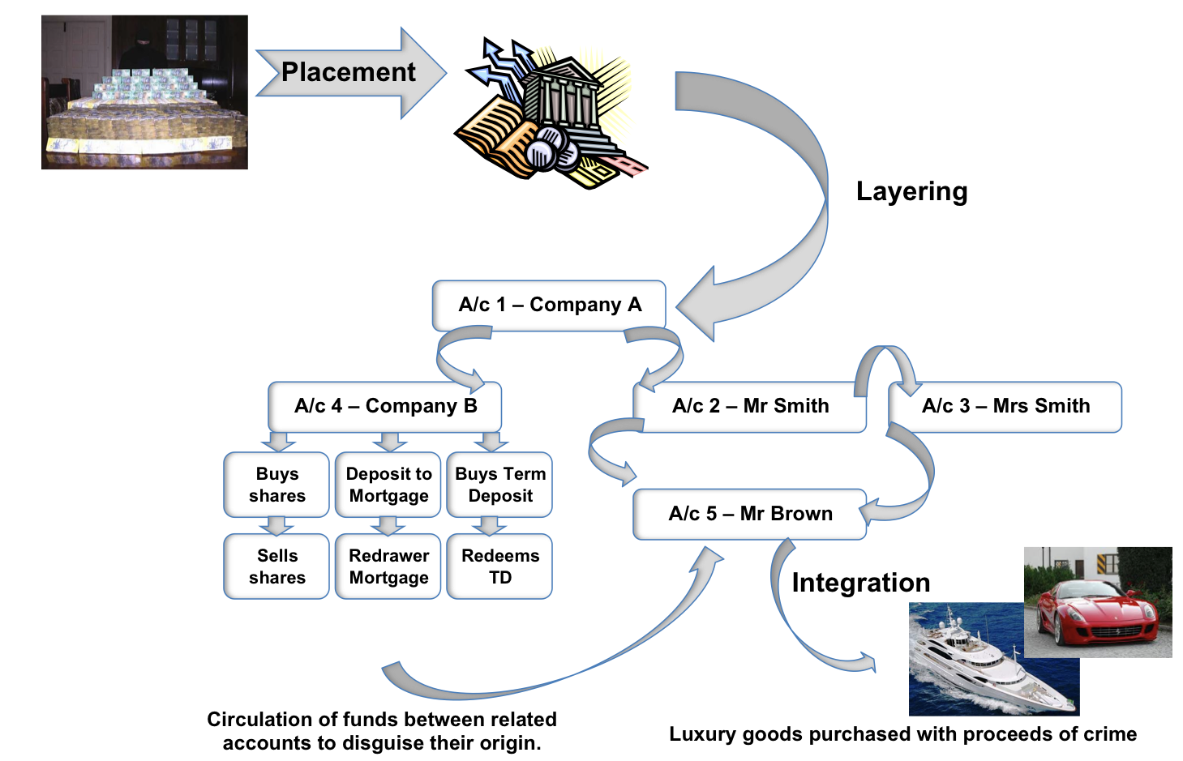
HOW MONEY LAUNDERING WORKS:

Slide 7

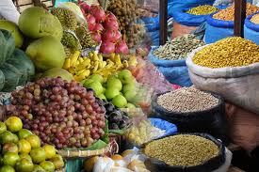

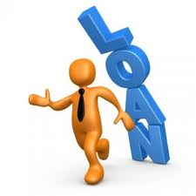
Some of the Popular Places from where Money is laundered through…
Stock Markets
Agricultural Products (as there is no income tax and mostly the transactions are on cash basis)
Property Market
Creating Bogus Companies
Showing Loans
False Export Import Invoices

Slide 8
Typologies/ Techniques employed
Deposit structuring or smurfing
Connected Accounts
Payable Through Accounts
Loan back arrangements
Forex Money Changers
Credit/ Debit cards
Investment Banking and the Securities Sector
Insurance and Personal Investment Products
Companies Trading and Business Activity
Correspondent Banking
Lawyers, Accountants & other Intermediaries
Misuse of Non-Profit Organizations.

Slide 9
Financing of terrorism:
Money to fund terrorist activities moves through the global financial system via wire transfers and in and out of personal and business accounts. It can sit in the accounts of illegitimate charities and be laundered through buying and selling securities and other commodities, or purchasing and cashing out insurance policies.
Although terrorist financing is a form of money laundering, it doesn’t work the way conventional money laundering works. The money frequently starts out clean i.e. as a ‘charitable donation’ before moving to terrorist accounts. It is highly time sensitive requiring quick response.

Slide 10
Financing of terrorism:
(i) State Sponsored
(ii) Other Activities- legal or non-legal
Legal Sources of terrorist financing
  Collection of membership dues
  Sale of publications
  Cultural of social events
  Door to door solicitation within community
  Appeal to wealthy members of the community
  Donation of a portion of personal savings

Slide 11
Financing of terrorism:
Illegal Sources
  Kidnap and extortion;
  Smuggling;
  Fraud including credit card fraud;
  Misuse of non-profit organizations and charities fraud;
  Thefts and robbery; and
  Drug trafficking

Slide 12
Money Laundering Risks:
What are the risks to banks?
(i) Reputational risk
(ii) Legal risk
(iii) Operational risk (failed internal processes,
people and systems & technology)
(iv) Concentration risk (either side of balance
sheet).
All risks are inter-related and together have the potential of causing serious threat to the survival of the bank

Slide 13
Reputational Risk:
The potential that adverse publicity regarding a bank’s business practices, whether accurate or not, will cause a loss of confidence in the integrity of the institution.
Reputational Risk : a major threat to banks as confidence of depositors, creditors and general market place to be maintained.
Banks vulnerable to Reputational Risk as they can easily become a vehicle for or a victim of customers’ illegal activities.

Slide 14
Operational Risk:
The risk of direct or indirect loss resulting from inadequate or failed internal processes, people and systems or from external events.
Weaknesses in implementation of banks’ programs, ineffective control procedures and failure to practice due diligence.

Slide 15
Legal Risk:
The possibility that lawsuits, adverse judgments or contracts that turn out to be unenforceable can disrupt or adversely affect the operations or condition of a bank.
Banks may become subject to lawsuits resulting from the failure to observe mandatory KYC standards or from the failure to practice due diligence.
Banks can suffer fines, criminal liabilities and special penalties imposed by supervisors.

Slide 16
Concentration Risk:
Mostly applies on the assets side of the balance sheet: Information systems to identify credit concentrations; setting prudential limits to restrict banks’ exposures to single borrowers or groups of related borrowers.
On liabilities side: Risk of early and sudden withdrawal of funds by large depositors- damages to liquidity.

Slide 17
Punishment for Offence:
Imprisonment up to seven years.
The same is 10 years in case of Narcotics and Drugs, and
Fine up to Rs 5 lacs.
In addition, the tainted property is also confiscated by the Central Government.

Slide 18
What KYC means?
Customer?
One who maintains an account, establishes business relationship, on who’s behalf account is maintained, beneficiary of accounts maintained by intermediaries, and one who carries potential risk through one off transaction.
Your? Who should know?
Branch manager, audit officer, monitoring officials, PO.
Know? What you should know?
True identity and beneficial ownership of the accounts.
Permanent address, registered & administrative address.

Slide 19
What KYC means?
Making reasonable efforts to determine the true identity and beneficial ownership of accounts;
Sources of funds.
Nature of customers’ business.
What constitutes reasonable account activity?
Who your customer’s customer are?

Slide 20
KYC Does Not Mean:
Denial of Service to the Common Person.
Intrusive Behavior.
Use of information for cross selling.
Harassment of customers- threatening to close down the accounts arbitrarily.

Slide 21
Advantages of KYC norms:
Sound KYC procedures have particular relevance to the safety and soundness of banks, in that:
They help to protect banks’ reputation and the integrity of banking systems by reducing the likelihood of banks becoming a vehicle for or a victim of financial crime and suffering consequential reputational damage;
They provide an essential part of sound risk management system (basis for identifying, limiting and controlling risk exposures in assets & liabilities).

Slide 22
Core elements of KYC:
Customer Acceptance Policy.
Customer Identification Procedure- Customer Profile.
Risk classification of accounts - risk based approach.
Risk Management.
Ongoing monitoring of account activity.
Reporting of cash and suspicious transactions.

Slide 23
Measures to deter money laundering:
Board and management oversight of AML risks.
Appointment a senior executive as principal officer with adequate authority and resources at his command.
Systems and controls to identify, assess & manage the money laundering risks.
Make a report to the Board on the operation and effectiveness of systems and control.
Appropriate documentation of risk management policies, their application and risk profiles.

Slide 24
Measures to deter money laundering:
Appropriate measures to ensure that ML risks are taken into account in daily operations, development of new financial products, establishing new business relationships and changes in the customer profile.
Screening of employees before hiring and of those who have access to sensitive information.
Appropriate quality training to staff.
Quick and timely reporting of suspicious transactions.

Slide 25
SUSPICIOUS TRANACTION:
Suspicious transaction means a transaction whether or not made in cash which, to a person acting in good faith –
  gives rise to a reasonable ground of suspicion that it may involve the proceeds of crime; or
  appears to be made in circumstances of unusual or unjustified complexity; or
  appears to have no economic rationale or bonafide purpose;

Slide 26
SUSPICIOUS TRANACTION:
Providing misleading information / information not easily verifiable while opening an Account.
Large cash withdrawals from: a dormant or inactive account or account with unexpected large credit from abroad.
Sudden increase in cash deposits of an individual with no justification.
Employees leading lavish lifestyles that do not match their known income sources.

Slide 27
Suspicious Transaction:
Large cash deposits into same account.
Substantial increase in turnover in a dormant account.
Receipt or payment of large cash sums with no obvious purpose or relationship to Account holder / his business.
Reluctance to provide normal information when opening an Account or providing minimal or fictitious information.

Slide 28
Role of cash in money laundering:
Disguise the audit trail.
Provide anonymity.
Concealing true ownership and origin of money.
Control over money.
Changing the form of money.

Slide 29
Cash Transactions:
    All cash transactions of the value of more than rupees ten lakhs or its equivalent in foreign currency.
    All series of cash transactions integrally connected to each other which have been valued below rupees ten lakhs or its equivalent in foreign currency where such series of transactions have taken place within a month.

Slide 30
DUE DATES:
Cash Transaction Report
  by 15th of the succeeding month.
  (individual transactions below rupees fifty
  thousand may not be included;)
Suspicious Transaction Report
  within 7 days of arriving at a conclusion that any transaction is of suspicious nature.

Slide 31
IPO SCAM - INDIA
Current account opened in the name of multiple companies on the same date in the same branch of a bank.
Sole person authorized to operate all these accounts who was also a Director in all the companies.
Identity disguised by using different spelling for the same name in different companies.
Multiple accounts opened in different banks by the same group of joint account holders.
Huge funds transferred from companies accounts to the individual’s account which was invested in IPO’s.

Slide 32
IPO SCAM - INDIA
Loans/ overdrafts got sanctioned in multiple names to bypass limit imposed by RBI.
Loans sanctioned to brokers violating guidelines.
Multiple DP accounts opened to facilitate investment in IPO.
Large number of cheques for the same value issued from a single account on the same day.
Multiple large value credits received by way of transfer from other banks.

Slide 33
IPO SCAM - INDIA
Several accounts opened for funding the IPO on the request of brokers, some were in fictitious names.
Refunds received got credited in brokers a/cs.
Margin money provided by brokers through single cheque.
Nexus between merchant banker, brokers and banks suspected.

Slide 34
Operational deficiencies:
Factors that facilitated the scam
Photographs not obtained.
Proper introductions not obtained.
Signatures not taken in the presence of bank official.
Failure to independently verify the identity and address of all joint account holders.
Directors identity/ address not verified.
Customer Due Diligence done by a subsidiary.

Slide 35
SATYAM – Issue:
The Enforcement Directorate has registered a case against Satyam Computer and its tainted founder-chairman B Ramalinga Raju for alleged money laundering.
The ED sources alleged that Raju had diverted funds of Satyam into purchasing nearly 50 plots in Medchal and Qutbullahpur near Hyderabad.
The ED alleged that several hundred crore rupees had been diverted from the Satyam Computer accounts and had been invested in purchasing land and other infrastructure for Maytas.

Slide 36
SATYAM – Issue:
The Directorate will go through deals of the IT company and ascertain their genuineness including payments made to acquire companies abroad.
The ED will also send a team to a few countries to investigate and get documents of bank accounts opened in violation of Indian laws.

Slide 37
Hasan Ali Khan – Issues:
India's lone banking regulator, Reserve Bank of India, recently blocked the application of Swiss bank UBS for a banking license in India on the ground that it was involved in $8 billion money-laundering racket
RBI said it put the UBS application on hold because the bank failed to cooperate in a money-laundering case in which controversial Bombay-based businessman Hasan Ali Khan was involved.

Slide 38
Hasan Ali Khan – Issues:
Khan is charged with large-scale breaching of India's currency controls.
RBI investigators found the link between UBS and Khan, as the businessman had deposited $8 billion at a Zurich branch of UBS.
They cited it as direct evidence for blocking the license of the bank.

Slide 39
High risk areas of AML:
High risk countries:
  Drug producing countries
  Countries with high levels of corruption
  Countries linked to terrorist financing
High risk customers:
  Private money transmitters
  Money changers
  Real estate dealers
  Casinos, gambling outfits
  Non profit organizations –charities
High risk services:
  Wire transfers
  Private banking
  Correspondent banking
  Electronic banking services-internet, debit/credit cards

Slide 40
Risk Factors:
Vulnerabilities:
  Entities may not be regulated
  Customer anonymity(Secrecy)
  No face to face relationship
  Anonymous funding(Promissory notes)
  Cross border transfers
  access to cash globally through ATMs
Possible risk mitigates:
  Verification of customer identity
  Limit funding options
  Limit card value
  Monitor transactions
  Reporting of suspicious activity
  No direct cash via ATM

Slide 41


