Slide 1
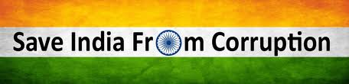

Removal of Extortionary Corruption – Key to Empowering the Indian Citizen
Mehul Bhanawat

Slide 2
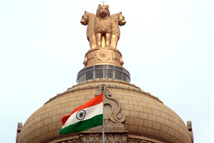
Meaning of corruption
Forms of corruption
Extortionary corruption in India.
Statistical Analysis
* Bribe
* Corrupt Department
* Areas of corruption
* Ranking of corrupt country
Impact of Extortionary corruption
* To Economy
* To Society
* To Country as a whole
Measures to combat Extortionary corruption – Productive theory to remove Extortionary corruption
Ways to empower Citizen of India
Conclusion.
CONTENT

Slide 3

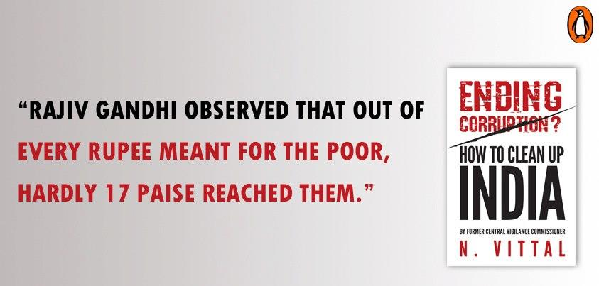

This is the condition of the rising country India…Think about it…

Slide 4

“Ethical values in general have drastically come down and society has become permissive and accepts corruption as normal.”
- CFO of a leading pharmaceutical company
Corruption
Ethical values

Slide 5
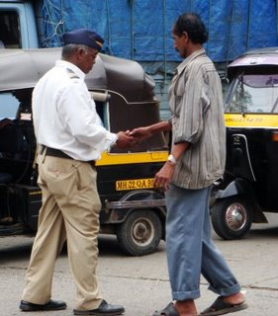
Corruption
There is no one comprehensive and universally accepted definition of corruption. It can be broadly defined as:-
“the misuse of public office for personal gains”
“as an act of bribery involving a public servant and a transfer of tangible resources”
“Corruption = Monopoly + Discretion – Accountability”
“An act x performed by an agent A is an act of institutional corruption if and only if:
x has an effect, E₁, of undermining, or contributing to the undermining of, some institutional process and/or purpose of some institution, I, and/or an effect, E_{c}, of contributing to the despoiling of the moral character of some role occupant ofI, agent B, qua role occupant of I;
At least one of (a) or (b) is true:
  A is a role occupant of I, and in performing x, A intended or foresaw E₁ and/or E_{c}, or A should have foreseen E₁and/or E_{c};
  There is a role occupant of I, agent B, and B could have avoided E_{c}, if B had chosen to do so.
Note that (2)(a) tells us that A is a corruptor and is, therefore, either (straightforwardly) morally responsible for the corrupt action, or A is not morally responsible for A's corrupt character and the corrupt action is an expression of A's corrupt character.”
Source: http://plato.stanford.edu/entries/corruption/

Slide 6


  Corruption is a serious disease and occurs in every economy, in every corner of the world. No country is free of corruption.
  There can be various reasons :-
            *Competition.
              *Inflation.
              *Desire of luxury etc.
  Corruption has no shape. It manifest itself in a variety of ways, continuously morphing into new forms.
  It ranges from misuse of position of trust for personal gain to bending of rules and regulations and also to turning a build eye to act which are morally and socially unacceptable to the society.

Slide 7
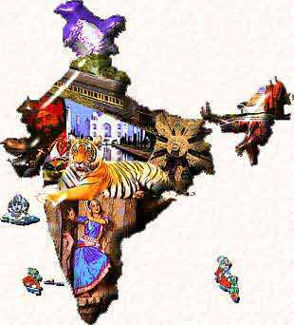
Forms of corruption
The main forms of corruption can be bribery, embezzlement, fraud , scams, extortion or broadly “some act that is against the law.” Is also includes severe deficiencies in corporate integrity systems, such as conflicts
Extortion
Embezzlement
Scams
Fraud
Bribery

Slide 8
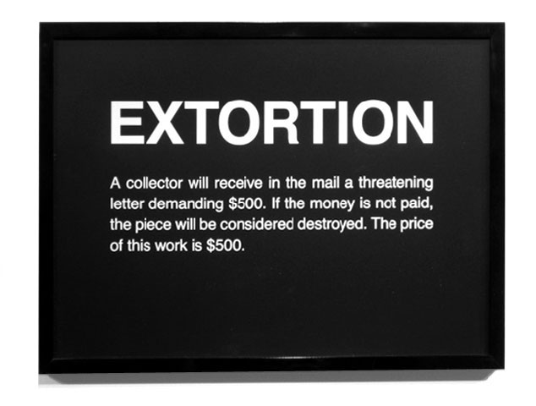
Extortionary corruption
Extortion is invariably one-sided where in the public servant extorts bribe from the beneficiary on the pretext of the threat of denial of service.
Extortionary Corruption can be defined as corruption where money has to be paid to acquire services that are legitimately due and honestly entitled.

Slide 9
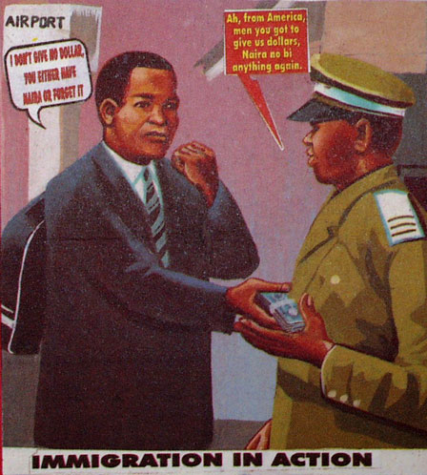
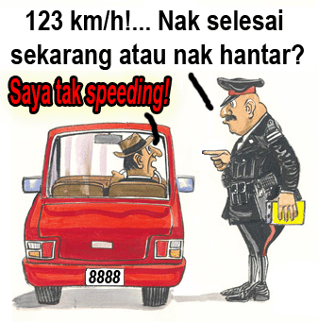
Extortion (also called blackmail, shakedown, outwresting, and exaction) is a criminal offence of unlawfully obtaining money, property, or services from a person, entity, or institution, through coercion.

Slide 10

The classical example for extortionary corruption is a tax bureaucrat who demands his cut, threatening to classify the client's tax return as fraudulent and prosecute unless a bribe is paid (Hindriks, Keen and Muthoo 1999).

Slide 11




Statistical analysis

Slide 12
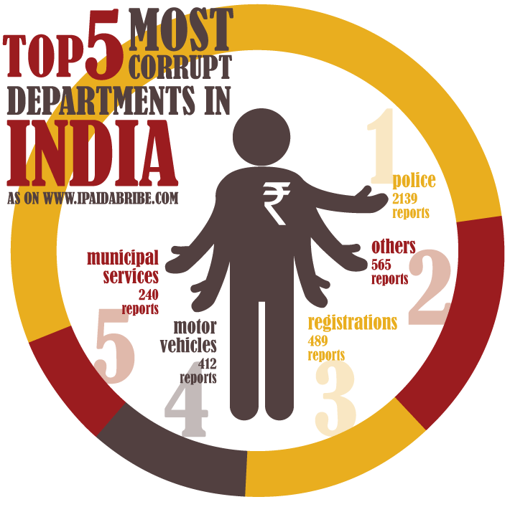

Slide 13
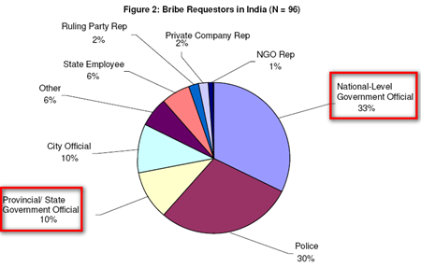

Slide 14
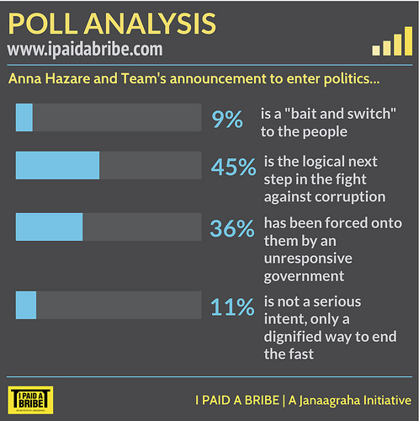
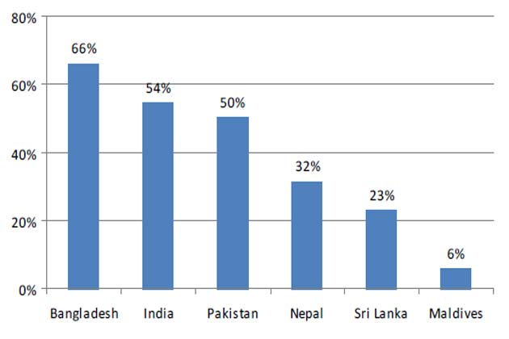
BRIBE

Slide 15

PLEASE REFUSE TO GIVE & TAKE BRIBE

Slide 16
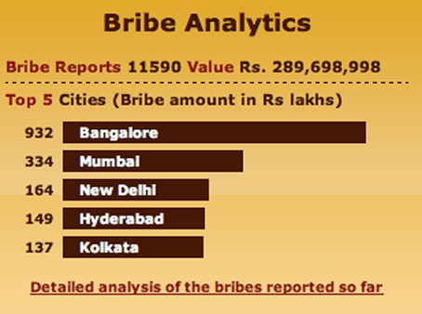
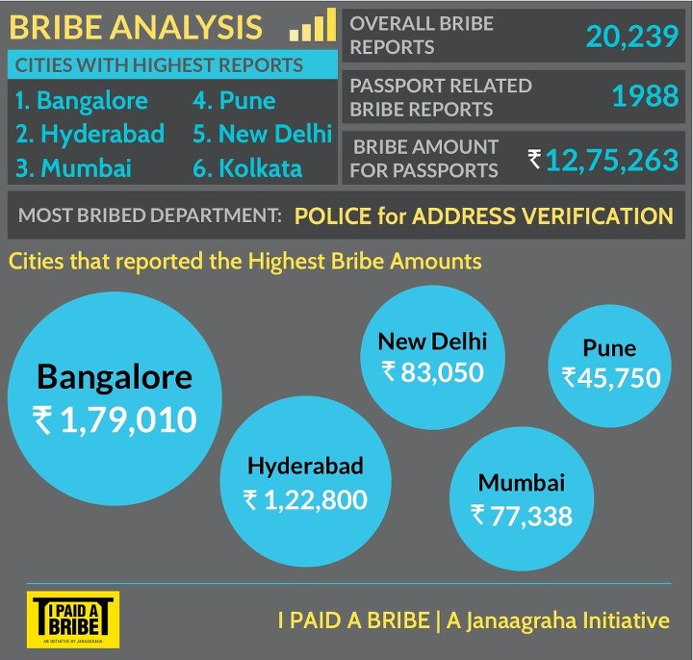
Who is Responsible ?
Think of it…

Slide 17
Details of Bribes Paid to Various Agencies in Bangalore
Agency/Service | Proportion in sample claiming to have paid | Average payment per transaction (Indian Rupees)
Electricity Board | 11% | 206
Water Board | 12% | 275
City Corporation | 21% | 656
Hospitals | 17% | 396
Regional Transport Office | 33% | 648
Telephones | 4% | 110
Development Authority | 33% | 1850
Average | 14% | 857
Further, 50% of the cases involving payment of bribes were extortionary in nature as agency officials demanded money; in a third of the cases, citizens offered speed money, anticipating that it would be necessary anyway.
Source:- Citizen Feedback Surveys report of Public Affairs Centre, Bangalore

Slide 18
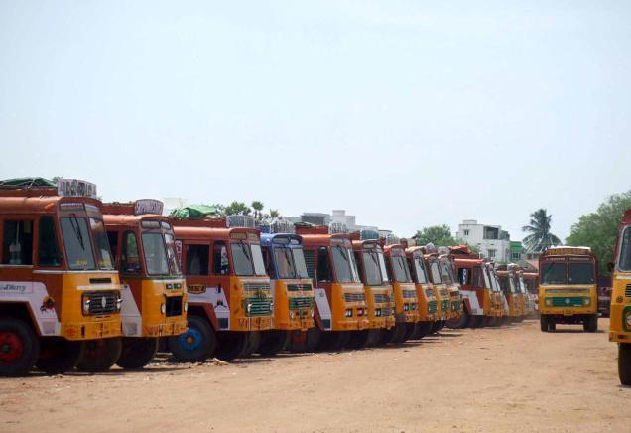
If these estimates seem a little high, consider this there are 4 million trucks. Each truck has to pay Rs. 200 a day. Thus almost Rs. 100 crore a day or Rs. 35000 crore a year is routed through corruption only in truck sector.

Slide 19

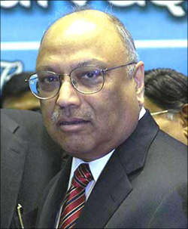
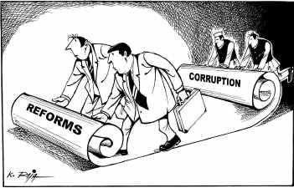
Clearly politicians spending huge amount of money in election, will want to get a good rate of return.
C K Prahalad, the late management guru estimated that almost Rs. 2.5 lakh crore is earned by politicians over a 5 year term. This calculation stems from an estimate that almost Rs. 8000 crore is spent on Union Parliamentary elections by political parties.
If assembly elections are included, the expenditure could easily exceed Rs. 25000 crore. Clearly for this kind of ‘investment’ a return of at least 10 times would be expected. Hence it is not unreasonable to estimate that almost Rs. 2.5 lakh crores is earned by politicians over 5 year period. That would mean almost Rs. 50,000 crore per annum.

Slide 20
Thus out of total corruption of Rs. 3 lakh crore, anywhere between Rs. 50,000 crores to Rs. 75,000 crores(including local government corruption) is political corruption and almost 80% of corruption is retail corruption. Thus though political corruption attracts most attention, retail corruption cannot be neglected as it almost forms 70-80% of all corruption. Indeed while there are mere 5000 politicians there are almost 20 million government employees.
However, very few, if any people, much less politicians are punished for corruption. Indeed not a single politician has been jailed for prolonged period for corruption, though it is realistic to presume that a very large percentage of politicians are corrupt. There is also very scant and not strong enough action against retail corruption. Hence both retail corruption and political corruption continue to thrive unchecked by law.

Slide 21
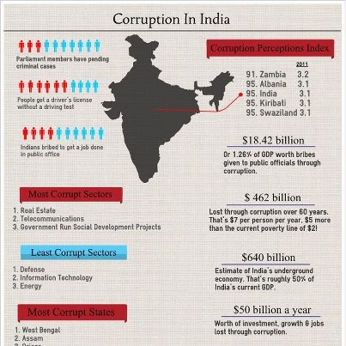

Slide 22
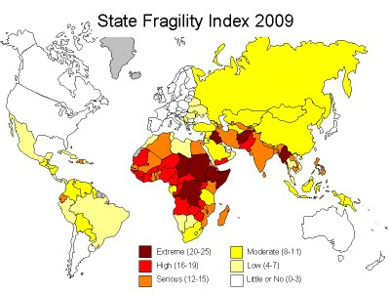

Slide 23
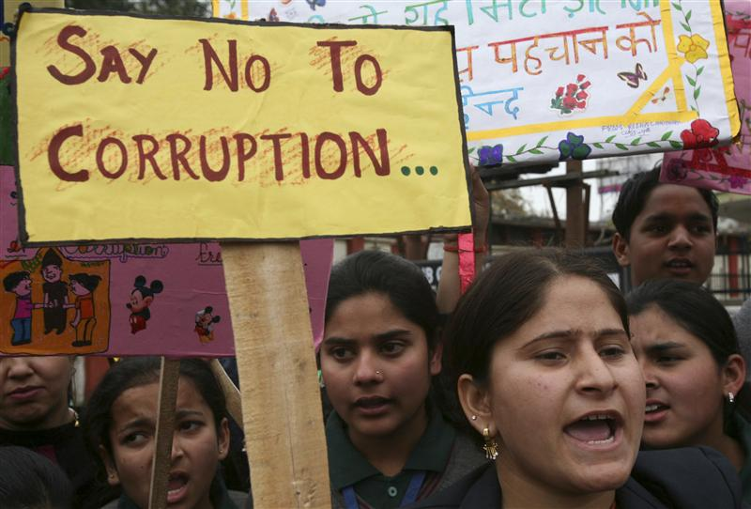
Impact of Extortionary corruption
Impact
Economy
Corporate
Society
Country as whole

Slide 24
Impact of corruption on India’s GDP growth
% of Respondents
Source: KPMG’s Bribery and Corruption Survey 2011

Slide 25
SEE THE IMPACT OF EXTORTIONARY CORRUPTION
It is difficult to estimate the quantum of corruption in India. But in a GDP of national economy of Rs. 60 lakh crores, almost 3 lakh crores – 5 lakh crores is routed through corruption. Thus almost 5% of GDP is routed through corruption.
New York: Rating agency Standard & Poor's (S&P) lowered India's GDP growth forecast to 5.5 per cent despite a slew of policy measures announced by the government last week.
The World Bank estimates that almost 5% of global GDP is lost due to corruption around the world and this may be as high as 25% in some African countries.

Slide 26
Source: KPMG’s Bribery and Corruption Survey 2011

Slide 27
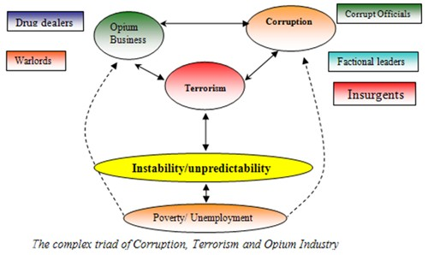
Impact on society

Slide 28



Society is now afraid of extortionary corruption, Aam Admi has nothing to do with this………

Slide 29
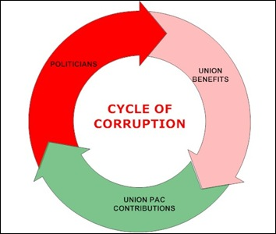
There are several challenges in checking corruption such as
1. Lack of strict enforcement and strong punitive action.
2. Weak enforcement of law.
3. Tolerance of corruption.
Which make corruption to run

Slide 30


No Law & order
No work to be executed without bribe

Slide 31
What should corporate do?
Corporate should realize that corruption is not merely moral issue but actually an economic one. Corporate should at least pay due taxes. Corporate should use international instruments to check corruption in the nation.
What should common people do?
Common people should use RTI to expose corruption. With informed collective assertion, common people can over years transform the extent of corruption in India. Common people should elect clean politicians.

Slide 32

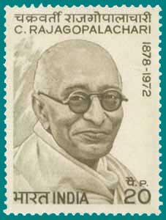
Measures to combat Extortionary corruption
Truly said by a great philosopher “JOURNEY OF THOUSANDS MILES BEGIN WITH SINGLE STEP”
First step towards removal of extortioary corruption was taken by C Rajgopalachari
The economy of India was under socialist-inspired policies for an entire generation from the 1950s until the late 1980s. The economy was characterized by extensive Regulation, protectionism, and public ownership, policies vulnerable to pervasive corruption and slow growth. In 1960s, Chakravarthi Rajagopalachari suggested License Raj was often at the core of corruption

Slide 33




Corruption is not just cash changing hands it is far bigger and far dangerous and far more complex ... let us fight all forms of corruption in the society , scams is just one form, misuse of power and authority is one other in many more forms of corruption in India, One should know the war against corrupt is weak as long as other forms exists.. think .. about this...
This the true picture of corruption.

Slide 34
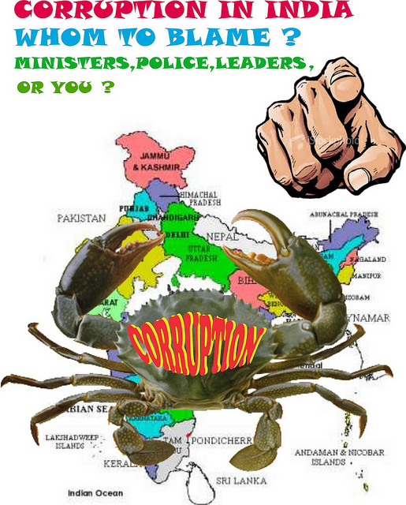
Corruption is everywhere, if you talk about politics, business, sports, police, BMC, schools, colleges or any educational institutes and even at hospitals and media. Corruption is misuse of opportunity, power and money and we cannot blame only leaders or officials. We people are equally responsible for corruption. Corruption is like cancer, you should act when it’s at small level. If you ignore it may spread and situation can become worst.

Slide 35
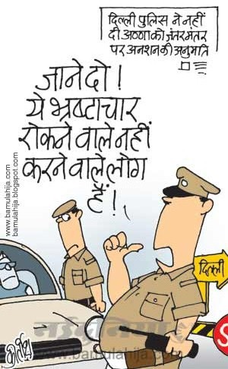
AS I have conducted survey on this I found answer from many that it is impossible to finish or make our country free from Extortionary Corruption.
WHAT YOU THINK ABOUT THIS OPINION
Kya Apko bhi yahi lagta hey

Slide 36


If Rakesh Sharma can touch the heights of MOON and can do YOGA their….
who can think of it no one….
But he did it….then why extortionary corruption can not came to END…..
The only thing required is THAT.
Where is will there is way

Slide 37
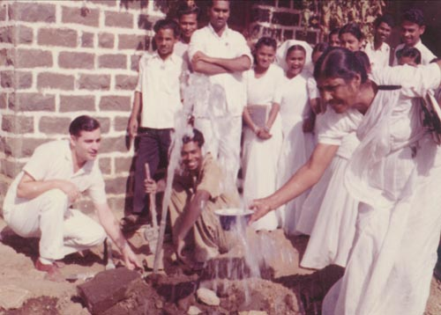
Fighting the menace:
Road under construction
The Indian government’s track record in combating bribery and Extrotionary corruption has not been very effective. The main reason for this is political interference and delayed justice that impairs the effectiveness of the verdict, opined corporate India. Respondents also stated that corruption levels are expected to remain at the current level irrespective of the current and impending legislations.

Slide 38
The Prevention of Corruption Act came into force in 1988.
However, the number of convictions under this Act are considered a abysmally low. No wonder, 84 percent of the respondents believe that the Indian government has not been very effective in enforcing anti-bribery and corruption laws.
The Right to Information Act (2005), a landmark legislation, under which one can seek specific information under the control of public authorities with the objective of promoting transparency and accountability of those holding public positions .This act in recent times has helped unearth certain prevalent malpractices in the country.
Source: KPMG’s Bribery and Corruption Survey 2011

Slide 39
Other anti-bribery and extortionary corruption initiatives in India include the presence of the State LokAyuktas; Central Vigilance Co0mmission; proposed National Anti-Corruption Strategy;
Guidelines on Corporate Governance. The moot point
however is ‘why enforcement of these legislations has not
been effective?’
Key reasons for poor enforcement
REASONS | %
Belief that the laws will not change anything | 11%
Lack of understanding of the law by affected parties resulting in little or no attempts to seek legal recourse | 7%
Political Interference | 20%
Delayed justice that impairs theeffectiveness of the verdict | 18%
Involvement of multiple agencies in investigating claims charges filed, which further delays fact finding and eventually the verdict | 14%
Penalties not being harsh enough to deter repetition of the crime | 15%
Fear of retribution/ victimisation by affected parties | 13%
Source: KPMG’s Bribery and Corruption Survey 2011

Slide 40
Most effective measures to curb bribery and corruption
Source: KPMG’s Bribery and Corruption Survey 2011

Slide 41



Structured regulatory reforms and empowering people: Key to fight corruption
India has been featuring low on Transparency International’s Corruption Perception Index. In fact we slipped three positions, ranking at the 87th position in the 2010 survey (84th rank in 2009 survey) as opposed to China at 78 and Brazil at 69.
Stringent punishments, high penalties and zero tolerance
of corrupt practices are some of the measures that could
be adopted in order to curb bribery and corruption. China for
instance levies high fines and may impose death penalty in
case a person is convicted of corruption.10 The laws in China
also stipulate that public officials disclose their income and
assets

Slide 42

Key to empowering Citizen of India
Increased awareness on laws and regulations
Collective effort by the private sector
Strong law enforcement
Increasing the sphere of current legislations
Need To Incorporate

Slide 43
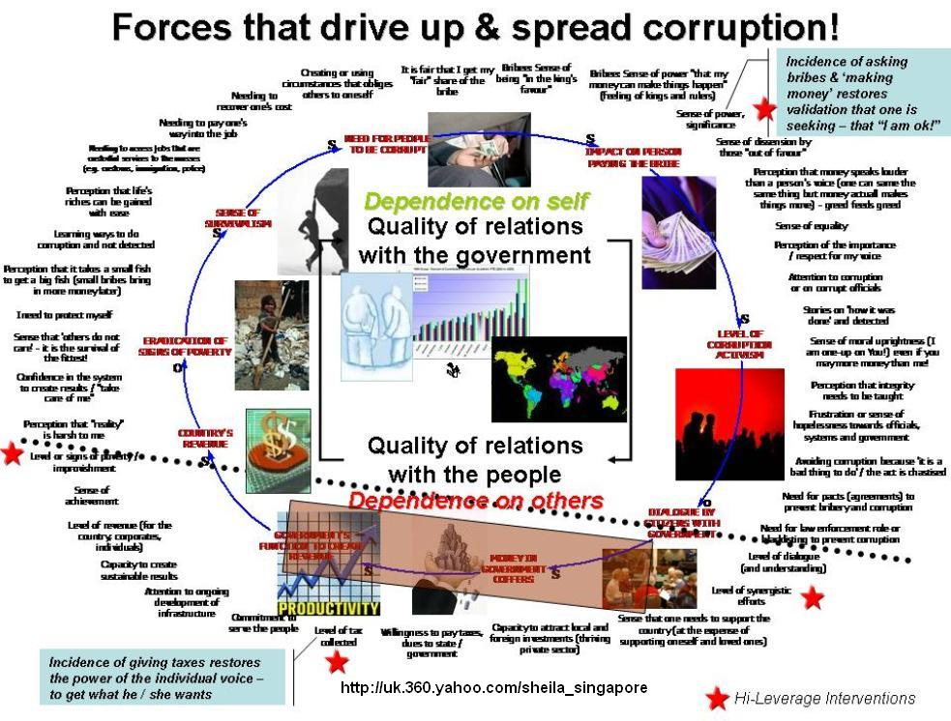

Slide 44
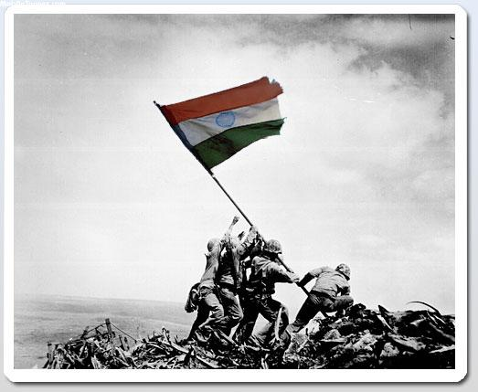
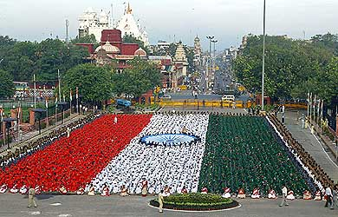
Respect Our nation

Slide 45

It is a fact that bribery and Extortionary corruption is a growing menace that has the potential to adversely impact India’s economic growth, and image to the world. By signing the G-20 Anti-corruption plan, India has signaled to the world its commitment to tackle this issue. However, unless concrete steps are taken in the enforcement of existing provisions under law to
prevent bribery and corruption, little change can
be expected.

Slide 46
In order to curb corruption, organisations could adopt the following preventive mechanisms:
Draw up a comprehensive code of conduct and ensurestrict enforcement of the code communicating zero tolerance towards corruption.
A regular monitoring mechanism to address issues arising out of Extortionary corruption.
A structured whistle blowing mechanism to report potential Extortionary corruption issues.
A comprehensive and periodic risk assessment mechanism, including third party audits with specific reference to corruption related risks.
While stringent compliance programs, upgraded controls and regular monitoring could help to prevent Extortionary corruption, social control like building an ethical culture in the organisation is one of the best ways to prevent any form of unethical practice including Extortionary corruption.

Slide 47

“ Just as it is impossible not to taste honey or poison that one may find at the tip of one’s tongue, so it is impossible for one dealing with the government funds not to taste, at least a little bit, of the King’s wealth. ”
(Kautilya, Arthashastra).

Slide 48

MEHUL BHANAWAT
CA- Final Student
ICAI Jaipur chapter
08696311133
mehulbhanawat001@gmail.com

