Slide 1
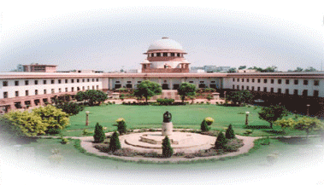

Supreme Court of India
A DOCUMENTARY
BY SAYANTAN BASU

Slide 2
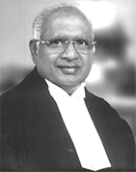
Appointment of Judges
President to appoint -
Consult Judges
Appt. of Chief Justice of India
Mr. A.N.Ray controversy
in 1973
S.P.Gupta v. Union of India (1982)
SCAORA v. Union of India
(1993)
Reference to Supreme Court under Art. 143 (1999)
Chief Justice of India
Justice K.G.Balakrishnan

Slide 3
Qualification for Appt. as Judge
Citizen of India
AND
High Court Judge for at least 5 years
OR
High Court Advocate for at least 10 years
OR
Distinguished Jurist

Slide 4
Impeachment of a Judge
Grounds: Proved Misbehaviour or Incapacity
Procedure:
  A Motion addressed to the President signed by 100 members of Loksabha or 50 members of Rajyasabha
  Investigation by Judges’ Inquiry Committee
  Motion carried in each House by majority of the total membership and by a majority of at least two thirds members present and voting
  President’s order for removal of the Judge

Slide 5
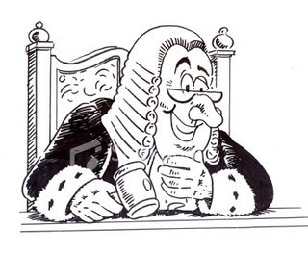
Independence of Judges
Appointment of Judges after Consulting Judges
Removal by Special Majority: Very difficult
Salaries and Pensions cannot be varied to their disadvantage
Salaries charged on the Consolidated Fund of India
Discussion of the conduct of Judges forbidden in Parliament
After retirement prohibition to plead in Court
Power to punish for its Contempt

Slide 6
Jurisdiction
Original Jurisdiction - Art. 131
Writ Jurisdiction
Appellate Jurisdiction: Civil
Appellate Jurisdiction: Criminal
Special Leave to Appeal - Art. 136
Advisory Jurisdiction
Review
Court of Record
Laying down Precedent
Complete Justice: Art.142

Slide 7
Original Jurisdiction
Dispute between:
  Govt. of India and any State
  Govt. of India and any State on one side and any other State on other side
  Two or more States inter se
Subject matter of Dispute:
Any question of Law or Fact on which existence or extent of legal right depends.
Exceptions:
  Pre-Constitution Treaties, Agreements
  Inter-State Water disputes

Slide 8

Writ Jurisdiction: Art. 32
Habeas Corpus
Mandamus
Prohibition
Certiorari
Quo Warranto

Slide 9

Habeas Corpus
To have a body
Object: To set free a person illegally detained
Producing Body in Court Necessary?
Petition by friend/Relative also. Locus Standi liberalised
Writ addressed to:
  Government
  An Official
  Private Person
For disobedience : Contempt of Court

Slide 10
Mandamus
Mandamus = A Command
Order to do something: demands some activity
Command to perform Public or Quasi-public duty
Writ available against:
  Government
  Public Servant
  Judicial Body
Writ not available against
  President of India
  Governor
  Private Individual

Slide 11
Prohibition
Order to stay a judicial Proceeding
When?
  Excess of Jurisdiction
  No Jurisdiction
During pendency of proceeding (Prevention)
To whom?
  Judicial Authority
  Quasi-judicial Authority
  Public Servant having duty to act judicially
Not to Administrative Authority

Slide 12
Certiorari
To whom: Judicial or Quasi-Judicial Authority
Object: To quash order or decision (Cure)
When?
  Court or Tribunal acts without jurisdiction
  Principles of Natural Justice not followed:
    Bias: Personal, Pecuniary
    Audi Alteram Partem
    Speaking Order
  Decision obtained by Fraud, Collusion, Corruption
  Error of Law apparent on the face of record

Slide 13
Quo Warranto
Quo Warranto = What authority?
Court inquires into legality of claim to Public Office
Court ousts incumbent if claim not well founded
Object: To prevent usurpation of Public Office (Constitutional or Statutory)
When?
  Disqualified for the post
  Procedure not followed
  Irregular appointment
Locus standi liberal

Slide 14
Appellate Jurisdiction –
Civil
From Judgment, Final Order, Decree, Sentence of High Court
Constitutional Question involved:
  Substantial question of Law as to the Interpretation of the Constitution
  And
  Certificate of the High Court
No Constitutional Question involved:
  Substantial Question of Law of general importance
  And
  In the opinion of the High Court the said question needs to be decided by the Supreme Court
  And
  Certificate of the High Court

Slide 15
Appellate Jurisdiction –
Criminal
As of right:
  HC on appeal reverses an order of Acquittal and sentences to death.
  HC withdraws a case to itself from subordinate court and sentences to death.
  HC enlargement of Cr. App. Juris. Act, 1970
On Certificate of the High Court
  High Court certifies a criminal case as fit one for appeal to the Supreme Court.
  Substantial question of law as to the interpretation of the Constitution + Cert. of HC

Slide 16
Special Leave to Appeal
(SLP) Art. 136
Discretionary power
Unfettered power
From : Any judgment, decree, order, sentence, determination in any cause or matter
Passed or made by any Court or Tribunal
Exception: Judgment of court of the Armed Forces
When?
  In exceptional cases
  Illegality, Irregularity, Error of Law
  Miscarriage of Justice
  Principles of Natural Justice violated

Slide 17
Advisory Jurisdiction – 1
Art. 143
President may refer to Supreme Court for opinion
Question of Law or Fact:
Which has arisen or likely to arise
And of great public importance
Court may after ‘Hearing’ report to the President
Court Shall after ‘Hearing’ report
Judges to hear: Minimum 5
No litigation – Opinion not binding on the Govt.

Slide 18
Advisory Jurisdiction – 2
Art. 143
In re Delhi Laws Act case (1951)
In re Kerala Education Bill (1958)
In re Berubari Union (1960)
Keshav Singh’s case (1965)
The Special Courts reference (1978)
Cauvery Water Disputes Tribunal (1992)
Ismail Faruqui v. Union of India (Ram Janma Bhumi case) (1994)
Judges’ Appt. and Transfer reference (1999)

Slide 19
Review
To review any judgment pronounced
or order made
Subject to Law passed by Parliament
When?
  Discovery of new important matters of evidence
  Mistake or error on the face of the record
  Any other sufficient reason
Review is exceptional phenomenon
Only where a grave and glaring error

Slide 20

Court of Record
Power to punish for Contempt of itself

Slide 21
Miscellaneous
Transfer of Cases, Appeals from one High Court to another
Withdrawal of cases from High Court
Precedent: Law declared by Supreme Court binding on all courts. (Art. 141)
Art. 142: Doing complete justice
Rule making power
Interpretation of the Constitution
Power of Judicial Review (Invalidating laws and executive actions)

Slide 22
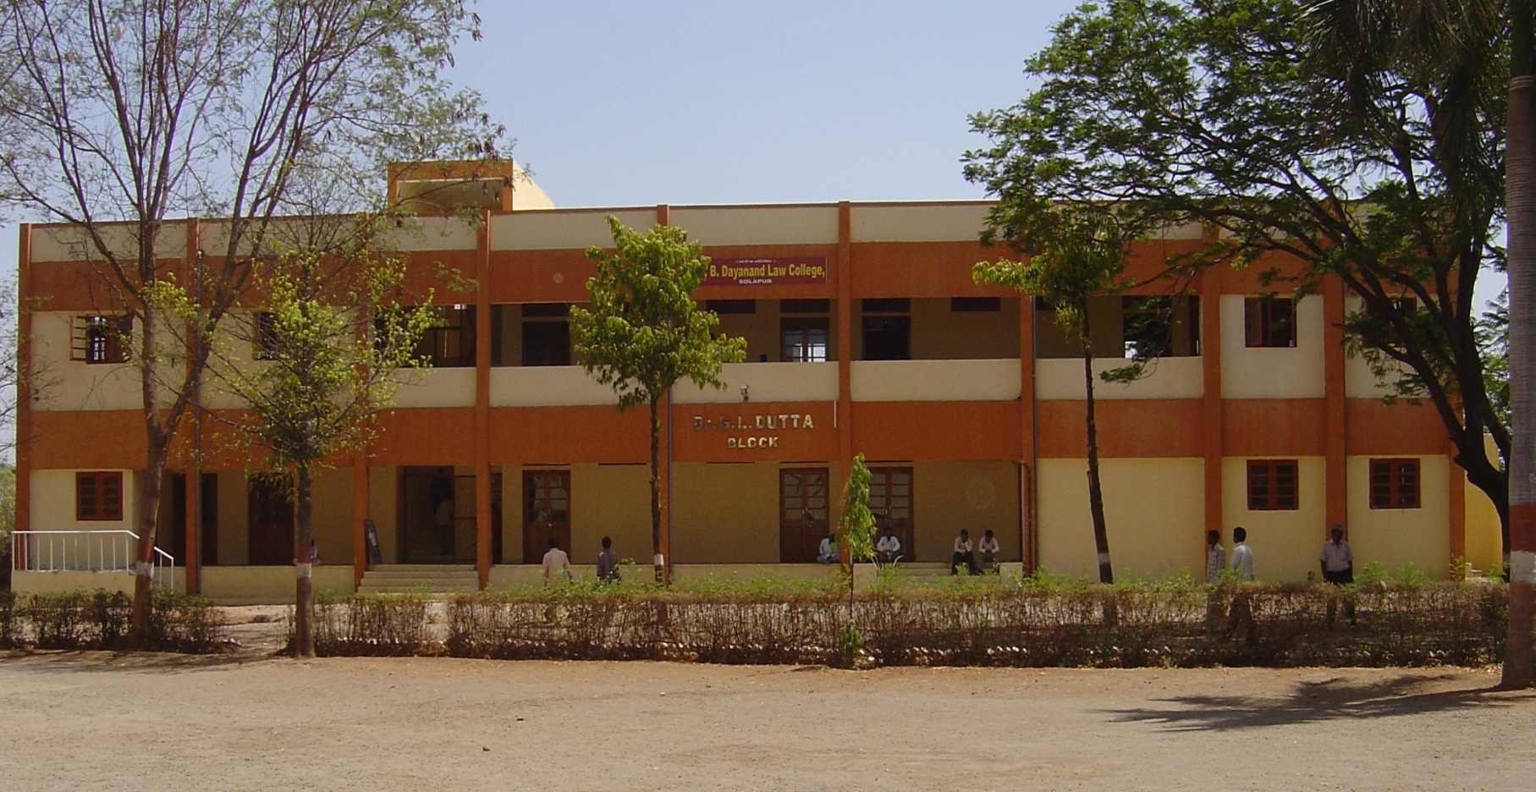

The End

