Slide 1

BY CA. SAYANTAN BASU
PRESENATATION ON

Slide 2
Contents
Introduction
Establishment
Role
Problem
Objectives
Functions
Organisation chart
Where the IMF gets its money
Special drawing rights
Membership
Success & failures
IMF & India
Conclusion

Slide 3
Introduction
The IMF is an intergovernmental institution established by an international treaty in 1945 to create a framework for international economic cooperation focusing on balance of payment problems and the stability of currencies.
IMF headquarters is in Washington D.C , U.S.A

Slide 4
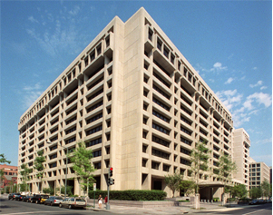
In the beginning ( 1945-2003 ) 29 member countries but In 2007, the number of member countries of IMF was 185.

Slide 5
Establishment of IMF
IMF was founded on 27th december,1945. During the closing years of World War Second, different countries realized that there must be a common International Forum for achieving economy cooperation, promoting International Trade and providing help to needy nations during emergency. So IMF was formed for this purpose.

Slide 6
World War Second has its adverse effect on global economy. To remedy the situation, an international monetary conference was convened in 1944, at Bretton Woods in America.
It was attended by the represenatives of 44 countries. India also participated therein.
It was decided in this Conference to set up IMF for the economic development of all countries.

Slide 7
PROBLEMS
Three main problems are :
☻Economic order and piece.
☻Reconstruction of economies
☻Stable world piece

Slide 8
Role
The IMF was intended to play two major roles in the Bretton Woods System:
the Fund should discourage aggressive exchange rate behavior by members and help them manage their balance of payments efficiently;
the Fund was given resources to lend international reserves to countries with balance of payments difficulties.

Slide 9
The goals of the IMF are defined in Article 1 of the Articles of Agreement in relatively broad terms, which over time has allowed the IMF to adjust and readjust its role in the constantly evolving economic world.

Slide 10
Objectives Of IMF
1) To Promote International Monetary Cooperation
2) To Establishment a System of Multilateral Payments
3) To Maintain Stability in the Rate of Exchange

Slide 11
4) To Provide Aid to Members during emergency
5) To reduce Disequilibrium in Balance of Payments
6) To promote balanced economic development

Slide 12
FUNCTIONS OF IMF
1) The funds provide a mechanism for improving short-term BOP Position
2) Fund provides a machinery for international consultationS
3) Technical Assistance
4) Imparts Training

Slide 13
5) Facilities during emergency
6) It serves as a short-term credit institutions
7) Determining Exchange Rate for every Country

Slide 14
IMF Organization Chart
International Monetary and Financial Committee
Board of Governors
Joint IMF-World Bank Development Committee
Independent Evaluation Office
Executive Board
Managing Director
Deputy Managing Directors

Slide 15
Organization
Board of Governors
  Each member country appoints one Governor and an Alternate Governor for each member country. It meets once a year. It frames the policies of the Fund.
Executive Board
  It conducts day to day affairs of the fund. It consists of 24 directors, 6 of whom are permanent directors and other 18 are elected directors. Permanent directors belong to those countries that have the largest quotas in the fund.
  18 elected directors are elected by member countries. India is one of the elected directors.
Managing Director
  the chairman of the Executive Board The Managing Director of IMF is elected by the executive directors.

Slide 16
Governors spend most of their time dealing with their own countries
  report their countries’ plans to their representatives
  only meet with entire IMF board once a year
Executive Board oversees the economic policies of the members
  holds meetings three times a week
Managing Director heads the the IMF staff of about 2,600 people
  traditionally held by a European

Slide 17
Where the IMF gets its money
Most comes from the quota subscriptions
  the money each member contributes when joining the IMF. The Capital resources of the fund are subscribed by the various member countries by way of their respective quotas. Each Member country is required to subscribe its quota partly in gold and partly in its own national currency. Each Member country is required to subscribe its quota partly in gold and partly in its own national currency.
General Arrangements to Borrow (1962)
  line of credit set up with several governments and banks throughout the world

Slide 18
Special Drawing Right (SDRs)
SDR is an invented currency
  its value is based on the worth of the world’s five major currencies
  US Dollar, French Franc, Pound Sterling, Japanese Yen, Deutsche Mark
Countries add SDRs to their holdings of foreign currencies
  keep available for need of payments that must be made in foreign exchange

Slide 19
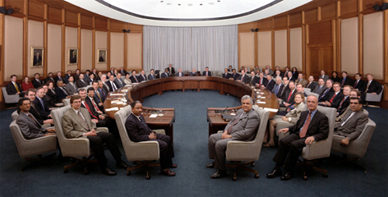
MEMBERSHIP
There are two types of members of the Fund
1) ORIGINAL MEMBERS- All those countries whose representatives took part in Bretton Woods Conference and who agreed to be the member of the fund prior to 31st December,1945, are called Ordinary Members

Slide 20
2) ORDINARY MEMBERS- All those countries who became its member subsequently are called Ordinary Members.
Any country can cease to be its member after giving a notice in writing to that effect . Fund can terminate the membership of such a country which does not observe its rules.
In 1945, the number countries was in 44, in year 2007 the number of member countries was 185.

Slide 21
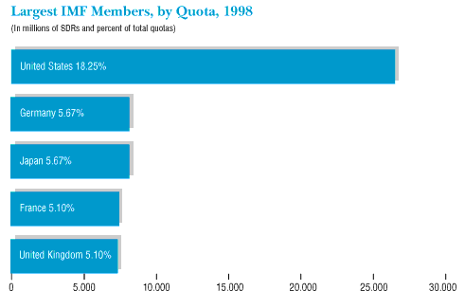
Members with largest quotas

Slide 22
SUCCESS OF IMF
1) International Monetary Cooperation
2) Reconstruction of European Countries
3) Multilateral System of Foreign Payments
4) Increase in International Liquidity
5) Increase in International Trade

Slide 23
6) Special Aid to Developing Countries
7) Providing Statistical Information
8) Helpful in Times of Difficulties
9) Easiness & Flexibility in Making International Payments

Slide 24
FAILURES OF IMF
1) Lack of Stability in Exchange Rate
2) Lack of Stability in the Price of Gold
3) Inability to Remove Restrictions on Foreign Trade
4) Rich Nations Club
5) No help for development projects

Slide 25
6) No Solution of International Liquidity
7) Interference in Domestic Economies
8) Inability to tackle the Monetary Crisis of August 1971
9) Less Aid for Developing Countries
10) High Rate of Interest

Slide 26
IMF AND INDIA
India is a founder member of IMF. Earlier India was made a permanent Executive Director of the Board of Directors.
At present India is no longer a permanent director. India is now an elected member of IMF.
India’s rank is 13th among 185 member nations.

Slide 27
ADVNANTAGES FROM MEMBERSHIP OF IMF TO INDIA
1) Facility of Foreign Exchange
2) Freedom from British Pound
3) Membership of the World Bank
4) Importance of India in International Sector
5) Economic Consultation

Slide 28
6) Help during Emergency
7) Financial help for five Year Plans
8) Special Drawing Rights
9) Help in Foreign Exchange Crisis
10) Profit from Sale of Gold

Slide 29
conclusion
The IMF works to foster global growth and economic stability. It provides policy advice and financing to members in economic difficulties and also works with developing nations to help them achieve macroeconomic stability and reduce poverty

Slide 30

Thank you..
Thank you..

