Slide 1
GROWTH OF REGIONAL RURAL BANKS (RRBs)
IN
INDIA

Slide 2
INTRODUCTION
To echo the thoughts of C.K. Prahlad, the “bottom of the pyramid” segments will be the growth drivers of the future – this is certainly being borne out by the market revolution that is taking place in India’s villages.
The Narasimham committee on rural credit recommended the establishment of Regional Rural Banks (RRBs) in meeting the needs of rural areas.

Slide 3
INTRODUCTION contd…
The main objective of RRBs is to provide credit and other facilities particularly to the small and marginal farmers, agricultural laborers, artisans’ and small entrepreneurs and develop agriculture, trade, commerce, industry and other productive activities in the rural areas.
RRBs came into existence to reduce regional imbalances and increase rural employment generation.

Slide 4
OBJECTIVES
To study the growth of RRB’s in India.
To study the present situation of RRB’s in India.
To study the factors that influences the performance of RRB’s.

Slide 5
NEED
Rural development has always been an important issue in all discussions pertaining to economic development, especially of developing countries, throughout the world.
Rural mass comprise a substantial majority of the population.
Specialised and innovative schemes to improve rural penetration are the new mantra.

Slide 6
SCOPE
The present study is based on regional rural banks in India. In the study an effort has been made to check the growth of regional rural banks in India.
The scope of study after the research would be that the regional rural banks which adopted the effective factors for growth are in sound position today and are influencing the other RRBs also.

Slide 7
LITRERATURE REVIEW
Misra (2002) explains in “The Performance of Regional Rural Banks (RRBs) in India. An attempt is made to enquire as to factors that influence the performance of the RRBs and the role-played by the sponsor banks.
Sathye Milind (Nov 2003) examined the measures of the productive efficiency of regional rural banks in a developing country, that is, India. The study recommends that the existing policy of reducing non-performing assets and rationalization of staff and branches may be continued to obtain efficiency gains.

Slide 8
LITRERATURE REVIEW contd…
Reddy A.Amarender(March 2006) examines the total factor productivity of RRBs.
In this Banks located in economically developed as well as low banking density regions exhibited significantly higher productivity growth.
Pati A.P. (June 2010) explains that in India an array of financial institutions are operating in the area of rural financing. Among those institutions Regional Rural Banks (RRBs) are prominent. The idea was to provide efficient service to the rural sectors so that the rural economy could provide the necessary input to the overall economy.

Slide 9
EXECUTION OF RESEARCH METHODOLOGY
Our research study is based on the secondary research and is descriptive in nature.
The data and information have been collected from the publications of the Reserve Bank of India, annual reports & other valuable publications.

Slide 10
RESEARCH DESIGN
Research design is purely and simply the framework or plan for a study that guides the collection and analysis of the data. The research design indicates the methods of research i.e. the method of gathering information and the method or sampling.
DESCRIPTIVE RESEARCH
Descriptive research, also known as statistical research, describes data and characteristics about the population or phenomenon being studied. Descriptive research deals with everything that can be counted and studied.
DATA COLLECTION
Secondary data and information have been collected from the publications of the Reserve Bank of India, annual reports & other valuable publications.

Slide 11
RESEARCH INSTRUMENTS
Performance parameter of Regional Rural banks in India are mentioned below.
Formula to check growth:-
value of 2009 – value of1999 100
value of 1999

Slide 12
0
Parameter | 1999 | 2000 | 2001 | 2002 | 2003 | 2004 | 2005 | 2006 | 2007 | 2008 | 2009 | Growth(%)
No. Of RRBs | 196 | 196 | 196 | 196 | 196 | 196 | 196 | 96 | 86 | 86 | 83
Capital | 1380 | 1959 | 2049 | 2143 | 2141 | 2221 | 25354 | 48488 | 58990 | 67855 | 76392 | 5435.65
Deposit | 27059 | 32226 | 39294 | 44539 | 49582 | 56295 | 69719 | 83143 | 99093 | 120184 | 124296 | 359.35
Investment | 6680 | 7760 | 8800 | 9471 | 17138 | 21286 | 33486 | 45666 | 48559 | 62629 | 96699 | 1347.5
Advance | 10559 | 12427 | 15050 | 17710 | 20934 | 25038 | 32692 | 40345 | 43456 | 46678 | 51283 | 385.62
Total Assets | 35820 | 42236 | 49596 | 56802 | 62500 | 70195 | 436805 | 803416 | 844982 | 898760 | 984364 | 2648.3
Interest Earned | 3281 | 3938 | 4619 | 5191 | 5391 | 5535 | 6041 | 6547 | 7729 | 7586 | 8786 | 165.94
Other Income | 151 | 207 | 240 | 370 | 430 | 697 | 743 | 790 | 873 | 853 | 1023 | 577.4
Total Income | 3432 | 4145 | 4859 | 5561 | 5821 | 6231 | 6784 | 7337 | 7602 | 8421 | 9809 | 185.8
Interest expanded | 2131 | 2565 | 2966 | 3329 | 3340 | 3363 | 5902 | 8441 | 8860 | 8362 | 9260 | 334.5
Operating Expanses | 982 | 1056 | 1165 | 1459 | 1667 | 1825 | 1958 | 2092 | 22134 | 2345 | 2598 | 164.6
Provision And Contigencies | 99 | 96 | 128 | 163 | 132 | 289 | 329 | 369 | 434 | 590 | 699 | 606.3
Total Expenses | 3113 | 3621 | 4130 | 4787 | 5107 | 5187 | 7860 | 10533 | 10994 | 10707 | 11758 | 277.7
Operating Profit | 319 | 319 | 729 | 774 | 714 | 1044 | 985 | 926 | 1383 | 1859 | 1987 | 522.8

Slide 13
CAPITAL GROWTH

Slide 14
DEPOSIT GROWTH

Slide 15
INVESTMENT

Slide 16
INTEREST EARNED

Slide 17
INTEREST EXPANDED

Slide 18
TOTAL INCOME

Slide 19
OPERATING PROFIT

Slide 20
CURRENT POSITION OF REGIONAL RURAL BANKS IN INDIA
(NATIONLIZED BANK)

Slide 21
PRIVATE BANKS

Slide 22
RRBs

Slide 23
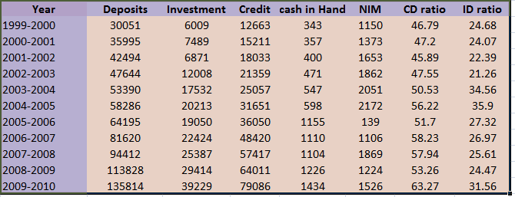
RRBS – IMPORTANT BANKING INDICATORS

Slide 24
COORELATION ANALYSIS
Correlation considers two variables x and y :-
Y = a + bX
If r = 1, then x and y are perfectly positively correlated.
If r = 0, then x and y are not correlated.
If r = -1, then x and y are perfectly negatively correlated.

Slide 25
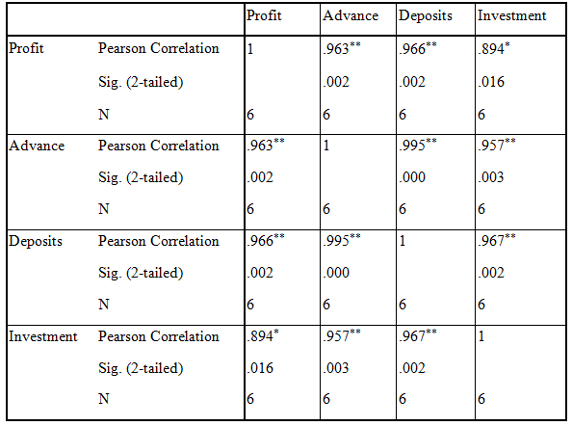
CORRELATION ANALYSIS

Slide 26
FINDINGS
The investments of RRBs have significant impact on profitability. One unit change in investment causes .894 time changes in the operating profit of Regional Rural banks in India respectively.
The advances,deposits and assets of RRBs have insignificant impact on profitability of rural sector banks. These variables have significant impact on profitability of Regional rural banks in India. But in all cases one unit change in these variables are able to explain very little change in profitability of respective banks.

Slide 27
RECOMMENDATION
FICO- score has been used (credit rating ).
A type of credit score that makes up a substantial portion of the credit report that lenders use to assess an applicant's credit risk and whether to extend a loan.
FICO is an acronym for the FAIR ISAAC CORPORATION, the creators of the FICO score.

Slide 28
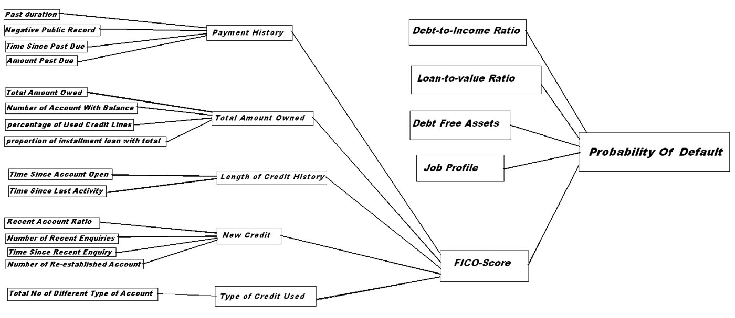
RECOMMENDATION (contd…)

Slide 29
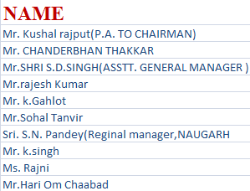
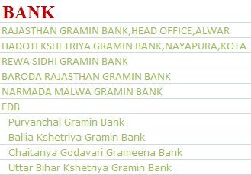





Slide 30
REFERENCES
Sayilgan,G.& Yildirim,O.(2009) Determinants of Profitability in Turkish Banking Sector: 2002-2007. EuroJournals Publishing,Issue 28.[http://www.eurojournals.com/finance.htm]
Singh,R.& Chaudhary, S. (2009) Profitability Determinants of Banks in India. International Journal of Global Business, 2 (1),pp. 163-180.
http://papers.ssrn.com/sol3/papers.cfm?abstract_id=1630104
. Velayudham, T. K., and Sankaranarayanan, V. (1990): “Regional Rural Banks and Rural Credit: Some Issues”, Economic and Political Weekly,September 22, pp.2157-2164
‘Are Regional Rural Banks (RRBs) Free from Overdues? Some Experience in Karnataka’,In A Ranga Reddy (ed) Management of Overdues in Rural Banking, Mittal Publications,New Delhi, 2002 (S. Erappa).
http://rspas.anu.edu.au/papers/asarc/novcon2001/MilindSathye.pdf

Slide 31
REFERENCES
NABARD, National bank News Review, (2004) “India’s RRBs : The Institutional Dimensions of Reform”, Nitin Bhatt & Y.S.P.Thorat, April-September. Bhatt, N and Y S P Thorat (2001), “India’s Regional Rural Banks : The Institutional Dimension of Reforms”, Journal of Microfinance, 3, pp 65-88.
http://rbidocs.rbi.org.in/rdocs/PublicationReport/Pdfs/63142.pdf
‘Are Regional Rural Banks (RRBs) Free from Overdues? Some Experience in Karnataka’,In A Ranga Reddy (ed) Management of Overdues in Rural Banking, Mittal Publications,New Delhi, 2002 (S. Erappa).
[httpwww.aus.educonferencessymp_sbmdocsaccountOlson%20and%20Zoubi%20(2010)%20MENA%20bank%20efficiency.pdf]

