Slide 1



National Bank for Agricultural and Rural Development

Slide 2


Introduction
Headquarters: Mumbai, Maharashtra,India
Established : 12 July 1982
Chairman :Dr. Prakash Bakshi
Managing Director: KG
Karmakar
Currency Reserves: 81,220Crore(2007)
Income of Rs. 92.02 billion

Slide 3
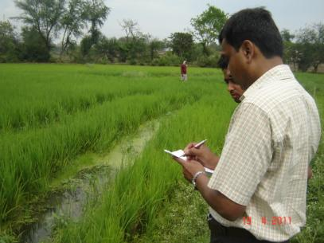

Besides this pivotal role, NABARD also:
Acts as a coordinator in the operations of rural credit institutions
Extends assistance to the government, and other organizations in matters relating to rural development
Offers training and research facilities for banks, cooperatives and organizations working in the field of rural development
Helps the state governments in reaching their targets of providing assistance to eligible institutions in agriculture and rural development
Acts as regulator for cooperative banks and RRBs
3

Slide 4
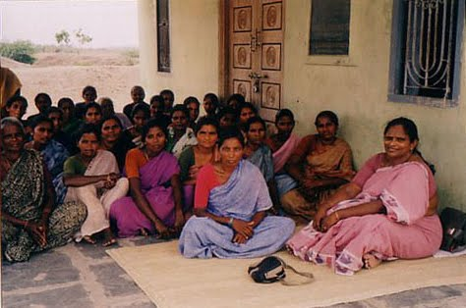
NABARD's Micro Finance - Vision and Mission
Vision:
Empowerment of rural poor by improving their access to the formal credit system through various MF innovations in a cost effective and sustainable manner
Mission:
To extend financial services to one third of India's unreached and underserved rural poor numbering nearly 100 million through one million SHGs with focus on women during a ten year period through various microfinance interventions
4

Slide 5

SHG - Bank Linkage Model
A homogeneous group of about 15 to 20
Every member to save a small amount regularly. Pooled savings kept in a savings bank account in SHG’s name
Depending on the SHG’s maturity, bank gives loan to the SHG as a multiple of the pooled savings. Bank loan added to the SHG kitty.
5

Slide 6
Design features of SHGs
Enables exclusion of rich
Self-selection
Focus on women
Saving first and credit later
Credit rationing
Shorter repayment terms
Market rates of interest
Progressive lending
6

Slide 7
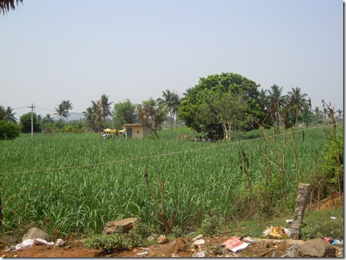
Initiatives to Support MFIs
MFDF redesignated as Micro Finance Development & Equity Fund (MFDEF) with enhanced corpus of Rs.200 Crore for promoting the sector through grant for capacity building support.
NABARD provides refinance to Banks at concessional rates of interest in order to encourage Bank –MFI linkage
A scheme for rating is launched by NABARD to enable qualifying and deserving MFIs to obtain loans from banks

Slide 8
NABARD and Micro finance
INFLUENCING
POLICIES
INVOLVING
INSTITUTION
ENCOURAGING
INNOVATIONS
CREDIT SUPPORT
MOTIVATING
PARTERNERS
NABARD
TECHNICAL
SUPPORT
COORDINATION
WITH PARTNERS
GROUP
FORMATION
TRANNING AND
CAPACITY BUILDING
GROUP LINKAGE

Slide 9

Innovative Projects
Setting up of grain banks
Project on processers cards
Project on e-grama
Joint Liability Groups
Setting up of computer munshis
Micro enterprise promotion by SHGs

Slide 10
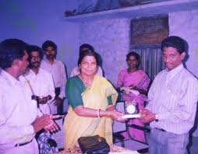
SCHEME OF PROVIDING TECHNOLOGY SUPPORT TO NGOs
Grant Assistance up to Rs.50,000
Purchase of PC
NGO should have completed 3 years
Should have promoted minimum 500 SHGs
Should not have been black-listed

Slide 11
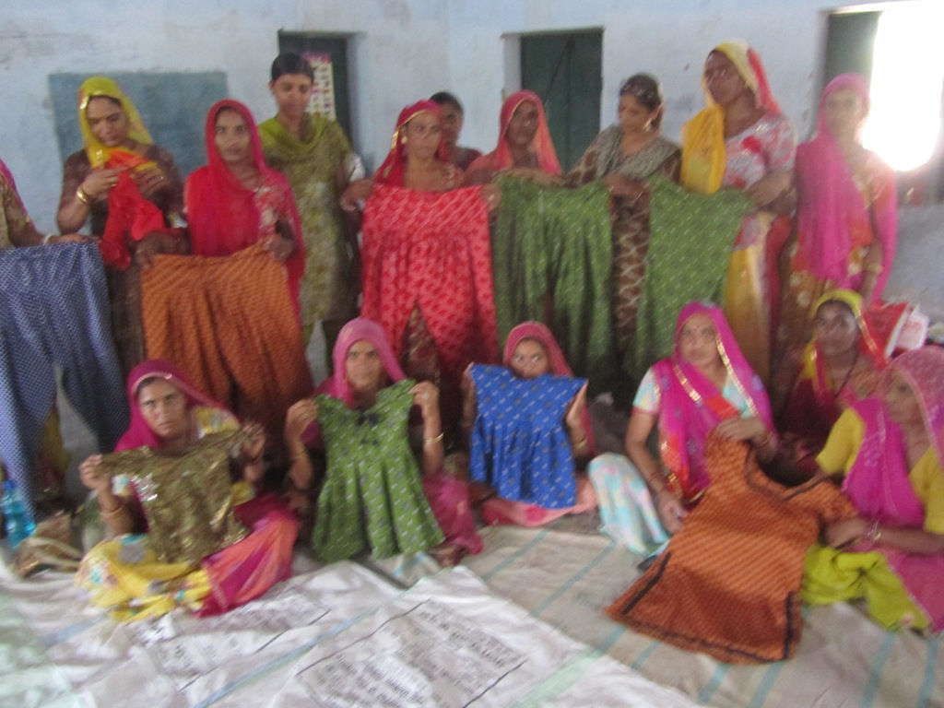
PRIYADARSHINI
Project
Micro Finance Institution
Women empowerment and livelihood program of Ministry of Women and child development GOI
Implemented in 2 districts of Bihar – Madhubani & Sitamarhi
Project outlay of US $ 30 million funded by IFAD and US $ 2.73 by GOI
December 2009-2017 (Effective from 4th Dec 2009)

Slide 12
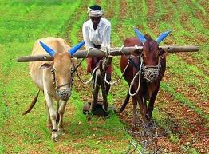

KISAN CREDIT CARD
The Kisan Credit Card is a pioneering credit delivery innovation for providing adequate and timely credit to farmers under single window, with flexible and simplified procedure, adopting whole farm approach, including the short-term credit, medium term and long term credit needs of the borrowers for agriculture and allied activities and a reasonable component for consumption needs.
Contents of Credit Card
Beneficiaries covered under the Scheme are issued with a credit card and a pass book or a credit card cum pass book incorporating the name, address, particulars of land holding, borrowing limit, validity period, a passport size photograph of holder etc., which may serve both as an identity card and facilitate recording of transactions on an ongoing basis.
• The coverage of KCC was extended to landless labourers, oral lessees, tenant farmers including defaulters.
• The concept of KCC has been extended to the borrowers of the long term cooperative structure.

Slide 13
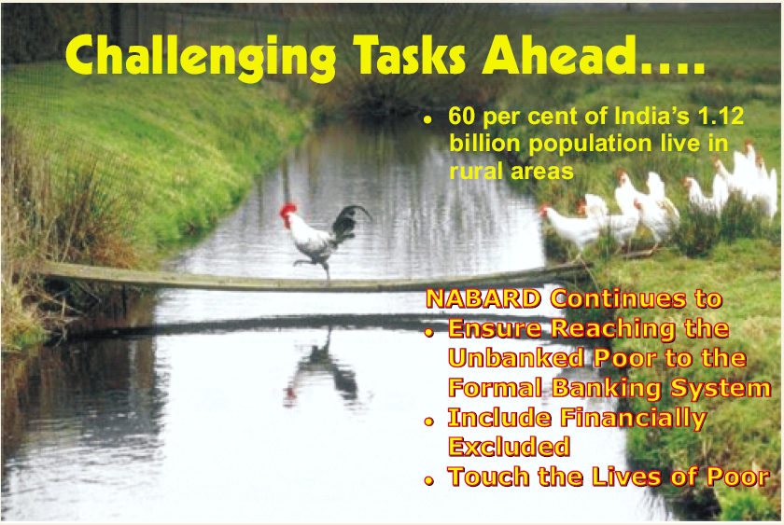

Slide 14
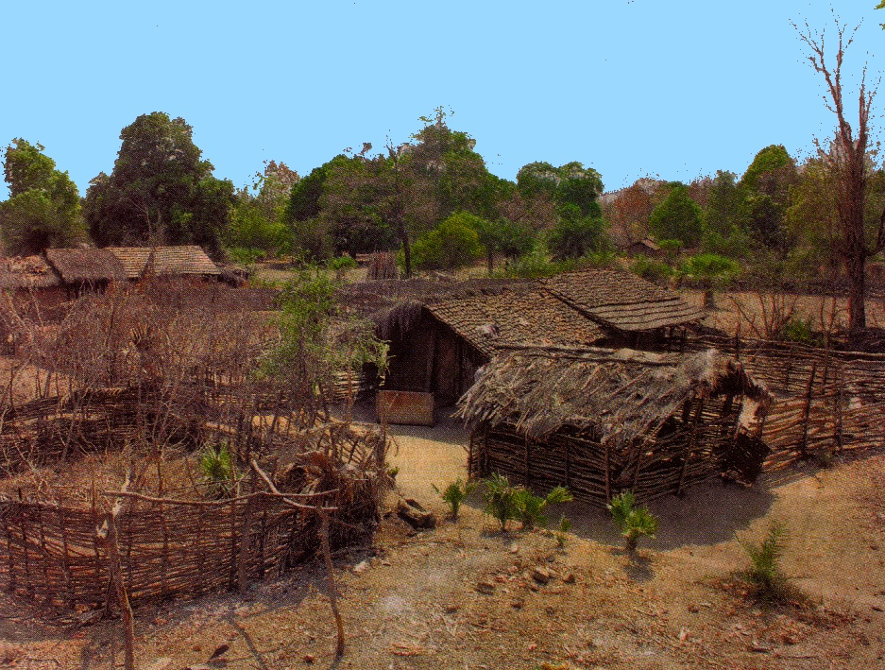

Reference
www.nabard.org
Status of microfinance(NABARD)
After under taking of poor village it became like this.

Slide 15

THANK YOU

