Slide 1

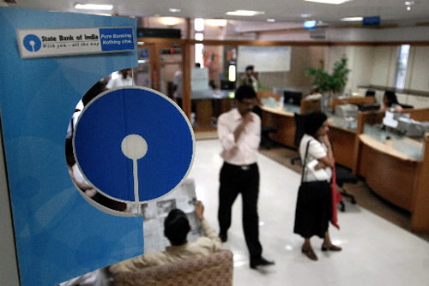
BY CA. SAYANTAN BASU

Slide 2
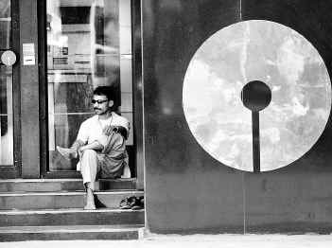
Banking in India originated in the last decades of the 18th century.
The first banks were The General Bank of India, and the Bank of Hindustan
The oldest bank in existence in India is the State Bank of India, (the Bank of Calcutta the Bank of Bengal).
The three banks merged in 1921 to form the Imperial Bank of India, which, upon India's independence, became the State Bank of India.

Slide 3
India Banks :
Nationalized Banks: List of 19 nationalized banks example :Allahabad Bank, Andhra Bank, Bank of Baroda, Bank of Maharashtra
Private Sector India Banks example Axis Bank, HDFC Bank, ICICI Bank, IndusIand Bank
Foreign banks: Some of the foreign banks with considerable operations in India are: ABN AMRO, American Express Bank, Bank of America

Slide 4
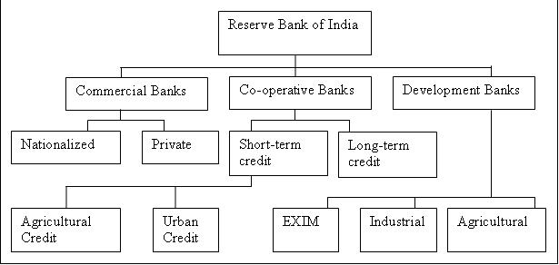

Slide 5
STATE BANK OF INDIA
The State Bank of India, the country’s oldest Bank and a premier
It is the only Indian bank to feature in the Fortune 500 list.
With about 8500 of its own 10000 branches and another 5100 branches the largest banking network to the Indian customer.

Slide 6
SBI & associates: The State Bank Group is the largest banking institution in India. The State Bank of India is the leading entity within the group. Its six subsidiaries are:
State Bank of Hyderabad
State Bank of Mysore
State Bank of Indore
State Bank of Patiala
State Bank of Travancore
State Bank of Bikaner and Jaipur

Slide 7
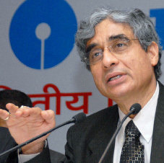
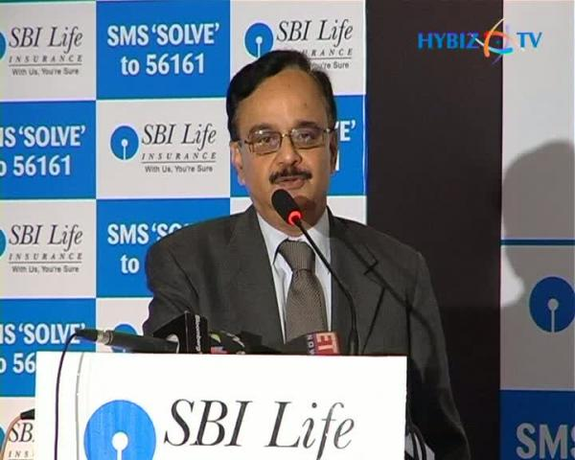
Mr O. P. Bhatt, Chairman
Mr R. Sridharan, Managing Director
8 directors and 1 Officer Employee Director

Slide 8
It presently has 82 foreign offices in 32 countries across the globe. It has also 7 Subsidiaries in India – SBI Capital Markets, SBICAP Securities, SBI DFHI, SBI Factors, SBI Life and SBI Cards - forming a formidable group in the Indian Banking scenario.
STATE BANK OF INDIA HAS BEEN ADJUGED THE BEST BANK 2009 BY BUSINESS INDIA GROUP August-2009
BSE: 500112
NSE: SBIN
ISIN: INE062A01012

Slide 9
Products
Personal banking : loan schemes, personal finance, deposit schemes etc.
Agriculture : micro credit, agricultural banking, regional rural bank etc.
NRI services
International banking : trade finance, merchant banking etc
Corporate banking : corporate accounts, project financing etc.

Slide 10
services
DOMESTIC TREASURY
SBI VISHWA YATRA FOREIGN TRAVEL CARD
BROKING SERVICES
ATM SERVICES
INTERNET BANKING
E-PAY
E-RAIL
RBIEFT
SAFE DEPOSIT LOCKER
MICR CODES
FOREIGN INWARD REMITTANCES
SBI E- Tax

Slide 11
BALANCE SHEET
IN CRORE RUPEES | March 2006 | March 2008 | March 2010
TOTAL SHARE CAPITAL | 526.30 | 631.47 | 634.88
TOTAL LIABILITIES | 493,869.56 | 721,526.31 | 1,053,413.73
TOTAL ASSETS | 493,869.54 | 721,526.32 | 1,053,413.74
BOOK VALUE | 525.25 | 776.48 | 1,038.76

Slide 12
Profit & Loss account of State Bank of India
IN CRORE RUPEES | MARCH 2006 | MARCH 2008 | MARCH 2010
TOTAL INCOME | 43,183.62 | 58,348.74 | 85,962.07
TOTAL EXPENSES | 38,776.93 | 51,619.62 | 76,796.02
NET PROFIT FOR THE YEAR | 4,406.67 | 6,729.12 | 9,166.05
TOTAL PROFIT FOR THE YEAR | 4,407.01 | 6,729.46 | 9,166.39
EARNINGS PER SHARE | 83.73 | 106.56 | 106.56

Slide 13
BSE : Feb 07,2011
Open Price | 2660.00 |  | Volume | 414280
High Price | 2687.50 |  | 52 Wk High | 3515.00
Low Price | 2636.00 |  | 52 Wk Low | 1934.40
Prev. Close | 2646.70
NSE : Feb 07,2011
Open Price | 2659.70 |  | Volume | 1745804
High Price | 2687.80 |  | 52 Wk High | 3515.00
Low Price | 2634.55 |  | 52 Wk Low | 1863.10
Prev. Close | 2645.80

Slide 14
Attribute | Value | Date
P/E ratio | 24 | 07/02/11
EPS (Rs) | 159.22 | Mar, 10
Industry P/E | 10.60 | 7/2/2011
Net profit margin (%) | 10.54 | Mar, 10
Return on average equity | 13.89 | Mar, 10
Report card

Slide 15
In crore rupees | SBI | PNB | BANK OF BARODA | CANARA BANK | BANK OF INDIA
Total share capital | 634.88 | 315.30 | 365.53 | 410.00 | 525.91
Total liabilities | 1053413.73 | 296632.78 | 278316.71 | 264741.09 | 274966.46
TOTAL ASSETS | 1053413.74 | 296632.78 | 278316.71 | 264741.09 | 274966.46
BOOK VALUE | 1038.76 | 514.77 | 414.71 | 305.83 | 243.75
EARNING PER SHARE | 144.37 | 123.86 | 83.96 | 73.69 | 33.15
FACE VALUE | 10 | 10 | 10 | 10 | 10
NET PROFIT IN RUPEES CRORE | 9,166.05 | 3,905.35 | 3,058.33 | 3,021.43 | 1,741.07

Slide 16
SBI is the largest PSB in India.
SBI is succeeding competing vigorously in all areas of banking and are extending these services to the nook and corner of the country
80% of the share capital is still with the Government
Is currently on a low compared to 2009.

Slide 17
Thank you

