Slide 1
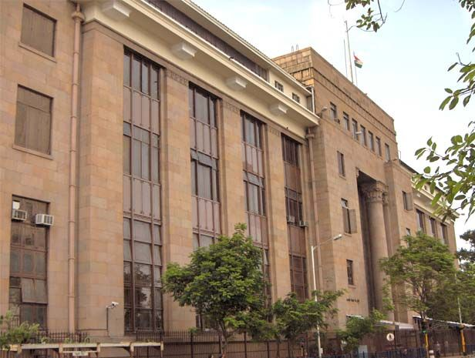
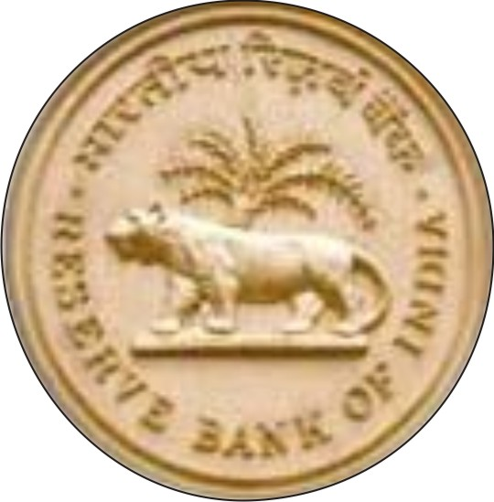

Reserve Bank of India
India’s Central Bank
Presentation By
BY CA. SAYANTAN BASU

Slide 2
Establishment
Established on April 1, 1935 with share capital of Five
Crores on recommendation of Hilton Young
Commission.
RBI was Nationalised in Year 1949.
Central Office was initially established in Calcutta and
moved to Mumbai in 1937

Slide 3
Structure
RBI Have 20 Directors :
  The Governor
  Four Deputy Governor
  One Govt. Official from Ministry of Finance.
  Ten Nominate Director, nominated by Govt.
  Four Directors to represent Headquarters at Mumbai,
  Kolkata, Chennai & New Delhi.
Appointed/ Nominated for period of Four Years.

Slide 4
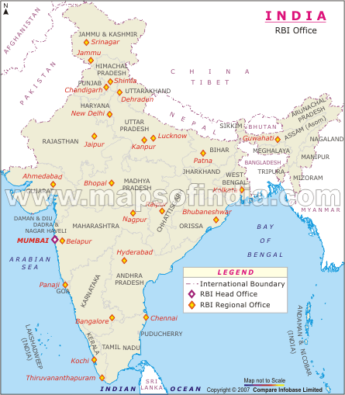
RBI Offices
Head office in Mumbai.
24 Regional offices, most
of them in State Capital.

Slide 5
Preamble
“… to regulate the issue of Bank Notes and keeping of
reserves with a view to securing monetary stability in India
and generally to operate the currency and credit system
of the country to its advantage."

Slide 6
Main Functions (Act, 1934)
Bank of Issue (Under Sec 22)
  RBI has sole right to issue One Rupees Notes and
  small coins in country as agent of Government.
  RBI has separate Issue Department to issue currency
  notes.
  RBI maintain Minimum Reserve in form of Gold and
  Foreign Exchange Reserve of which almost 55%
  should be in Gold.

Slide 7
Main Functions (Act, 1934)
Banker to Government
  RBI is banker, agent and advisor of Central Government
  and all State Government in India.
  RBI helps the Government to float new loans and to
  manage public debt.
  RBI makes loans and advances to the States and local
  authorities.

Slide 8
Main Functions (Act, 1934)
Banker’s Bank & Lender of Last Resort
  RBI maintains banking accounts of all schedule
  banks.
  Every schedule bank have to keep cash reserve a fix
  percentage of their aggregate deposit liabilities .
  Banks always expect for help from RBI in time of
  banking crisis.

Slide 9
Main Functions (Act, 1934)
Controller of Credit
  RBI holds the cash reserves of all schedule banks.
  It holds credit operations of banks through quantities
  RBI has power to ask bank or whole banking system
  not to lend particular group or person.
  Every bank have to get license from RBI for banking
  operation. RBI can also cancel this license.
  Every bank gives weekly return showing assets and
  liabilities in details .

Slide 10
Main Functions (Act, 1934)
Custodian of Foreign Reserves
  RBI responsible to maintain official rate of exchange
  as according terms of I.M.F.
  RBI reserves the international currency.
  RBI observes relationship of Indian Currency with
  other International currency.

Slide 11
Main Functions (Act, 1934)
Promotional Functions
  RBI ask banks and financing agencies to promote rural
  and semi-urban areas by financing (funding ).
  RBI setup directly or indirectly some institutions like :
    Deposit Insurance Corporation ( 1962 )
    Industrial Development Bank ( 1964 )
    Unit Trust of India ( 1964 )
    Industrial Reconstruction Corp. of India ( 1972 )
    Agricultural Refinance Corporation ( 1963 )
  RBI promotes villagers for saving and route this money
  as short term credit to agriculture.

Slide 12
List of Executives
Governor
  Dr. D Subbarao
Deputy Governors
  Dr. Rakesh Mohan, Smt. S. Gopinath, Smt. Usha Thorat
Executive Directors
  Sh. V.K. Sharma, Sh. C. Krishnan, Sh. Anand Sinha,
  Sh. V.S. Das, Sh. G. Gopalkrishna, Sh. H.R. Khan,
  Sh. D.K. Mohanty

Slide 13
Address of RBI
Reserve Bank of India,
Central Office,
Shaheed Bhagat Singh Road,
Mumbai – 400 001
Ph.No. 22660868, Web : www.rbi.org.in

Slide 14
?
Any Question

Slide 15
Thank
You

