Slide 1
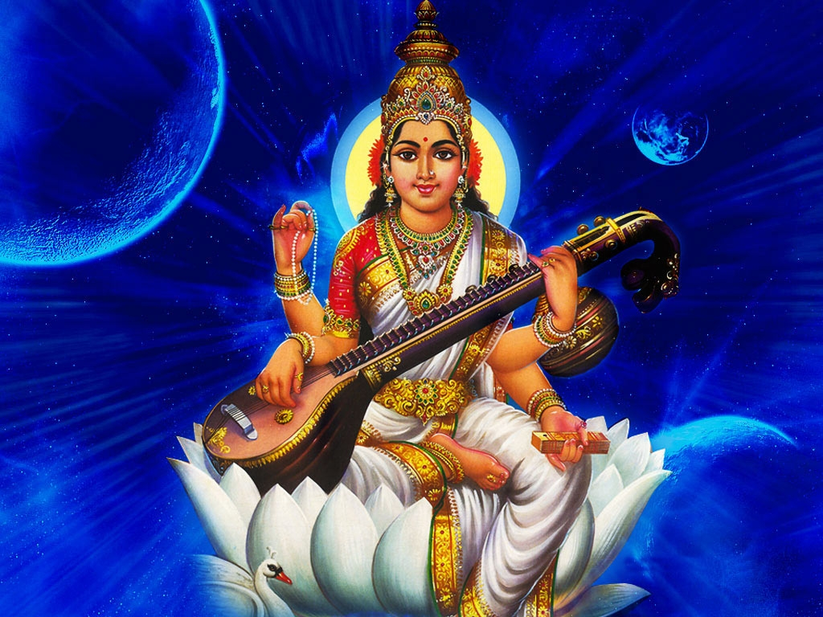
Maa Saraswati

Slide 2
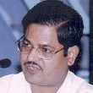
CA SURENDRA KUMAR RAKHECHA
1. Career Counselor and Motivator
2. Gold Medalist :Secondary Education : Rajasthan, 1977
3. All India First in Hindi Typewriting Competition in the youngest age of 16 (history)
4. Composed "SARASWATI VANADNA" and performed as a Playback Singer in an Educational Tele Film "Disha.“
5. Public Speaker on various topics i.e. Religion, Social Issues, Education and Meditation.

Slide 3

This We Do At School Everyday

Slide 4
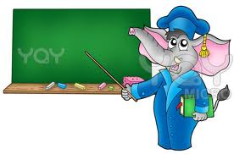
Tell me what is Today?

Slide 5
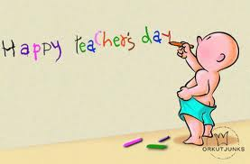
5TH September i.e. Teachers Day !

Slide 6
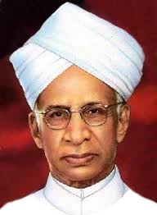
DR. “SARVEPALLI” RADHAKRISHNAN
Born 5th September, 1988
His birthday was recommended as Teacher’s Day by Jawaharlal Nehru
M.A. in Philosophy and Logic
Thesis on The Ethics of the Vedanta

Slide 7

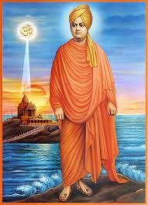

Slide 8

THE THESIS :
THE ETHICS OF VEDANTA
Dr. A. G. Hogg :
“The THESIS which Radha-krishnan prepared for the M.A. Degree courses shows a remarkable understanding of the main aspects of the philosophical problems, a capacity for handling easily a complex argument, besides mastgery of good English.”

Slide 9
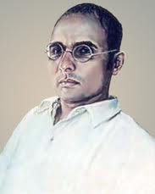
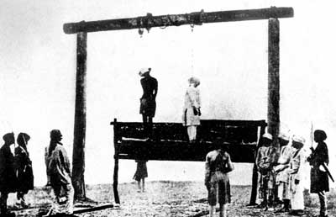
Veer Savarkar
The First War of Independence

Slide 10
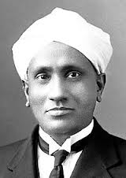
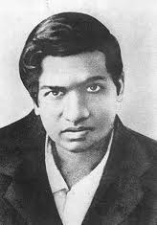
C V. Raman & Ramanujan
Physics and Mathematics Guru

Slide 11
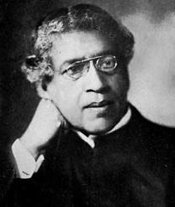
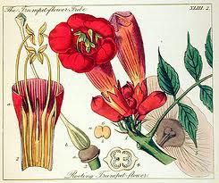
Dr. Jagdish Chandra Bose & Botany

Slide 12
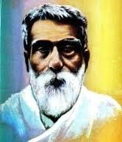
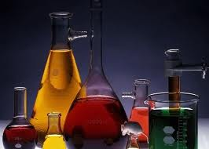
Acharya Prafull Chandra Ray & Chemistry

Slide 13
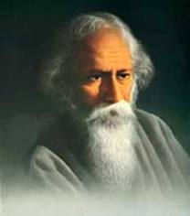
A Book on :
The Philosophy of Rabindranath Tagore
“Your book delighted me. The earnestness of your endeavor and your penetration have amazed me. I am thankful to you for the literary grace of its language which is so beautiful and free from all technical jargons and a mere display of scholarship.”
- Gurudev Tagore

Slide 14
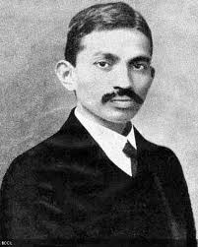
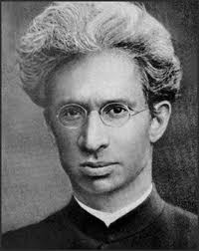
Early Life when Radhakrishnan met Gandhi at Madras in 1915

Slide 15
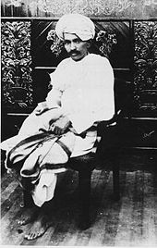
Meeting with Gandhi
In Early Life : 1915
Gandhi’s views on Cow’s Milk : It is essence of BEEF.
In December, 1947
Dedicating book :
A commentary on
BHAGWAD GITA
GANDHI TOLD I AM YOUR ARJUN AND YOU ARE MY KRISHNA, I AM CONFUSED.

Slide 16
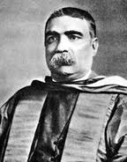
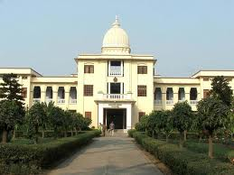
Sir Ashutosh Mukherjee :
Vice Chancellor of Calcutta University

Slide 17
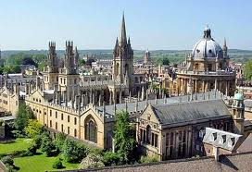
Lecturer At Oxford University
Dr. Radhakrishnan
became the
FIRST INDIAN SCHOLAR
(Age below 30)
to teach at
OXFORD UNIVERSITY
where Indians had hitherto gone only
as students !

Slide 18

Called for a great work by J M MUIRHEAD in 1917
INDIAN PHILOSOPHY, 1923
To include in Library of Philosophy
History of Indian Philosophy: Long span of 3000 years
Single hand efforts
Titled as PHILOSOPHIC CLASSIC and A LITERARY MASTERPIECE
Recognized as Branch of Study

Slide 19

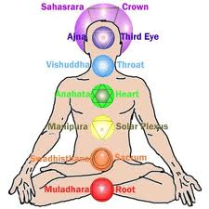
The Roots of Indian Philosophy

Slide 20

Harold Macmillan
British Prime Minister
It has been said that there is no fool like an old fool, except a young fool.
But the young fool has first to grow up to be an old fool to realize what a damn fool he was when he was a young fool.

Slide 21
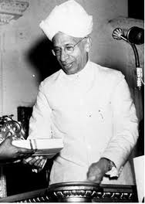
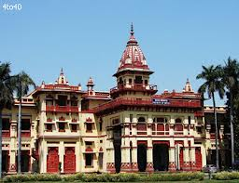
At Benaras University in 1939

Slide 22
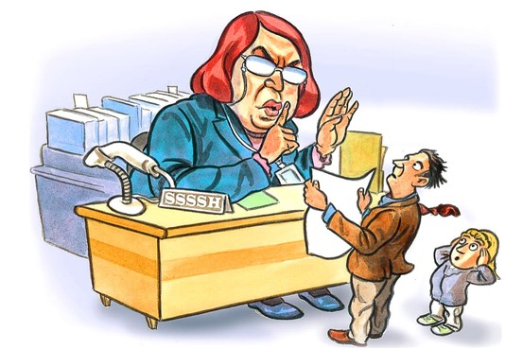
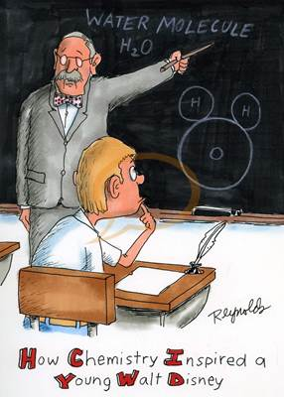
Two Different Heads = Zero or one goes to be Hero

Slide 23
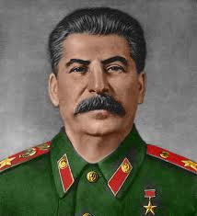

As an Ambassador at Soviet Russia

Slide 24
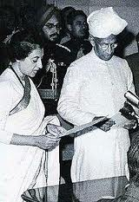
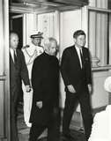
With
Indira Gandhi & John F Kennedy

Slide 25
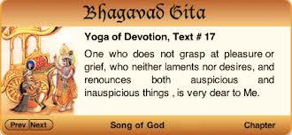
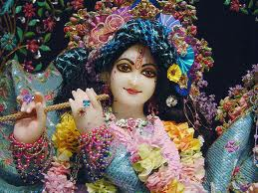
Lord Krishna & Gita

Slide 26
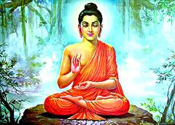
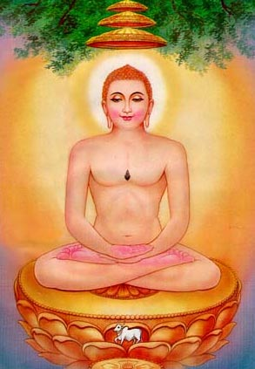
Buddha & Jainism

Slide 27
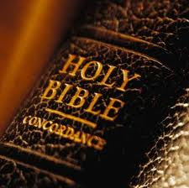
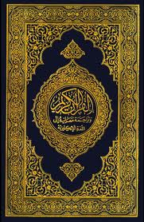
Bible & Quran

Slide 28
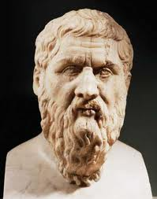
Plato : Greek Philosopher & Mathematician
1. Student of Socrates,
and
2. Founder of the
Academy in Athens,
the first institution of higher learning in the Western world.
Along with his mentor, Socrates, and his student, Aristotle, Plato helped to lay the foundations of Western philosophy and science.

Slide 29
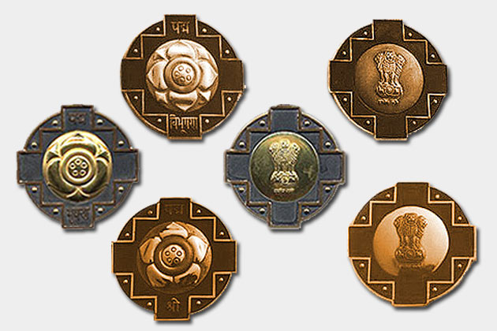
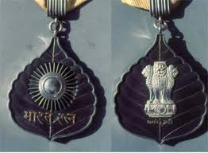
First Bharat Ratna Award

Slide 30

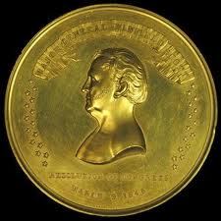
Hard Reality about His Early Life

Slide 31
The Most Wonderful Work
A general student named :
Mohd. Usman
Just came for guidance to pass B.A.
Later on he became :
1. Vice Chancellor of Madras University
2. Ist Indian as Acting Governor of Madras State
3. Member of Viceroy’s Executive Council
4. Choice of cartoonists’ delight
NO STUDENT IS AVERAGE,
IT THE PERFORMANCE WHICH REMAINS AVERAGE.
A STUDENT SCORING 50% MARKS CAN BE TRANSFORMED INTO ACHIEVER OF 90% !

Slide 32

My sincere gratitude to all teachers

