Slide 1
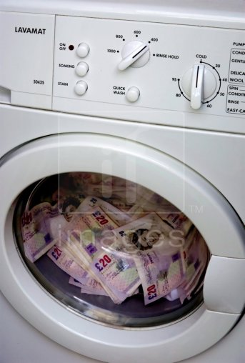
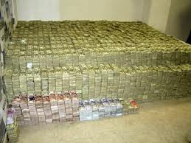
Money Laundering
U Loka Ramakrishna
Managing Director
Loka Education Private Limited

Slide 2

What the hell Money Laundering is?
The most common types of criminals who need to launder
money are drug traffickers, embezzlers, corrupt politicians
and public officials, mobsters, terrorists and con artists.
Money laundering happens in almost every country in the world, and a single scheme typically involves transferring money through several countries in order to obscure its origins.

Slide 3
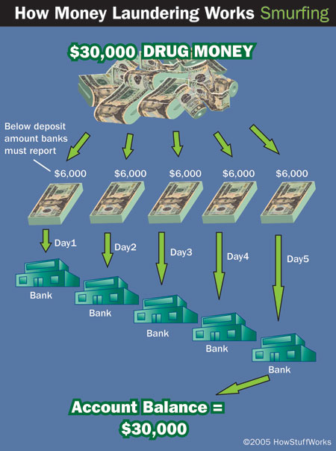
Structuring deposits Also known as smurfing, this method entails breaking up large amounts of money into smaller, less-suspicious amounts.

Slide 4
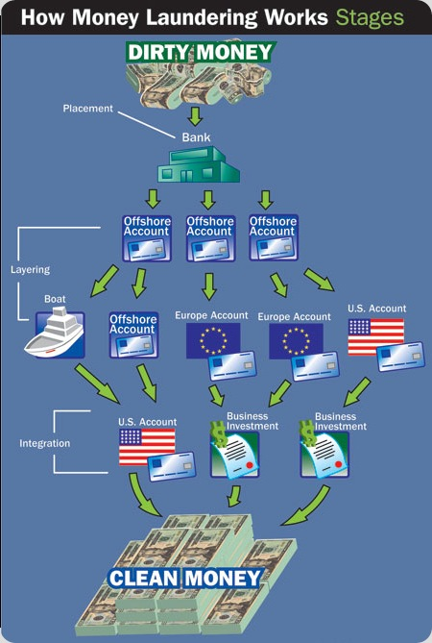
Overseas banks Money launderers often send money through various "offshore accounts" in countries that have bank secrecy laws, meaning that for all intents and purposes, these countries allow anonymous banking

Slide 5
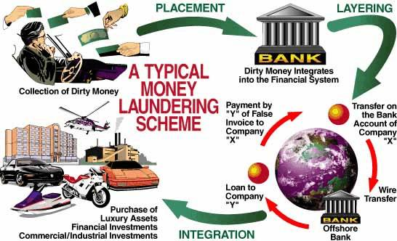
Underground/alternative banking some countries in Asia have well-established, legal alternative banking systems that allow for undocumented deposits, withdrawals and transfers

Slide 6
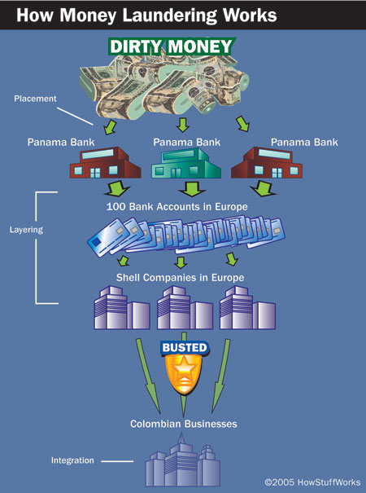
Shell companies These are fake companies that exist for no other reason than to launder money.

Slide 7
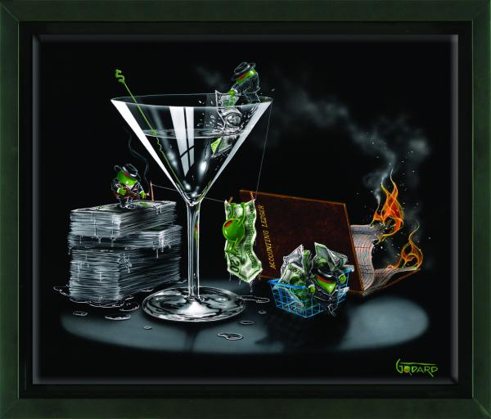
Investing in legitimate businesses Launderers sometimes place dirty money in otherwise legitimate businesses to clean it.

Slide 8

Most money-laundering schemes involve some combination of these methods, although the Black Market Peso Exchange is pretty much a one-stop-shopping system once someone smuggles the cash to the peso broker.
The variety of tools available to launderers makes this a difficult crime to stop, but authorities do catch the bad guys every now and then.

Slide 9


Every one is equal in the
eyes of the Law
Directorate General of Economic Enforcement
Be Good and do Good

Slide 10
Thank You
By
U. Loka Ramakrishna

