Slide 1
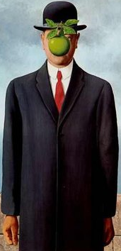
THE POWER OF SELF
ONE MADE A DIFFERENCE

Slide 2
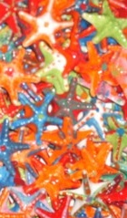
THE STARFISH STORY
One day a man was walking along the beach when he noticed
a boy picking something up and gently throwing it into the ocean.
Approaching the boy, he asked, What are you doing?
The youth replied, Throwing starfish back into the ocean.
The surf is up and the tide is going out. If I don’t throw them back, they’ll die.
Son, the man said, don’t you realize there are miles and miles of beach and hundreds of starfish?
You can’t make a difference!
After listening politely, the boy bent down, picked up another starfish,
and threw it back into the surf. Then, smiling at the man, he said
“I MADE A DIFFERENCE FOR THAT ONE”

Slide 3
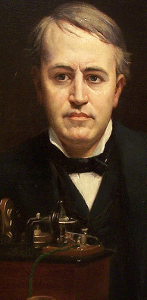
SELF BELIEF be·lief:/bɪˈlif/ Spelled[bih-leef] noun something believed; an opinion or conviction:
THOMAS ALVA EDISON -American inventor and businessman. He developed many devices that greatly influenced life around the world, including the phonograph, the motion picture camera, and a long-lasting, practical electric light bulb. He was one of the first inventors to apply the principles of mass production and large teamwork to the process of invention, and therefore is often credited with the creation of the first industrial research laboratory.
-----------------------------------------------------------------------------------------------------------------------
BELIEF
PERSISTENCE
VISION
-----------------------------------------------------------------------------------------------------------------------
If we did all the things we are capable of, we would literally astound ourselves
When i have fully decided that a result is worth getting I go ahead of it and make trial after trial until it comes.
I have not failed. I've just found 10,000 ways that won't work.

Slide 4
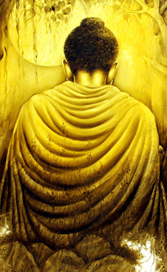
SELF AWARE a·ware: /əˈwɛər/ Spelled[uh-wair] adjective having knowledge; conscious
SIDDHĀRTHA GAUTAMA BUDDHA a spiritual teacher from the Indian subcontinent, on whose teachings Buddhism was founded
----------------------------------------------------------------------------------------
FAITH
PERSERVERENCE
COURGE
----------------------------------------------------------------------------------------
All that we are arises with our thoughts-With our thoughts we make the world.
By your own efforts-Waken yourself, watch yourself
The mind is everything. What you think you become.

Slide 5
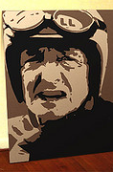
SELF CONFIDENCE con·fi·dence:ˈkɒnfɪdəns/ Spelled[kon-fi-duhns] noun belief in oneself and one's powers or abilities; self-confidence; self-reliance; assurance:
HERBERT JAMES "BURT" MUNRO a New Zealand motorcycle racer, famous for setting an under-1,000 cc world record. Munro was 68 when he set his last record.
-------------------------------------------------
BELIEF
PERSERVERENCE
SKILL
-------------------------------------------------
You live more in five minutes on a bike like this than some people live in a lifetime.
I see your front tires gone a bit flat on ya.
Oh yeah well the good news is its only flat on the bottom
These brakes, they're completely inadequate.
I'm planning on going, not stopping.

Slide 6
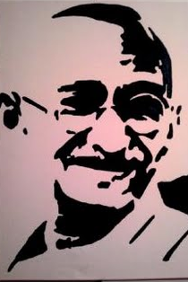
SELFLESS self·less:ˈsɛlflɪs/ Spelled[self-lis] adjective having little or no concern for oneself, especially with regard to fame, position, money, etc.; unselfish.
MOHANDAS KARAMCHAND GANDHI was the pre-eminent political and ideological leader of India.
-----------------------------------------------------------------------------------
BELIEF
FORESIGHT
PATIENCE
-----------------------------------------------------------------------------------
A man is but the product of his thoughts what he thinks, he becomes.
First they ignore you, then they laugh at you, then they fight you, then you win.
In a gentle way, you can shake the world.

Slide 7
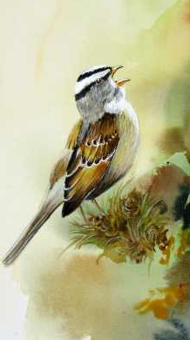
BUT!
A little bird was flying south for the winter. It was so cold; the bird froze up and fell to the ground in a large field. While it was lying there, a cow came by and dropped some dung on it. As the frozen bird lay there in the pile of cow dung, it began to realize how warm it was. The dung was actually thawing him out! He lay there all warm and happy, and soon began to sing for joy.
A passing cat heard the bird singing and came to investigate. Following the sound, the cat discovered the bird under the pile of cow dung, and promptly dug him out and ate him!
The morals of this story are:
NOT EVERYONE WHO DROPS SHIT ON YOU IS YOUR ENEMY.
NOT EVERYONE WHO GETS YOU OUT OF SHIT IS YOUR FRIEND.
AND WHEN YOU'RE IN DEEP SHIT, KEEP YOUR MOUTH SHUT!

Slide 8

THANKS

