Slide 1

Tools of Communication
The Necessity in Present Era
Pooja Kapoor
NRO0217151

Slide 2
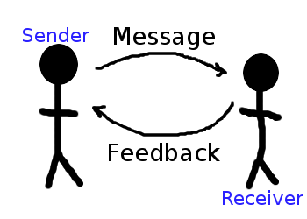
Definition of Communication
Communication is the exchange of thoughts, messages, or information, as by speech, signals, writing, or behavior. Derived from the Latin word "communis", meaning to share..

Slide 3

Modes of Communication
Oral

Slide 4

Written

Slide 5

Silence
I've begun to realize that you can listen to silence and learn from it.

Slide 6


Body Language

Slide 7
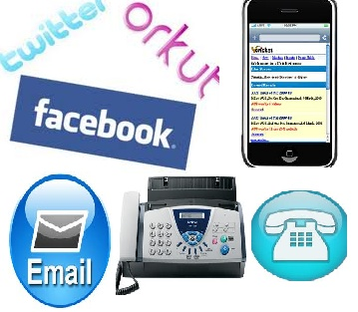
Basic Tools of Communication
Landline telephones
Cell phones
Smartphone's
Video and web conferencing
Social networking sites
Fax
Emails

Slide 8
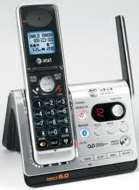
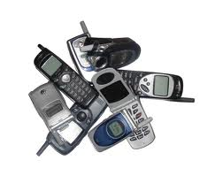
Landline telephones & Cell phones
Basic & Important Tool
Cover a Wider Area
Used almost everywhere
Quicker than email
Comfortable to use
Immediate Communication
Effective Oral Communication

Slide 9
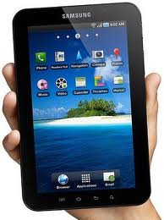
Smartphone's
Stay In Touch
Multimedia Functions
Applications
Remote Office

Slide 10
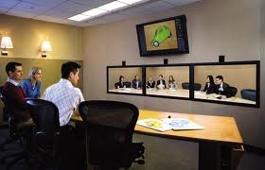
Video conferencing
Increases Productivity
Saves Money
Saves Time
Reduced Travel Costs
Sustained Competitive
Advantage

Slide 11
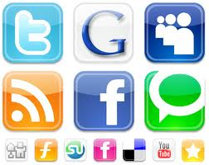
Social networking sites
Increased skills in
technology
Increased exposure to
varied views
Access to resources
Exchange plans and
information
Cheap and effective way to
convey Information

Slide 12
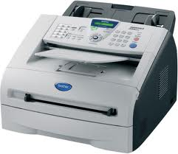
Fax
Rapid Document
Transfer
Proof of Sending
Convenience
Quickly Deal
Save Money on Postage

Slide 13

E-mails
Easy to use
Fast
Automated emails
Environment friendly

Slide 14


Thanks

