Slide 1

Health & Stress Management
NAME : ABHINAV JAIN
EVENT : NATIONAL CA STUDENT’S COVENTION’12 , LUDHIANA
STUDENT REGISTRATION NO. : NRO0213311
MOBILE NO. +919888681547
E-MAIL ID : abhi_abhi1990@hotmail.com

Slide 2
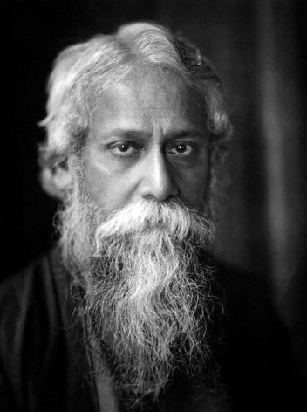
RABINDRANATH TAGORE ONCE SAID :
“Clouds come floating into my life, not to carry rain
or usher storm, but to add color to my sunset sky.”

Slide 3

We have Heard the cliché that
“ CA Studies are STRESSFUL “

Slide 4
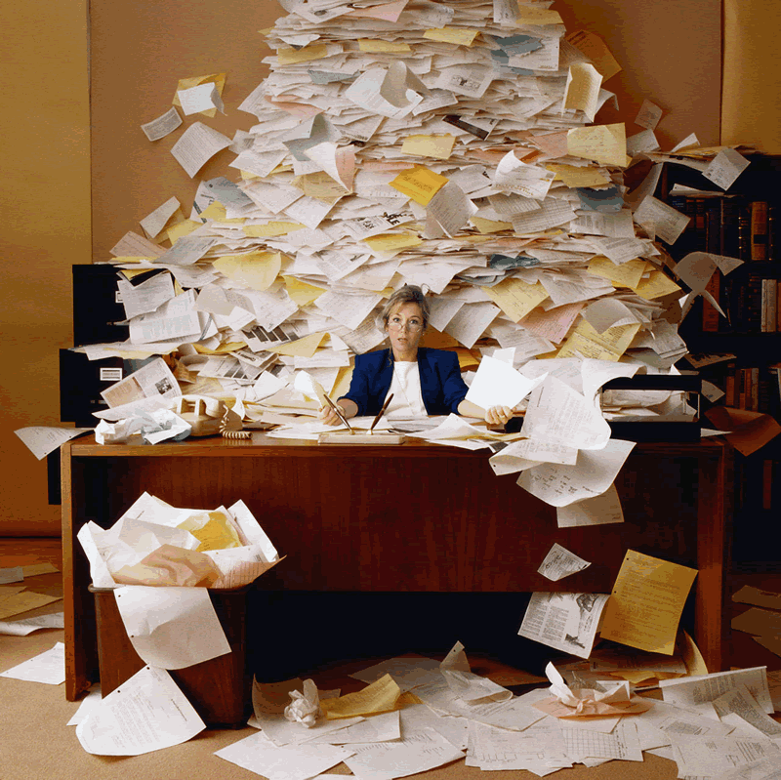
Questions that come to our Mind
What is Stress
Types of Stress
Causes of Stress
Effects of Stress

Slide 5
STRESS ?? WHAT’S THAT ??
“Stress is a physical, mental or emotional response
to events which causes physical or mental tension.”
Stress is a part of everyone’s life.
But it should not be greater than the individual’s capacity to handle stress.

Slide 6
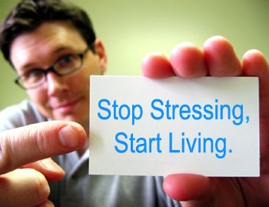
If such a case occurs,
it will cause mental and physical
imbalance in the individual.
Stress should work as a
productive power and not as
a restriction which can
cause physical and
mental imbalance.

Slide 7
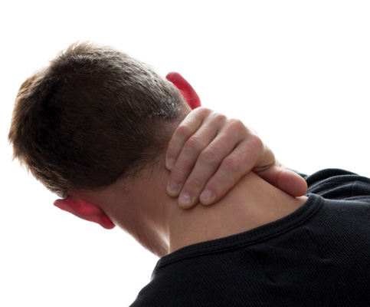
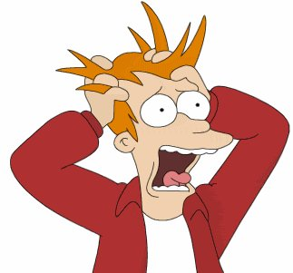
TYPES OF STRESS
PHYSICAL STRESS
Symptoms :
Neck Pain
Headache

Slide 8
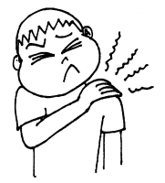
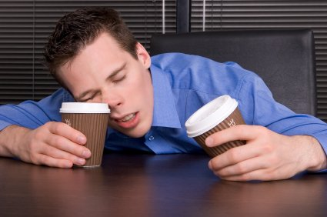
C) STIFFNESS OF MUSCLES
D) INSOMNIA

Slide 9
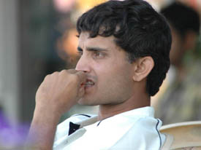
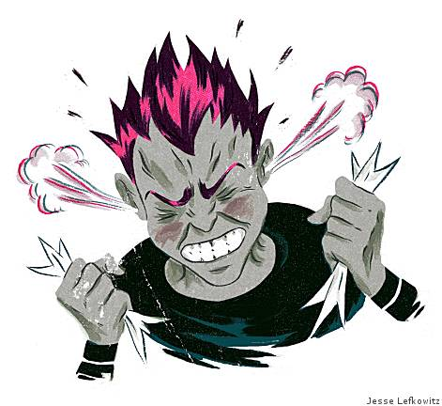
2. EMOTIONAL STRESS
Symptoms :
Anxiety
B) Anger

Slide 10


DEPRESSION
MEMORY LOSS

Slide 11

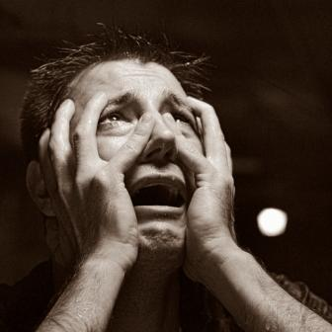
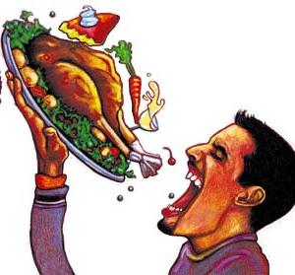
3. PSYCHOLOGICAL STRESS
Symptoms :
Social Isolation Phobias
Eating Disorders
Night Terrors

Slide 12
FURTHER CLASSIFICATION
TERMS GIVEN BY PROF. SELYE FROM HUNGARY
IN 1974
POSITIVE STRESS ( EUSTRESS )
NEGATIVE STRESS ( DISTRESS )

Slide 13

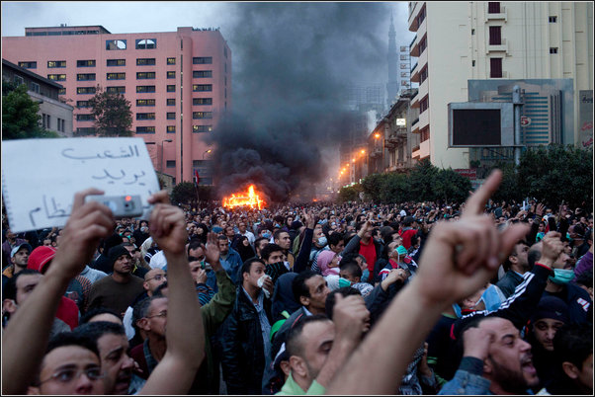
SOURCE OF STRESS
ENVIRONMENTAL FACTORS :
CHANGES IN BUSINESS CYCLE
POLITICAL UNCERTAINITIES
TECHNOGICAL UNCERTAINITIES

Slide 14
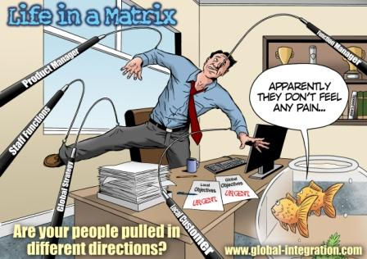
2) ORGANISATIONAL FACTORS :
ROLE CONFLICTS
ROLE OVERLOAD
ROLE AMBIGUITY
COMPLEX ORGANISATIONAL STRUCTURE

Slide 15

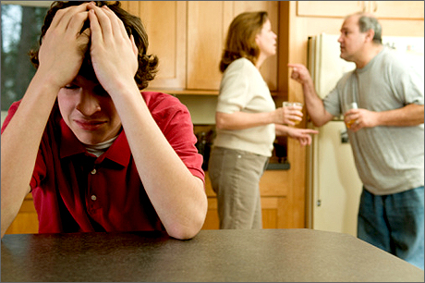
3) INDIVIDUAL FACTORS :
BROKEN MARRIAGES
BROKEN FAMILIES
ECONOMIC PROBLEMS
OVER-SUSPICIOUSNESS

Slide 16


4) INDIVIDUAL DIFFERENCES :
PERCEPTION
JOB EXPERIENCE
SELF EFFICACY
HOSTILITY

Slide 17
EFFECTS OF STRESS
PHYSIOLOGICAL SYMPTOMS :
NOWADAYS, IT’S NOT OF MUCH RELEVENCE
2) PSYCHOLOGICAL SYMPTOMS :
LACK OF CLARITY ABOUT EMPLOYEE’S DUTY,
AUTHORITY AND RESPONSIBILITY INCREASES STRESS
3) BEHAVOURAL SYMPTOMS :
CONSUMING ALCOHOL
SMOKING
SLEEP DISORDERS

Slide 18

HEALTH MANAGEMENT
LORD BUDDHA ONCE SAID :
“Without Health, Life is not Life;
It is just a state of Languor and Suffering “

Slide 19
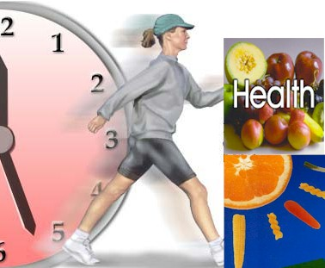
“Health is a state of complete
physical,
mental and
spiritual well being and
not merely the absence of disease.”

Slide 20

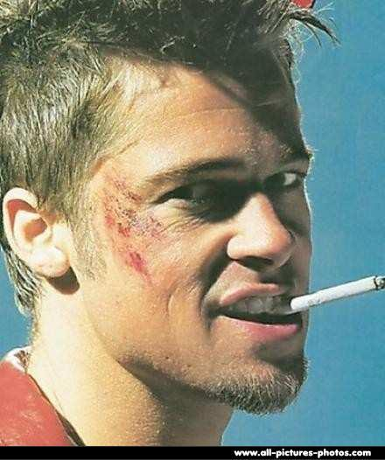
WAYS OF COPING STRESS
&
ILL HEALTH
UNHEALTHY WAYS OF COPING HEALTH AND STRESS
RELATED ISSUES ARE :
SMOKING
CONSUMING ALCOHOL
DRUGS (NARCOTICS) THAT ARE MORALLY UNACCEPTED AND ILLEGAL
OVER-EATING OR UNDER-EATING

Slide 21
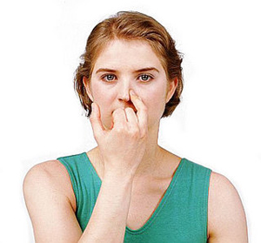
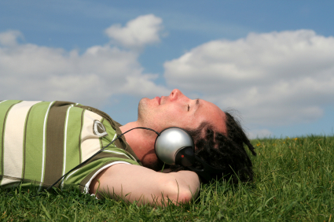
CORRECT WAYS OF COPING WITH STRESS :
1) STRESS RELIEF STRATEGIES :
BODY RELAXATION EXERCISES LIKE
BREATHING EXERCISES
GUIDED IMAGERY ( PLAYING A SOFT MUSIC )

Slide 22
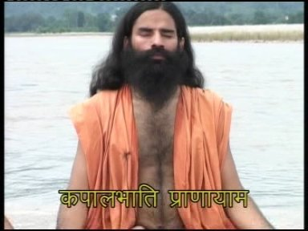

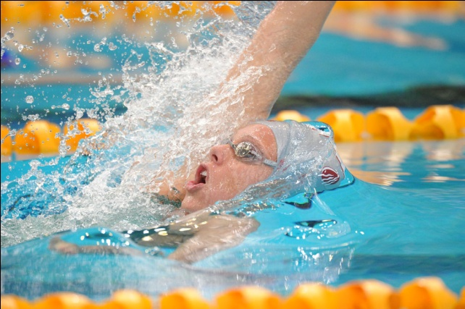
2) PHYSICAL EXERCISES :
YOGA
AEROBICS
WORK OUT ROUTINE LIKE CYCLING, JOGGING , GYM AND SWIMMING

Slide 23


3) HEALTHY EATING :
Drinking at least 2-3 litres of Water daily. It helps in
Detoxification as well as keeps us cool and hydrated.
Eating a variety of foods like green leafy vegetables, fruit,
etc that are good in nutrients.

Slide 24
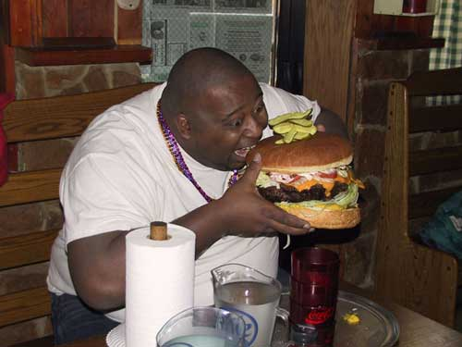
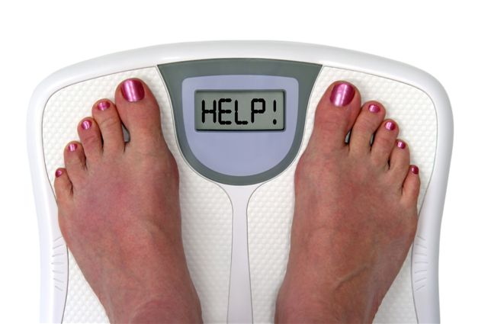
Maintaining an optimum weight.
Avoiding oily and fatty items like Chips and Burgers. Even
though they might seem irresistible, but we will have to
forego them otherwise we will have to find time for various
health problems like obesity, hypertension, high cholesterol
and the like.

Slide 25
4) OTHER TIPS :
Changing perceptions
Breaking bigger tasks into smaller tasks
Avoid PROCASTINATION (unnecessary delay of work)
Get enough sleep
Avoiding late night eating. Doctors recommend
that there should be a gap of minimum
two-three hours between Food Intake and the sleep.

Slide 26

THE KEY WORD IS
BALANCE

Slide 27
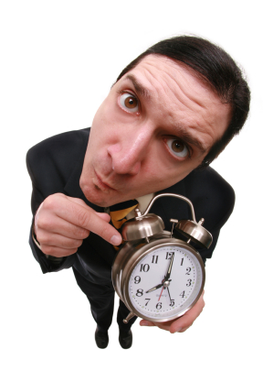
WHY SHOULDN’T STRESS BE ELIMINATED
AT 1ST PLACE ITSELF ?
MAINTAIN POSITIVE ATTITUDE
DEVELOP TIME MANAGEMENT SKILLS
IMBIBE THE QUALITY OF “PUNCTUALITY”
SET UP TARGETS AND
ENJOY YOUR SUCCESS
BRING IN REGULARITY
AND MOST IMPORTANTLY,
DISCIPLINE

Slide 28

QUOTE FROM THE BOOK “ THE ALCHEMIST “
BY PAULO COELHO
“At a certain point in our lives, we lose control of what's
happening to us, and our lives become controlled by fate.
That's the world's greatest lie.”

Slide 29
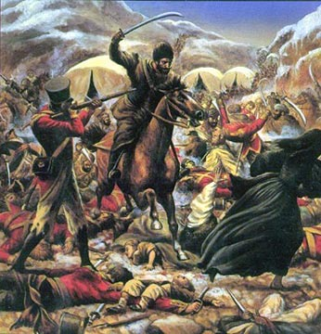
SURVIVAL OF THE FITTEST
From the book “ THE ORIGIN OF SPECIES “ by Charles Darwin in 1859

Slide 30
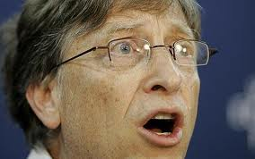
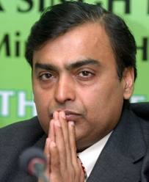
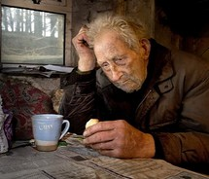
STRESSED PEOPLE OF THIS PLANET
BILL GATES MUKESH AMBANI AN ORDINARY POOR MAN

Slide 31

AIM HIGH, FLY HIGH

Slide 32
THANK
YOU

