Slide 1
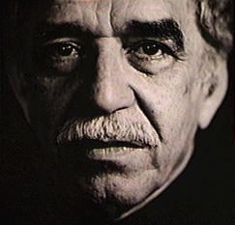
GABRIEL GARCÍA MÁRQUEZ
“13 PHRASES FOR LIVING”

Slide 2
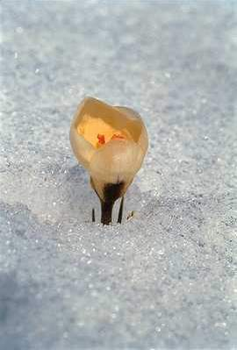
I love you not for whom you are, but who I am when I’m by your side.

Slide 3
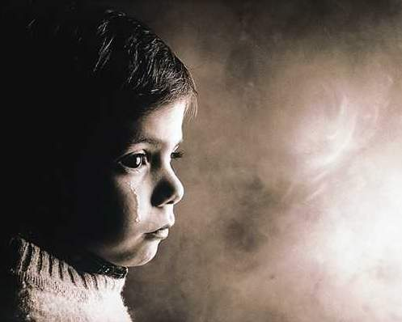
No person deserves your tears, and who deserves them won’t make you cry.

Slide 4

Just because someone doesn’t love you as you wish, it doesn’t mean you’re not loved with all his/her being.

Slide 5

A true friend is the one who holds your hand and touches your heart.

Slide 6

The worst way to miss someone is to be seated by his/her side and know you’ll never have him/her.

Slide 7
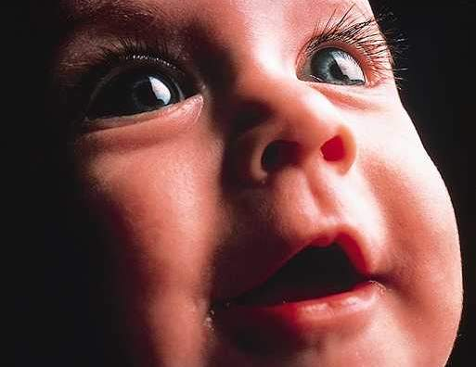
Never stop smiling, not even when you’re sad, someone might fall in love with your smile.

Slide 8

You may only be a person in this world, but for someone, you’re the world.

Slide 9

Don’t spend time with someone who doesn’t care spending it with you..

Slide 10
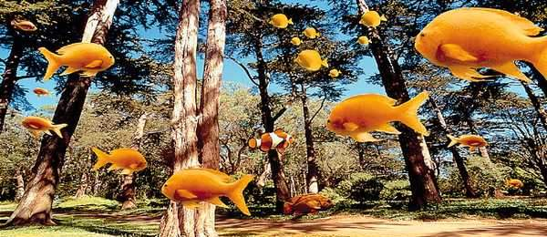
Maybe God wants you to meet many wrong people before you meet the right one, so when this happens, you’ll be thankfull.

Slide 11
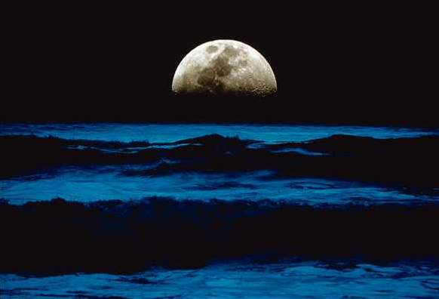
Don’t cry because it came to an end. Smile because it happened.

Slide 12

There will always be people who’ll hurt you, so you need to continue trusting, just be carefull.

Slide 13

Become a better person and be sure to know who you are before meeting someone new and hoping that person knows who you are.

Slide 14
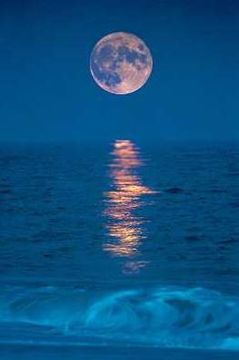
Don’t struggle so much, best things happen when not expected.

Slide 15
Dedicated to people who, for different reasons, are my friends, no matter if I don’t meet them regularly, if I don’t call them often... Just remember one thing
“EVERYTHING THAT HAPPENS HAS A REASON BEHIND”

