Slide 1
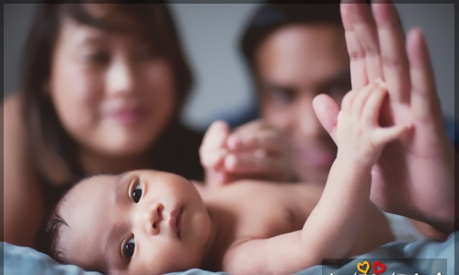
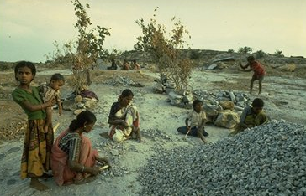
There were Stone-cutters toiling on the roadside.

Slide 2
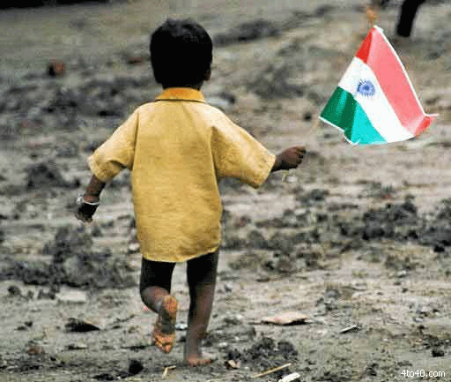
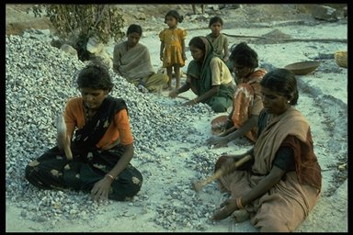
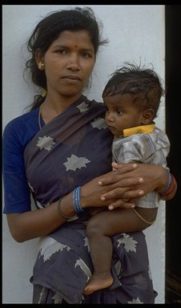
When asked for their Responses.
One replied with pains, “ No choice!
I have got to do this Labour for my child”

Slide 3
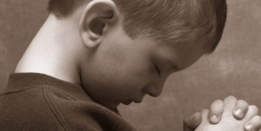
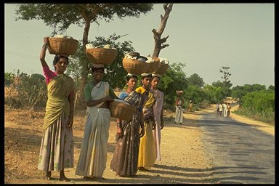
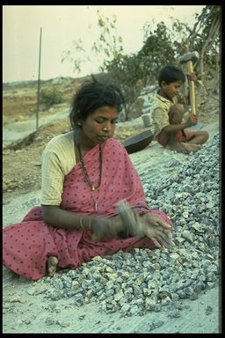
Another said with pride,
“Our roads are getting built;
I do it as Duty to my Nation”

Slide 4
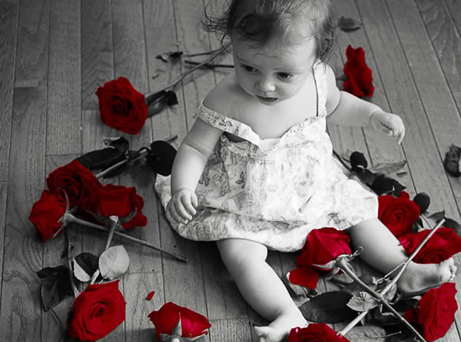
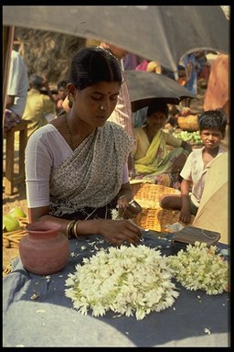
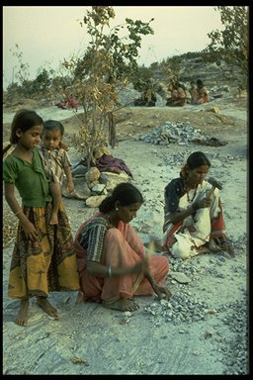
While the third calmly said,
“ I do it as Worship of the Lord
at the Temple that is being built.”

Slide 5
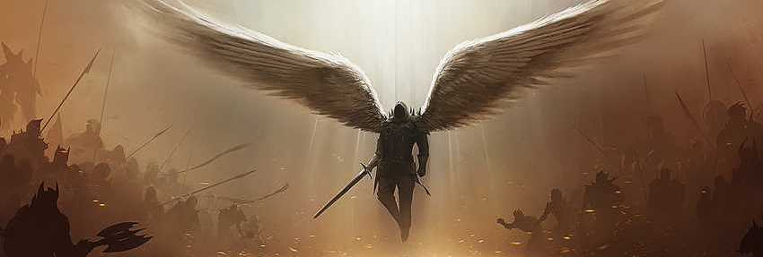
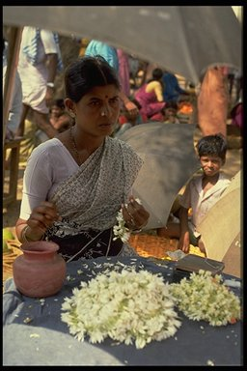
The Child of the first became A Stonecutter,
An Army Officer of the Second,
And A Renowned Architect of the third.
And No wonder why.

Slide 6
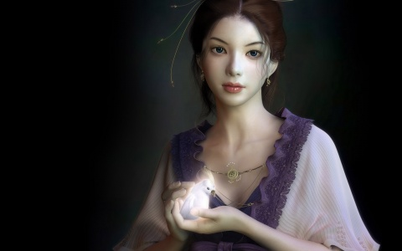
They were doing the same job - Stonecutting-
But
their ATTITUDE made the whole difference.
Do What You Love…
Love What You Do!!
By Aryan Simghania

