Slide 1
STRATEGIC MANAGEMENT
CHAPTER – 03 STRATEGIC ANALYSIS
It is the process of determining alternative censes of action that would
enable the firm to achieve the vision mission and operatives.
The important considerations for Strategic Analysis are
Industry of competitive conditions.
Firm’s own Capabilities
Firm’s internal resources.
Firm’s internal strengths and weaknesses
Market Position

Slide 2
STATEGIC ANALYSIS SEQUENCE
1
Appraisal of firm’s
External Situations
2
Appraisal of Firm’s
Internal Situations
+
3
Evaluate Alternative
4
Decide the choice
of Strategy
5
Implement
6
Achieve Mission
and Objectives

Slide 3
METHODS OF INDUSTRY AND COMPETATIVE ANALYSIS
1. SWOT Analysis
S
O
W
T
2. TOWS MATRIX
Same SWOT
But recognize and integrate them into strategic planning.
Developed by Heniz Weihrich
(A German Professor in USA)
4. A step above SWOT analysis

Slide 4
Internal External | Organizational Strengths | Organisationsal Weakness
Environmental Opportunities | Strategic Options
 | SO | WO
Environmental Threats | ST | WT

Slide 5




SO -
ST (USA) Vs. (China)
USA
China

Slide 6

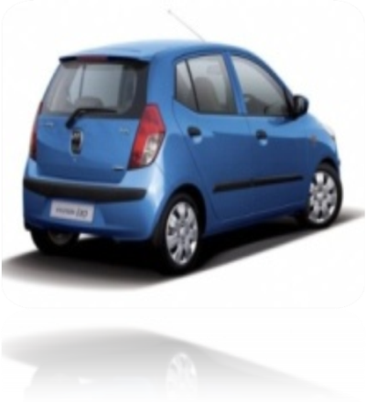
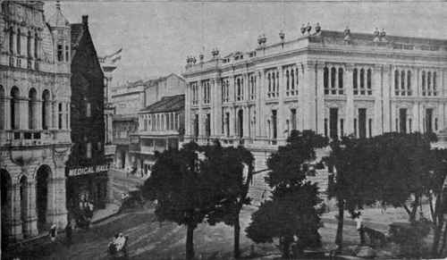
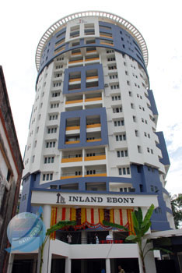



WO
AMBASSADOR
HYUNDAI i10
WT
Merge
Liquidate
Shutter Down
Bankruptcy

Slide 7


B. C. G. MATRIX
High Growth Rate
High Market Share
Best Situation
Long run Growth of the Co
Make more investment
Forward/Backward integration
Market Expansion
Product Expansion
Low Market Share But High
Growth Rate
Needs more cash but cash
Generation is low
Why question Mark?
Because we need to decide
Whether strengthen them
Or Sell them.
HIGH
LOW
Stars
Question Mark
HIGH
2
⬆
1
?
3
Cash cow
4
Dog
LOW
High Market Share
Low Growth
Lot of Cash Generated
Yesterdays Stars go
for product modification,
As they become weak
Think of retrenchment
Foundation of the Co.
Low Growth
Low Market Share
Liquidate
Divest/ retrench
HIGH
Market Share
LOW
Co’s. Strenght in Market
N
ML
F
C

Slide 8
1. Focus on existing
Product.
2. Nothing New
3. Increase Sales
4. More Advertising
5. More Personal
Selling
6. Aggressive
Promotion
7. Make market
un attractive to
competitors
_____________
8. E.g.. M & M in
Mah. Guj.
FORMULA : BUILD/HOLD/HARVEST/DIVEST
AN SOFF’S MATRIX
(PRODUCT/ MARKET GROWTH MIX)
1. Introduce New
Product in
Existing market
Slightly
modified
product also
_____________
3. Wider / Better
Appeal to
Customers.
Existing product
New product
Existing
market
MKT
PENETRATION
PRODUCT
DEVELOPMENT
New
market
MKT
DEVELOPMENT
DIVERSIFICATION
1. Sell existing Product in New Market
2. Identify New Markets
3. Geographical Expansion
4. New Packing
5. New Advertising in New Areas
6. E.g.. ITC Hotels in all Business/
Tourist / Hill Resorts / Cities
7. Reliance Communication
[Total Net Work]
8. Maruti Udyog Ltd. etc.
1. Change Line & Direction of Business
2. Start New
3. Acquire Another one
4. Risky
5. No Experience in Market
(GOLDEN RULE SHIFT PRODUCT / MARKET / STRATEGIES
AS MARKET CONDITIONS CHANGE)

Slide 9
GE - 9 CELL MATRIX Improvement Over BCG Matrix
4 Vs. 9 Cells GE of USA With Mc. KENSEY & CO.
VERTIX AXIS
HORIZONTAL AXIS
INDUSTRY ACTRICTIVNESS
BUSINESS STRENGTH
Market size, growth rate
Industry Profit margin
Intensity of competition,
Seasonality cyclicity, cavity
Economies of scale, Tech /
SOC / Env
Relative market share, profit
Margin, Ability to compete,
Knowledge of customer,
Market sta ________and
Weaknesses, caliber of
Management etc.
9 CELL
ZONE
INDUSTRY ACTACATIVNESS LOW TO HIGH
BUSINESS STRENGTH - WEAK TO STRONG
3
(GREEN) (GO AHEAD)
HIGH
MEDIUM
LOW
2
(YELLOW) (WAIT & SEE)
INDUSTRY ACTRACTIVNESS
1
(RED)(STOP)
STRONG AVERAGE WEAK
BUSINESS STRENGTH AND COMPETATIVE POSITION
GREEN
GO
GROW
BUILD
EXPAND
MAJOR INVESTMENT
YELLOW
WAIT & SEE
HOLD
STABILITY
CONSOLIDATION
RED
STOP
DIVEST
RETRENCH
LIQUIDATE TURNAROUNG

Slide 10
MATRIX DEVELOPED BY
ARTHUR – D – LITTLE COMPANY
(Oldest US. consulting firm in Boston Massachusetts
Deals with Portfolio Analysis
Developed by Arthur Little Company
Concept has 4 x 5 Matrix
4 x 5 = 20 – Matrixes deal with stages in PLC
Introduction / Embryonic
Growth
Maturity
4. Decline

Slide 11
Dominant
H A R V E S T
Strong
H O L D
B U I L D
Favored
Tenable
Weak
Product Life Cycle
Build - Product introduction stage and a favorable or strong business strength.
Hold - Product is in Maturing stage and favorable to Dominant Strength.
Harvest - Product is in decline stage and strong or Dominant.
Divest - Product growth / Mature / Decline stage Int. Business strength is weak,
Tenable or favored.

Slide 12
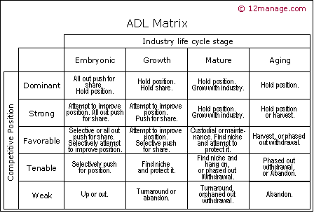

Slide 13
SHORT NOTE AN PORTFOLIO ANALYSIS
Meaning :
It is a tool by which the management identifies and evaluates the various
products / business that make up the company.
Nature / Feature / Significance
Product lines / Ranges are identified
What are the investment made in them ?
What are their returns.
Best but portfolios are the ones which fits in the SW of the Co & OT in the
environment
5. P.A helps an competitive Analysis.
6. Highly useful for multi product and multi business firms.
7. Accordingly channelize them.
8. Divert resources from cash rich products to more prospective ones.
9. So that growth is faster
10. Based and 3 factors.
(a) SBU
(b) E.C
(c) PLC

Slide 14
Short Note on P.L.C.
Product Life Cycle
I N T R O D U C T O R Y
S A L E S
G R O W T H
M A T U R I T Y
D E C L I N E
T I M E
PLC
Shows Relationship between sales and time of growth of a product.
Every Product Passes through 4 successive stages
1. Introduction - Slow Growth
2. Growth - Rapid Growth
3. Maturity - Slow Down
4. Decline - Sharp down drift
PLC is studied to know at which stage is each product pay more affection to products
at decline stages.
Decide strategies accordingly expenditure
Example
1. During Introductory Stage - Go for expansion
2. During Growth Stage - Go far expansion
3. During Maturity Stage - Harvest
4. During Decline Stage - Combination Strategies

Slide 15
ST. MANAGEMENT – CHAPTER – 3
Class Assignment On BCC Matrix
Q. Coaching Class Industry in a suburb consists of Two firms
(a) Mahesh Tutorial Commerce
(b) Success Tutorial Commerce
From the following information of Mahesh Tutorial Commerce, prepare BCG
Matrix
Product | Revenue Rs | % Revenues | Profit Rs | % of Profit | % of Market share | % of industry growth rate
CPT/IPCC | 3 Cr | 48 | 60 lakhs | 48 | 80 | + 15
XII Std | 2 Cr | 32 | 25 lakhs | 20 | 40 | + 12
TYBCOM | 1 Cr | 16 | 37.5 lakhs | 30 | 60 | 20
FYBCOM& SYBCOM | 25 Lakhs | 4 | 2.5 lakhs | 2 | 5 | - 10
TOTAL | 6.25 Cr | 100 | 125 lakhs | 100
STARS
Q. MARKS
CASH COWS
DOGS

