Slide 1
INTERPERSONAL SKILLS: IT’S IMPORTANCE AT WORKPLACE
PRESENTED BY
CS Pankaj Khanna

Slide 2
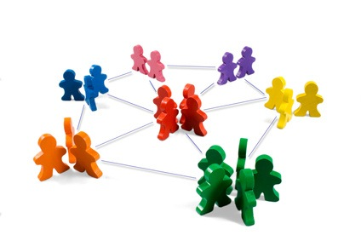
Interpersonal skills
Interpersonal skills are the skills that a person uses to interact with other people. Interpersonal skills are sometimes also referred to as communication skills.
Interpersonal skills involve using skills such as active listening and tone of voice, they include delegation and leadership. It is how well you communicate with someone and how well you behave or carry yourself.

Slide 3
INTERPERSONAL SKILLS
listening
questioning
language &
communication
using
feedback
conflict handling

Slide 4


Slide 5
INTERPERSONAL SKILLS INVOLVES
Communication:
Persuading
Influencing
ListeninG
Leadership:
Problem solving
Decision making
Negotiating
Conflict management
Team management:
Delegating
Motivating

Slide 6
Interpersonal Relationships

Slide 7

ESSENTIAL INTERPERSONAL SKILLS
  Self awareness
  Control
  Motivation
  Acknowledging the interests of subordinates
  Communication skills

Slide 8
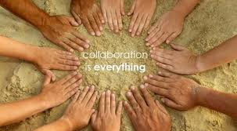
NEED FOR INTERPERSONAL SKILLS
Your team interacts with other team.
Hierarchy is flattened, so our co workers increase.
People work as team.
Collective intellect is very effective for all types of problems.
A good interpersonal skill will allow us to network effortlessly & effectively.

Slide 9

IMPROVE INTERPERSONAL SKILLS
Smile
Be appreciative
Pay attention to others
Practice active listening
Bring people together
Resolve conflicts
Communicate clearly
Humor them
See it from their side
Don't complain

Slide 10

BENEFITS OF INTERPERSONAL SKILLS AT WORKPLACE
To succeed in management you need good interpersonal skills, you need to understand how to deal with other people. This unit help us enormously in dealing with the work tasks we are responsible for.
There are several personal benefits that can be obtained by a person with strong interpersonal skills. These skills are highly valued in the workplace and a person who possesses them is seen to add great value.
In addition to career growth and increased productivity, these skills can also greatly reduce stress.
"The people with whom you work reflect your own attitude. If you are suspicious, unfriendly and condescending, you will find theses unlovely traits echoed all about you. But if you are on your best behavior, you will bring out the best in the persons with whom you are going to spend most of your working hours." - Beatrice Vincent

Slide 11

WORKPLACE SUCCESS lINKED TO GOOD INTERPERSONAL SKILLS
Research shows that employees with keen interpersonal skills often have the edge in gaining the respect of peers and bosses. A focus on your own actions in relationships is clearly part of a long-term influencing strategy. Yes, I’m talking about what some refer to as the dreaded “soft skills.” Personally, my dread is that these “soft skills” are usually the most difficult skills for employees to acquire and demonstrate. And more, the lack of these “soft skills” is a frequent cause for the company’s “rising star” to fall. So, maybe these “soft skills” are really the “hard skills” that can make a difference for your own influence and overall success!

Slide 12

CONCLUSION
If you have effective interpersonal skills, you have
Appropriate assertion skills
Active listening skills
The ability to accept criticism
Respect for the face and dignity of the other person

Slide 13
THANK YOU

