Slide 1
Theory of Cost
Prepared by : Saurabh Chakraborty
Student : M.Com.
Subject: Managerial Economics

Slide 2
Cost Analysis
Cost analysis refer to the study of Behaviour of cost in relation to one or more Production Criteria like size of output, scale of operation,price of factor of production.
In other word, Cost Analysis related to the Financial aspects of Production relationa against Physical aspect.

Slide 3
Actual Cost
Actual cost is defined as the cost or expenditure which a firm incurs for producing or acquiring a good or service. The actual costs or expenditures are recorded in the books of accounts of a business unit. Actual costs are also called as "Outlay Costs" or "Absolute Costs" or "Acquisition Costs".
Examples: Cost of raw materials, Wage Bill etc.

Slide 4
Sunk Cost
Sunk costs are those do not alter by varying the nature or level of business activity. Sunk costs are generally not taken into consideration in decision - making as they do not vary with the changes in the future. Sunk costs are a part of the outlay/actual costs. Sunk costs are also called as "Non-Avoidable costs" or "Inescapable costs".
Examples: All the past costs are considered as sunk costs. The best example is amortization of past expenses, like depreciation.

Slide 5
Explicit Cost
Explicit costs are those expenses/expenditures that are actually paid by the firm. These costs are recorded in the books of accounts. Explicit costs are important for calculating the profit and loss accounts and guide in economic decision-making. Explicit costs are also called as "Paid out costs"
Example: Interest payment on borrowed funds, rent payment, wages, utility expenses etc.

Slide 6
Implicit Cost
Implicit costs are a part of opportunity cost. They are the theoretical costs ie., they are not recognised by the accounting system and are not recorded in the books of accounts but are very important in certain decisions. They are also called as the earnings of those employed resources which belong to the owner himself. Implicit costs are also called as "Imputed costs".
Examples: Rent on idle land, depreciation on dully depreciated property still in use, interest on equity capital etc.

Slide 7
Accounting Costs
Accounting costs are the actual or outlay costs that point out the amount of expenditure that has already been incurred on a particular process or on production as such accounting costs facilitate for managing the taxation need and profitability of the firm.
Examples: All Sunk costs are accounting costs

Slide 8
Economic Costs
Economic costs are related to future. They play a vital role in business decisions as the costs considered in decision - making are usually future costs. They have the nature similar to that of incremental, imputed explicit and opportunity costs.

Slide 9
Direct Cost
Direct costs are those which have direct relationship with a unit of operation like manufacturing a product, organizing a process or an activity etc. In other words, direct costs are those which are directly and definitely identifiable. The nature of the direct costs are related with a particular product/process, they vary with variations in them. Therefore all direct costs are variable in nature. It is also called as "Traceable Costs"
Examples: In operating railway services, the costs of wagons, coaches and engines are direct costs.

Slide 10
Indirect Costs
Indirect costs are those which cannot be easily and definitely identifiable in relation to a plant, a product, a process or a department. Like the direct costs indirect costs, do not vary ie., they may or may not be variable in nature. However, the nature of indirect costs depend upon the costing under consideration. Indirect costs are both the fixed and the variable type as they may or may not vary as a result of the proposed changes in the production process etc. Indirect costs are also called as Non-traceable costs.
Example: The cost of factory building, the track of a railway system etc., are fixed indirect costs and the costs of machinery, labour etc.

Slide 11
Controllable Costs
Controllable costs are those which can be controlled or regulated through observation by an executive and therefore they can be used for assessing the efficiency of the executive. Most of the costs are controllable.
Example: Inventory costs can be controlled at the shop level etc.

Slide 12
Non Controllable Costs
The costs which cannot be subjected to administrative control and supervision are called non controllable costs.
Example: Costs due obsolesce and depreciation, capital costs etc.

Slide 13
Historical Costs and Replacement Costs
Historical cost or original costs of an asset refers to the original price paid by the management to purchase it in the past. Whereas replacement costs refers to the cost that a firm incurs to replace or acquire the same asset now. The distinction between the historical cost and the replacement cost result from the changes of prices over time. In conventional financial accounts, the value of an asset is shown at their historical costs but in decision-making the firm needs to adjust them to reflect price level changes.
Example: If a firm acquires a machine for Rs.2,00,000 in the year 1990 and the same machine costs Rs.4,00,000 now. The amount Rs.2,00,000 is the historical cost and the amount Rs.4,00,000 is the replacement cost.

Slide 14
Fixed Costs
Fixed costs are the costs that do not vary with the changes in output. In other words, fixed costs are those which are fixed in volume though there are variations in the output level.. If the time period in volume under consideration is long enough to make the adjustments in the capacity of the firm, the fixed costs also vary.
Examples: Expenditures on depreciation costs of administrative, staff, rent, land and buildings, taxes etc.

Slide 15
Variable Costs
Variable Costs are those that are directly dependent on the output ie., they vary with the variation in the volume/level of output. Variable costs increase in output level but not necessarily in the same proportion. The proportionality between the variable costs and output depends upon the utilization of fixed facilities and resources during the production process.
Example: Cost of raw materials, expenditure on labour, running cost or maintenance costs of fixed assets such as fuel, repairs, routine maintenance expenditure.

Slide 16
Opportunity Cost
Opportunity cost is concerned with the cost of forgone opportunities/alternatives. In other words, it is the return from the second best use of the firms resources which the firms forgoes in order to avail of the return from the best use of the resources. It can also be said as the comparison between the policy that was chosen and the policy that was rejected. The concept of opportunity cost focuses on the net revenue that could be generated in the next best use of a scare input. Opportunity cost is also called as "Alternative Cost".

Slide 17
Average Cost
Average Cost (AC) , refers to the cost per unit of output assuming that production of each unit incurs the same cost. It is statistical in nature and is not an actual cost. It is obtained by dividing Total Cost(TC) by Total Output(Q)
AC= TC/Q

Slide 18
Marginal Cost
Marginal costs(MC), refers to the additional costs that are incurred when there is an addition to the existing output level of goods ans services. In other words, it is the addition to the Total Cost(TC) on account of producing additional units.

Slide 19
Cost Function
The cost function refers to the Mathematical relation between Cost of a Product and the various Determinance of cost.
C=f(Q,T,Pf,K)
Where,
C=Total Cost
Q=Output
T=Technology
Pf=Factor Price
K=Capital

Slide 20
Cost Function
Short run Cost Function C=f(Q)
Long run Cost Function C=f(Q,T,Pf,K)

Slide 21
Short Run Cost
Fixed Cost
Variable Cost
Total Cost

Slide 22
Short Run Fixed Cost(SFC)
Fixed Cost are hose cost which are independent of output i.e. they do not change with change of output.
In case of Firm shut down for some time,Fixed Cost are to be borne by the firm.
Example, Factory Rent,Interest on Capital Employed etc.

Slide 23
Short Run Variable Cost(SVC)
Variable cost are those cost which changes with changes in Output.
In case of firm shut down for some time ,Variable Cost dose not occur and hence avoided by the Firm.
Example, Payment of Wage , Price of Raw Materials etc.

Slide 24
Total Cost
Total cost (TC) refers to the money value of the total resources/inputs required for the production of goods and services by the firm. In other words, it refers to the total outlays of money expenditure, both explicit and implicit, on the resources used to produce a given level output. Total cost includes both fixed and variable costs and is given by TC = VC + FC

Slide 25
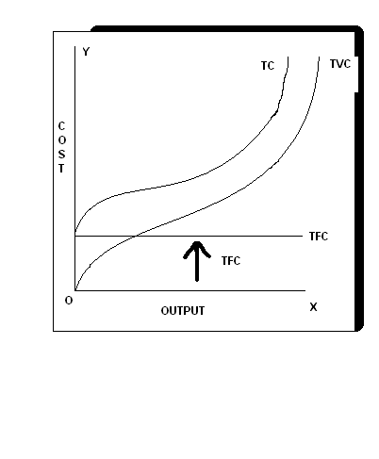
Short Run Total Cost Curves

Slide 26
Short Run Average Cost
Average fixed costs
Average variable cost
Average Total Cost

Slide 27
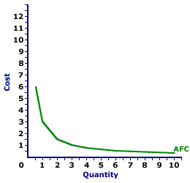
Short Run Average Fixed cost
Average Fixed Cost (AFC) is Total Fixed Cost (TFC) is divied by the Number of Units of output Produced.
It referred by “Fixed Cost per unit of Output”
Average Fixed Cost (AFC) steadily Falls as output increase meaning thereby, it slop downwards but dose not touch X-Axis as Average Fixed Cost (AFC). 0

Slide 28
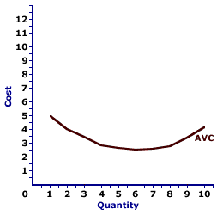
Short Run Average Variable Cost
Average Variable Cost (AVC) is Total Variable Cost (TVC) divided by the Number of Units of Output Produced.
Referred to “Variable Cost per units of Output
Average Variable Cost fall s as Output increases from O to Normal Capacity of Output due to occurrence of increases returns.
Beyond Normal Capacity of Output ,AVC rises steeply as Diminishing returns occurs.
AVC first Falls, reaches its minimum and then rises again.

Slide 29
Short Run Average Total Cost
Average Total Cost is the sum of Average Variable Cost & Average Fixed Cost.
ATC=AVC+AFC
It is refers to as “Total Cost per Units of Output”
Behaviour of ATC is depand on Behaviour of AVC&AFC.

Slide 30
Short Run Average Total Cost
Since in beginning , Both AVC &AFC Falls, therefore , ATC also Falls.
When AVC increase ,AFC decrease,ATC continues to Falls AFC > AVC.
As Output increase ,AVC increase and thus AVC>AFC and hence ATC increase.
ATC is “U” Shapes curve

Slide 31
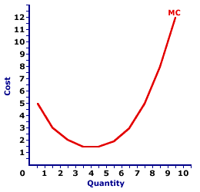
Short Run Marginal Cost(SMC)
Marginal Cost is the addition made to the Total Cost by Production of a Additional Units of Output.
MC=TCn-TCn-1
Marginal Cost is the independent of Fixed Cost.
Marninal Cost first Decline , reaches minimum & then rises.

Slide 32
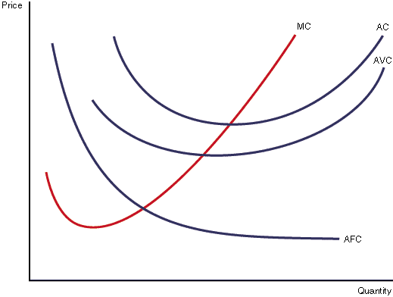
Short Run Average & Marginal Cost Curves

Slide 33
Cost Schedule
Total Cost | Total Fixed Cost | Total Variable Cost | Total Cost (2+3) | Average Fixed Cost (2/3) | Average Variable Cost (3/1) | Average Cost (5+6) | Marginal Cost
1 | 2 | 3 | 4 | 5 | 6 | 7 | 8
0 | 30 | 0 | 30 | - | - | - | -
1 | 30 | 10 | 40 | 30 | 10 | 40 | 10
2 | 30 | 18 | 48 | 15 | 9 | 24 | 8
3 | 30 | 24 | 54 | 10 | 8 | 18 | 6
4 | 30 | 32 | 62 | 7.5 | 8 | 15.5 | 8
5 | 30 | 50 | 80 | 6 | 10 | 16 | 18
6 | 30 | 72 | 102 | 5 | 12 | 17 | 22

Slide 34
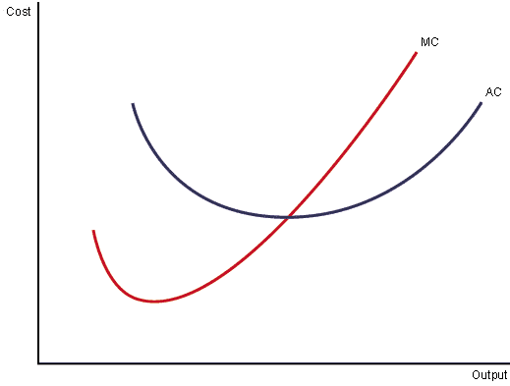
Relationship Between Average Cost(AC) And Marginal Cost(MC)
When Marginal Cost is less then Average Cost ,Average Cost is Falling.
When Marginal Cost is greater then Average Cost,Average Cost is Rising.
The Marginal Cost Curve must cut the Average Curve at AC’s minimum point and from below.

Slide 35
Long Run Average Cost Curves
Long Run is a period of time during which the firm can vary all of its Outputs.
The fims moves one plant to another in Long run. To increase the Output,Firm acquires Big plants .
Long Run Cost of Production is the least possible Cost producing any given level of Outputwhen all individual factors are Variable.
The minimum Point on LRAC Curve is the “Minimum Efficient Scale”.

Slide 36
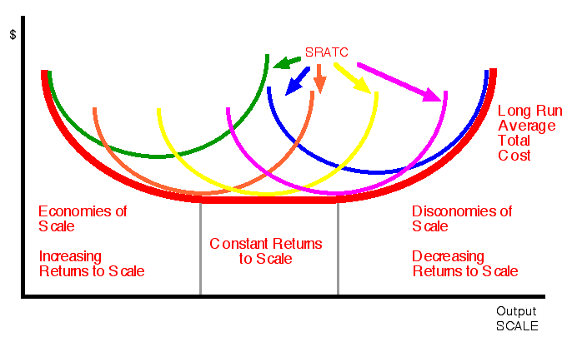
Long Run Average Cost Curves

Slide 37
Long Run Cost Curves
Long Run Cost Curve depicts the functional relationship between Output and Long run cost of Production.
It envelopes the set of U-Shaped Short Run Average cost Cureve corresponding to different Plan size.
Long Run Cost Curve is “U-Shaped” , reflecting economies of Scale (or increase rate of Scale) when Negatively Sloped and Diseconomies of Scale(or decrease rate of Scale) when Positively Slpoed.

Slide 38
Long Run Average Cost Curves
Every Point on the long run cost curve is a tengency point with some Short run Average Cost Curve.
Long Run Cost Curve not tengent to the minimum poine of the Short Run Cost Corve.
Long Run Cost called as “Planning Curve” as a Firm plan to produce any Output in the Long run by choosing a plant on the Long Run Average Cost Curve corresponding to the given Output.

Slide 39
THANK YOU

