Slide 1
Rural Banking
BASED ON MARWAR GRAMIN BANK

Slide 2
Our Mission
Mission is to transform into a Bank with sound financials committed to overall economic development of rural areas with technical development , care, competence and compassion towards its customers

Slide 3
To stage a turn around in profitability and NPA reduction, to double the flow of credit to agriculture, to achieve a quantum jump in savings bank deposit mobilisation, to ensure saturation of villages in our service area, to connect branches with core banking , Bank into the most preferred techno banking outlet in rural areas.

Slide 4
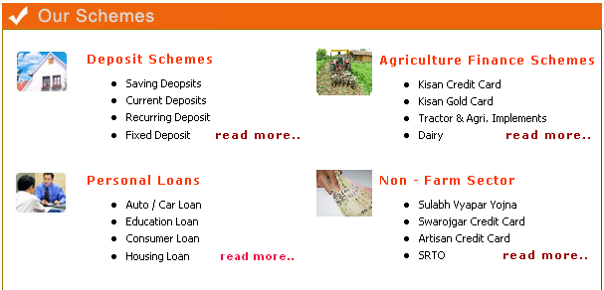

Slide 5
MGB Gramin Bank Savings Deposit Scheme
Liquidity of funds
Regular growth of money

Slide 6
MGB Gramin Bank Current Deposit Scheme
Liquidity of funds.
Banking convenience to business.

Slide 7
MGB Gramin Bank Recurring Deposit Scheme
Regular saving every month.
Higher returns on savings.
Interest compounded at quarterly rest.
0.5% additional interest to senior citizens.

Slide 8
MGB Gramin Bank Fixed Deposit Scheme
Parking of surplus fund for a certain period to fetch maximum return.
Period ranging from 15 days to 10 years.
0.5% additional interest to senior citizens.

Slide 9
Kisan Credit Card
Working Capital for crop, seeds ,fertilizers diesel ,pesticides Etc
Finance for consumer purpose like education of children's electric bills etc.
Renewal after 5 year

Slide 10
Kisan Gold Card
Advance on the basis of agriculture land and income of farmer
Finance for land development , purchase of Machinery
Repayment 6 to 7 year

Slide 11
Tractor & Agri.Impliments
Advance for tractor , Thrasher , Power Tillers etc.
Land holding 8 acres
Repayment 6 to 9 year

Slide 12
Dairy
Purchase of Buffaloes, Cows and cross breed Cows
Finance as per Unit cost
Repayment 5 year

Slide 13
Housing Loans
Wide range of requirements addressed
You can avail up to Rs.20 lacs for buying/constructing your dream house

Slide 14
Auto Finance / Car Loan
Loan facility is available for Agriculturist and Non-agriculturist customers
Loans available up to Rs 5 Lakhs for any new car make/model

Slide 15
Education Loans
For students in India - maximum Rs.7.50 Lacs
For students abroad - maximum Rs.15 Lacs

Slide 16
Consumer Loans
Avail of up to Rs. 1.5 Lacs for any kind of product.
All the salaried persons of Govt. / Semi-govt. or reputed organisation, can apply for this loan

Slide 17
MGB Sulabh Vyapar Yojna
Working capital to traders
Calculation on projected sales

Slide 18
Swarojgar Credit Card
Loan for investment and working capital
Repayment for term loan 60 month

Slide 19
Artisan Credit Card
Loan for investment and working capital
Limit for 3 year

Slide 20
Small Road & Water Transport Operation
Advance for Tempo, Auto Rickshaw, Taxi Car/Jeep, Truck etc.
RTO Permit necessary

Slide 21

Micro Credit
Through a wide range of micro-credit and micro-savings offerings, ICICI Bank already touches the lives of millions of low-income households across India, and is looking ahead to expand its services in the future.

Slide 22
MICRO FINANCE
Micro finance is not new to State Bank of India. Bank’s association with non-government organizations (NGOs) or voluntary agencies in extending financial help can be traced as far back as 1976 well before NABARD introduced SHG-Bank Credit Linkage Programme as a pilot project in 1992.

Slide 23
SELF HELF GROUP’S
SBI is maintaining its position as a leader among Commercial Banks in credit linking of SHGs and is a prime driver for the movement. As at the end of March 2010, SBI with a share of approximately 31% of total SHGs financed by Commercial Banks, is far ahead of others

