Slide 1

LESSON - 3
PRINICPLES AND METHODS OF BANK FINANCE

Slide 2

ROLE OF BANKS
BANK PLAY A VERY CRUCIAL ROLE IN THE ECONOMIC GROWTH OF COUNTRY.
PROVIDING FUNDS IN THE FORM OF BANK CREDIT.
BANK WITH THEIR WIDE NETWORK ASSIST IN INDUSTRIALISATION.

Slide 3
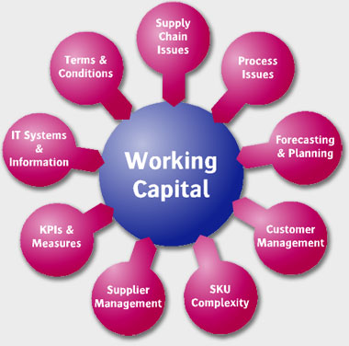

Slide 4

WORKING CAPITAL
THE FUNDS REQUIRED TO MEET DAY-TO-DAY OPERATIONS IS KNOWN AS THE WORKING CAPITAL REQUIREMENT.

Slide 5
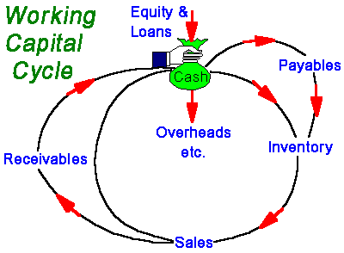

Slide 6

CALCULATING WORKING CAPITAL

Slide 7
ORGANISATION REQUIRE FUNDS FOR FOLLOWINGS
FOR CREATION OF FIXED ASSETS.
FOR MEETING THE WORKING CAPITAL REQUIREMENT.
BANK EXTEND LOANS FOR BOTH THESE PURPOSES.

