Slide 1
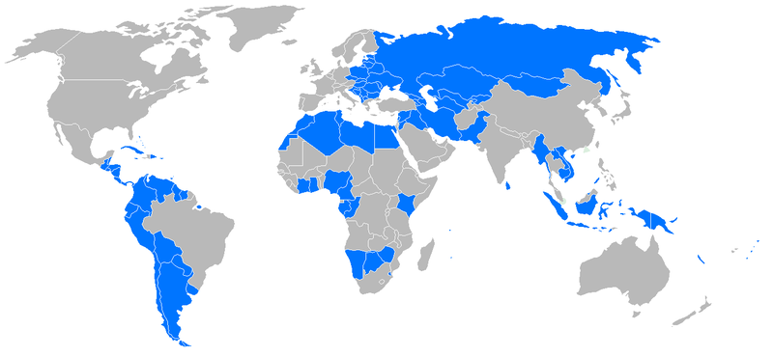
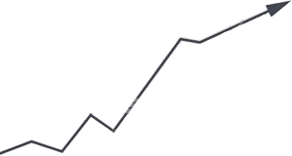

Purnendu Kayal
Payel Manna
Kuntal Ghosh
Kalyan Sarkar
Saurav Mishra
Rajesh Paul
MARKET
EMERGING

Slide 2


EMERGING MARKET
It is a market which is not so, developed but it’s on the way of being developed.
This type of markets are seen in less developed or developing countries.
It’s generally based on some emerging sectors of economy, these are known as “sunrise sectors” like BFSI(BANKING,FINANCIAL SECTOR & INSURANCE) & Retail sectors in India.
Based on market size, India holds second position,only next to China.

Slide 3
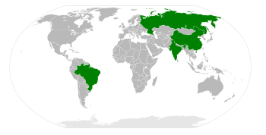
BRIC
(BRAZIL,RUSSIA,INDIA,CHINA)

Slide 4
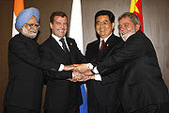
BRIC:AN OVERVIEW
Countries encompass 24% of world land coverage.
Hold 40% of world population
Combined GDP was $15.435 trillion in.
Goldman sachs argues by 2050 it will be most dominant economies.
On 16th june,09,countries held their first summit to form political club in Yekaterinburg, Russia
China & India are global giant in manufacturing & service.
Brazil & Russia are dominant global suppliers of raw materials.
Some time, India & China are called together “CHINDIA” to represent ASIAN BRIC.

Slide 5
FACTS & FIGURES
OF BRIC
PARICULARS | BRAZIL | RUSSIA | INDIA | CHINA
AREA | 5th | 1st | 7st | 3rd
GDP-NOMINAL | 10th | 8th | 12th | 3rd
POPULATION | 5th | 9th | 2nd | 1st
GROWTH RATE | 81th | 69th | 28th | 16th
EXPORT | 21th | 11th | 23rd | 2nd
IMPORT | 27th | 17th | 16th | 3rd
RECEIVED FDI | 16th | 12th | 29th | 5th
EXCH.RESERVE | 7th | 3rd | 4th | 1st
ELCTRICITY CONSMP. | 10th | 3rd | 7th | 2nd
M.PHONE USER | 5th | 4th | 2nd | 1st
INTERNET USER | 5th | 11th | 4th | 1st

Slide 6
BRAZIL: with full of Zeal
World largest emerging market as measured by MSCI Global emerging market index.
Size of the market is $509.1 billion with free float capitalization.
World 10th largest market in terms of volume.
While US grew less than 1% in 2008,Brazil grew by 5.1%.
Heavy internal demand & independence from America make it more powerful in economic reform.
In 2008 it lent IMF $ 10 billion for the first time, although it used to borrow loan from IMF previously.
GDP%

Slide 7
RUTHLESS RUSSIA

Slide 8
RUSSIA IN A NUTSHELL
World largest country with 9th populous country in the world.
The country is a permanent member of G8,G20,APEC,EurAsEC.
Estimated GDP in 2008 was $1.676 trillion USD,with per capita income of $11807 USD.
It has world largest resource of mineral & energy power.
Has world 3rd largest foreign exchange reserve along with world largest forest reserve.

Slide 9
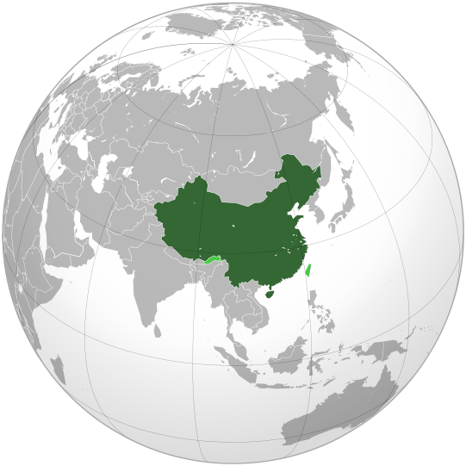
CHALLENGING CHINA

Slide 10
CHINA:AN OVERVIEW
Largest country in the east-Asia & most populous in the world with over 1.3 billion people.
Has world 3rd largest nominal GDP at 4.32 trillion USD,with per-capita income 3259 USD in 2008.
Primary ,secondary, tertiary industries contribute 11.3%,48.6%,40.1% respectively in 2008.
World 3rd largest trading power only behind US & Germany with 2.56 trillion USD.
It has world largest foreign exchange reserve with 2.1 trillion USD.
One of favorites destination of FDI, attracted 80 billion USD in 2007.
Only 10% of the population is below poverty level (below from 78% in 1978) of 1 USD due to rapid industrialization.

Slide 11
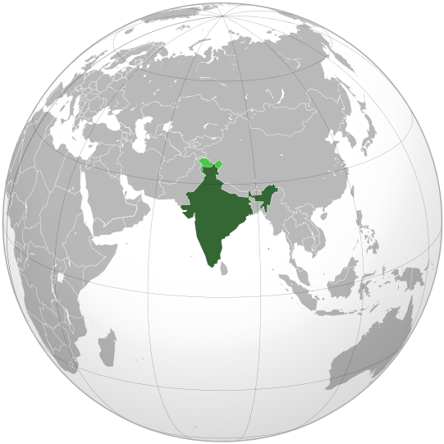
IRRESISTIBLE INDIA

Slide 12
AN INSIGHT OF INDIA
Seventh largest country by area & 2nd populous country in the world.
Average GDP is 9%,it was 12.06 trillion USD & per capita income was 1017 USD in 2008.
It’s 12th largest economy at market exchange rate & 4th largest in purchasing capacity.
Since the economic reform in 1991,it has been a one of the rapid growing countries.
Since its large population with qualified English speaking people, India has become one of the majors of offshoring.

Slide 13

MARKET INDICATORS
Movement of sensex
Movement of nifty
Other sartorial indices
Inflows of foreign capital by FIIs(foreign institutional investors).
Capital inflows by DIIs(domestic institutional investors).
Rate of GDP
Per capita income
Performance of Indian depositary receipts

Slide 14
COMPARISON parameters
Price earning ratio: earning per share/market price of share.
  Indicates profitability & investment turnover period.
  PE ratio of Indian market is 18,which is higher than Russian & Korean market.
  India has fifth highest PE ratio in the world.
Cash earning ratio: price per share/cash flow per share.
  Indicates future market’s expectations
  India has second highest CE ratio(13.8), next to Israel.
Market capitalization(MC) to GDP ratio:MC is market value of shares * no. of shares unpaid.
  Indicates investment propensity
  India’s market is 50% of GDP

Slide 15

FACTORS EFFECTING INDIA
Population
Growth rate(9% of GDP)
Concentration on social infrastructure
Policy liberalization
Sophisticated demand
Man power
Strong fundamentals of economy
Rapid rate of industrialization
Increasing purchasing capacity

Slide 16

key sectors IN INDIA
Banking sector
Finance sector
Insurance sector
Back-end retail sector
Logistic sector
Renewable energy sector
Education sector
Transportation sector
Telecommunication sector
Hospitality sector
R&D sector

Slide 17
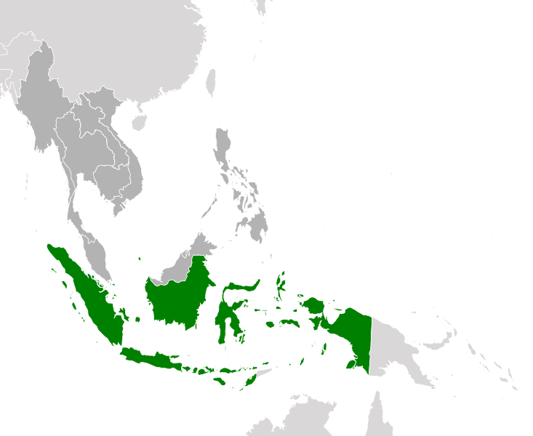
SOUTH EAST ASIA

Slide 18
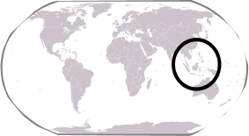
Impressive
INDONESIA

Slide 19
AN OVERVIEW
Has largest economy in the south-east Asia.
It’s a member of G-20 major countries.
Estimated GDP in 2008 was $511.765 billion with per capita income of $2239.
Economy has been growing @ 7% in average.
Service sector , followed by industry, agriculture are the significant contributors to GDP.
Country has extensive resource of crude oil, natural gas, tin ,copper.
Though the country was hit by East Asian financial crisis in 97-98 but it tide over the crisis.

Slide 20
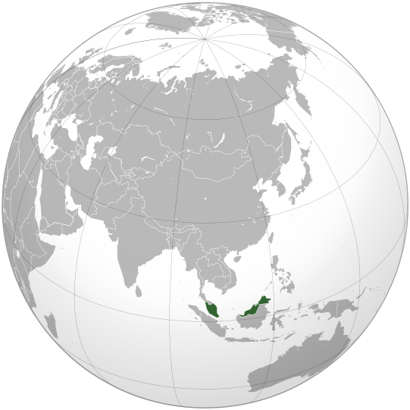
Magnificent
MALYASIA

Slide 21
EMERGING MARKET
& MALYASIA
In 2008 it’s recognized as “newly industrialized country”.
Estimated GDP in 2008 was $221.606 billion USD, with per capita income $8118 USD .
It’s recognized as world largest computer hard disk manufacture.
Besides, it exports Rubber, Palm oil & Tin to other Asian countries.
Annual growth of the country is 7% in average.
Second developed country in south-east Asia only after Singapore.

Slide 22
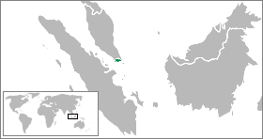
STUNNING SINGAPORE

Slide 23
SINGAPORE
Despite the smallest nation in south-east Asia, its one of the “FOUR ASIAN TIGERS”.
It’s 5th wealthiest country in terms of GDP per capita in 2008 & has foreign exchange reserve of 174.2 billion USD in the same year.
Economy heavily depends on export & refining imported goods, especially manufacturing(26% of GDP).
It has become a hub of financial investment because of its bearish economy.
estimated GDP was 181.939 billion USD,with per capita income of $38972.
Its known to be one the tenth most expensive city to live in (as per economist intelligence unit )

Slide 24
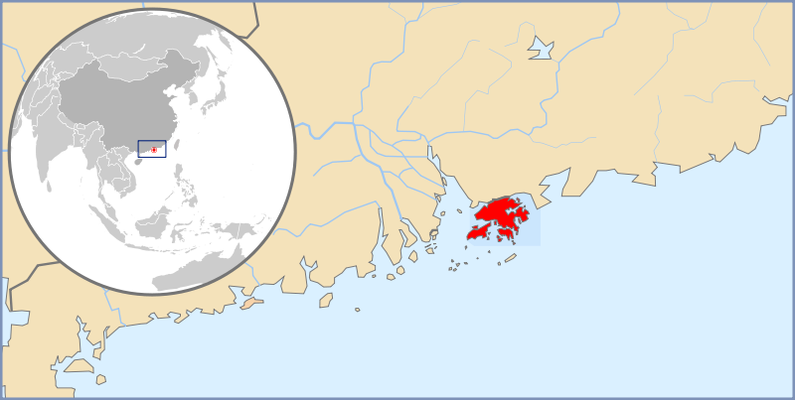
HEAVENLY
HONGKONG

Slide 25
It’s world one of the largest financial centers, with market capitalization of 2.97 trillion USD as on Oct,07.
Its known to be world freest economy by Index of economic forum for 15 consecutive years.
Estimated GDP in 2008 was 223.786 billion USD along with per capita income of 44413 USD.
Economy mostly depends on service sector, consist of 90 % of GDP.
Its world’s eleventh largest trading entity, total trade exceeds its GDP.

Slide 26
