Slide 1

IND AS 40
Investment Property
Presented by CA Yashpal M. Doshi

Slide 2
Objective
Objective of this standard is to prescribe the accounting treatment for investment property and related disclosure requirement.
The critical areas that deserve special attention are :
Exercising judgment in the determination of whether or not a property qualifies to be classified and accounted for as Investment property
Reclassification of assets, into and out of the category of investment property
Extensive disclosures

Slide 3
Owner-occupied property : (Ind AS 16)
Owner-occupied property is property held (by the owner or by the lessee under a finance lease) for use in the production or supply of goods and services of for administrative purposes.
Investment property : (Ind AS 40)
Investment property is property (land or a building – or part of a building – or both) held (by the owner or by the lessee under a finance lease) to earn rentals or for capital appreciation or both, and not held for,
(a) Use in the production or supply of goods of services or for administrative purposes or
(b) Sale in the ordinary course of business.

Slide 4
Classification of Property
Tangible Fixed Assets
Land or Building or Both
(Property)
Production/Supply of Goods/Services
Administrative Purposes
Others
(Plant and Equipment)
Rental Income/Capital Appreciation
Owner Occupied Property
(Ind AS 16)
Owner Occupied Property
(Ind AS 16)
Investment Property
(Ind AS 40)
Property, Plant and Equipment
(Ind AS 16)

Slide 5
Classification issues
Partly owner-occupied property
Property taken under operating lease
Ancillary Services
Property under construction
Investment property leased out to Holding or Subsidiary

Slide 6
Recognition
(Paragraph 16)
Investment property shall be recognised as an asset when, and only when:
it is probable that the future economic benefits that are associated with the investment property will flow to the entity; and
the cost of the investment property can be measured reliably.

Slide 7
Measurement
(Paragraph 20)
An investment property shall be measured initially at its cost. Transaction costs shall be included in the initial measurement.
The cost of a purchased investment property comprises its purchase price and any directly attributable expenditure. Directly attributable expenditure includes, for example, professional fees for legal services, property transfer taxes and other transaction costs.
The cost of self-constructed property comprises of construction & development cost at the date when the construction is complete.

Slide 8
Cost Evaluation
What to include?
What to exclude?
Initial acquisition cost
Non-refundable duties & taxes
Costs incurred subsequently to add to, replace part of, or service a property
In case of acquisition of investment property through replacement, then the cost of replacing part of an existing investment property
Cost of day-to-day servicing of such property
Cost of day-to-day servicing may include primary cost of labour and consumables, and may include the cost of minor parts i.e. Repair & Maintenance, these costs are to be recognised in P&L as incurred

Slide 9
Acquisition of Investment property on deferred payment
If payment for an investment property is deferred, its cost is the cash price equivalent. The difference between this amount and the total payments is recognised as interest expense over the period of credit.
Example :
X Ltd. acquired an investment property under defer payment plan:
Down payment on date of acquisition Rs. 50,00,000
After 6 months Rs. 1,20,00,000
After 1 year Rs. 5,00,00,000
The incremental borrowing rate of the company is 11%.
What is the cost of investment property at initial recognition? How should X Ltd. account for the difference?

Slide 10
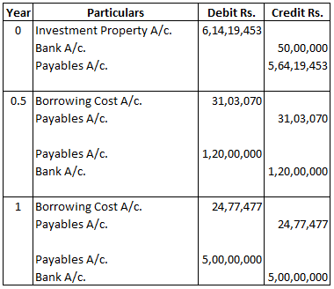
Solution :

Slide 11
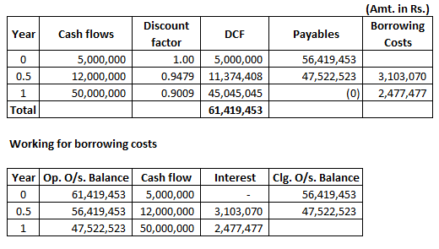
Workings :

Slide 12
Measurement of property acquired in exchange transaction
If the fair value of the asset received in more clearly evident, then the entity recognises the investment property at its fair value at initial reco gnition.
Otherwise, it is measured at fair value of the asset given up.
If the acquired asset is not measured at fair value, its cost is measured at the carrying amount of the asset given up.

Slide 13
Transfer i.e. Change in Use
(Paragraph 57)
Transfers to, or from, investment property shall be made when, and only when, there is a change in use, evidenced by:
Commencement of owner-occupation, for a transfer from investment property to owner-occupied property;
Commencement of development with a view to sale, for a transfer from investment property to inventories;
End of owner-occupation, for a transfer from owner-occupied property to investment property; or
Commencement of an operating lease to another party, for a transfer from inventories to investment property.

Slide 14
Disposals
(Paragraph 66)
An investment property shall be derecognised (i.e. eliminated from the balance sheet) on disposal or when the investment property is permanently withdrawn from use and no future economic benefits are expected from its disposal.
Gains or losses arising from the retirement or disposal of investment property shall be determined as the difference between the net disposal proceeds and the carrying amount of the asset and shall be recognised in profit or loss (unless Ind AS 17 requires otherwise on a sale and leaseback) in the period of the retirement or disposal.

Slide 15
Disclosure
(Paragraph 75)
An entity shall disclose:
Accounting policy for measurement
Criteria for classification
Fair valuation of investment property by a qualified independent valuer
Any amount recognised in Profit or Loss for:
rental income
direct operating expenses
restrictions on realisability of remittance of income and proceeds of disposal
contractual obligation if any

Slide 16

Major differences between Ind AS 40 & AS 13
Ind AS 40
AS 13
Clearly distinguishes between investment property & owner occupied property
Covers property held by a lessee under finance lease
Provides examples
Provides exclusions for scope covering investment property
Covers recognition criteria under different scenario
Defines investment property
The standard is silent in respect of property held by lessee under FL
Does not give any example of investment property
No such provision in the standard
The existing standard is silent on any such treatments

Slide 17



Slide 18


