Slide 1

DU PONT ANALYSIS
Himanshu Bahl

Slide 2

Also known as
        Du Pont Identity
        Du Pont Equation
        Du Pont Model
        Du Pont Method
        Pioneered by DU PONT Company of United States
        It is a system of financial analysis which received wide spread recognition and acceptance
        It was developed by DU PONT company for analyzing and controlling financial performance
        It is an expression which breaks Return on Equity into three parts :
        Profitability (Measured by Profit Margin)
        Operating Efficiency (Measured by Asset Turnover)
        Financial Leverage (Measured by Equity Multiplier)

Slide 3

Profit Margin
Profit Margin = Net Profit
Sales
Net Profit = Net Sales – Total Cost
Cost of Goods Sold = xxx
Operating Expenses = xxx
Interest and Taxes = xxx
Total Cost = xxx

Slide 4
Asset Turnover
Asset Turnover = Net Sales
Total Assets
Total Assets = Current Assets + Fixed Assets
Inventory = xxx
Accounts Receivables = xxx
Cash and Bank Balance = xxx
Current Assets = xxx

Slide 5
Equity Multiplier
Equity Multiplier = Assets
Shareholder’s Equity

Slide 6
Return on Equity
Return on Equity = Net Profit Margin X Asset Turnover X Equity Multiplier
Return on Equity = Net Profit Sales Assets
Sales Assets Shareholder’s Equity
Return on Equity = Net Profit (or Profit after Tax)
Shareholder’s Equity

Slide 7
Return on Investment
        Helps in understanding How the net Return on Investment is influenced by the Net Proft Margin and Total Asset Turnover Ratio
Return on Investment = Net Profit Margin X Asset Turnover

Slide 8

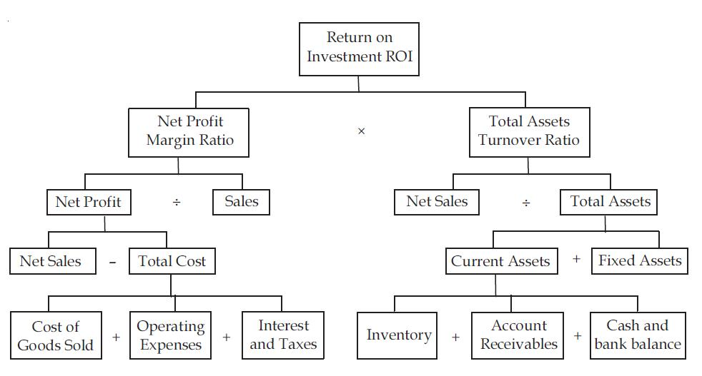
DU PONT CHART

Slide 9
Refrences
http://icwai.org/studies/Fin_Managt.aspx
        http://financenmoney.in/roi-and-the-du-pont-analysis/
        http://www.investopedia.com/terms/e/equitymultiplier.asp
        http://www.investopedia.com/terms/r/returnonequity.asp
        http://en.wikipedia.org/wiki/DuPont_analysis
        http://www.financeformulas.net/Equity_Multiplier.html
        http://www.slideshare.net/rivalheart20/du-pont-presentation
        http://www.slideshare.net/rivalheart20/du-pont-presentation
        http://www.slideshare.net/jennna/du-pont-analysis
        http://www.slideshare.net/VinitKhushalani/du-pont-analysis-19013960
        http://en.wikipedia.org/wiki/Earnings_before_interest_and_taxes
        http://en.wikipedia.org/wiki/Leverage_%28finance%29

