Slide 1
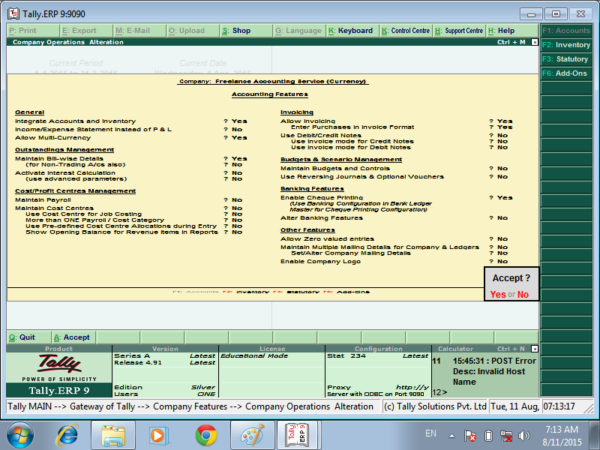

Enabling Multi-Currency
GO TO Gateway of Tally
Select F11: Accounting Features
Set Allow Multi-Currency to Yes
Accept to Save

Slide 2
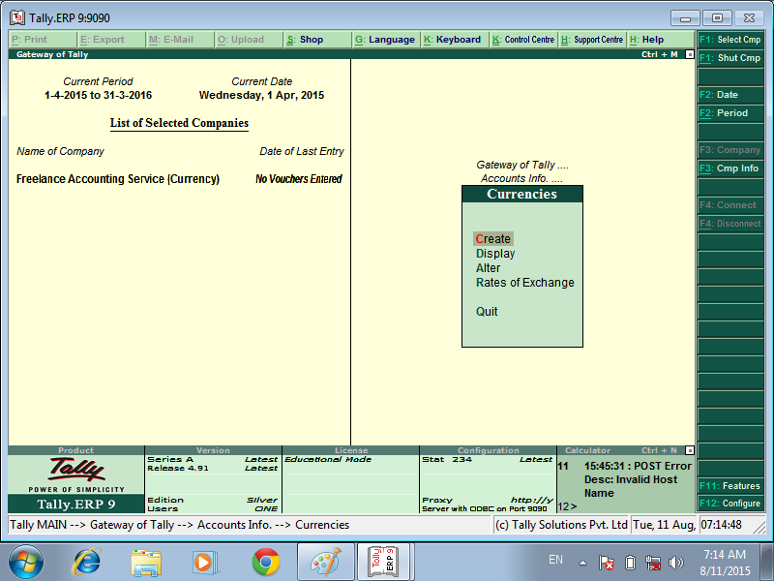
Gateway of Tally
Accounts Info
Currencies

Slide 3
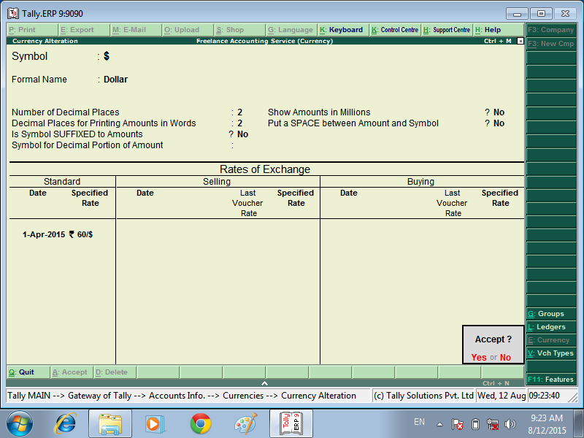
Creating a Currency

Slide 5
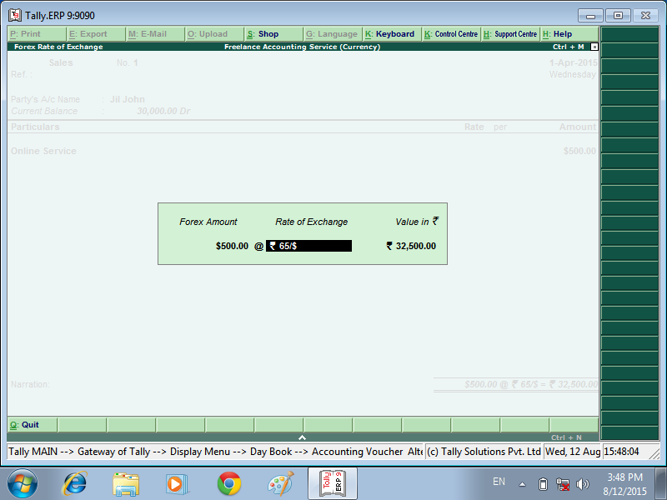
Creating a SALES Voucher
ENTER DOLLAR AMOUNT – RATE OF EXCHAGE – SHOW VALUE IN – SAVE THE VOUCHER

Slide 6
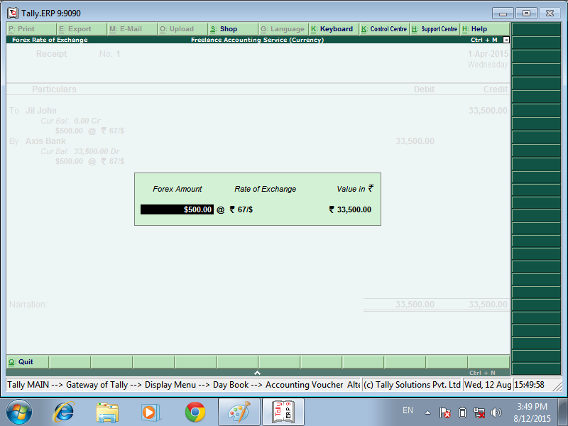
ENTER THE RECEIPT VOUCHER
ENTER RATE FO EXCHANGE
SAVE VOUCHER

Slide 7
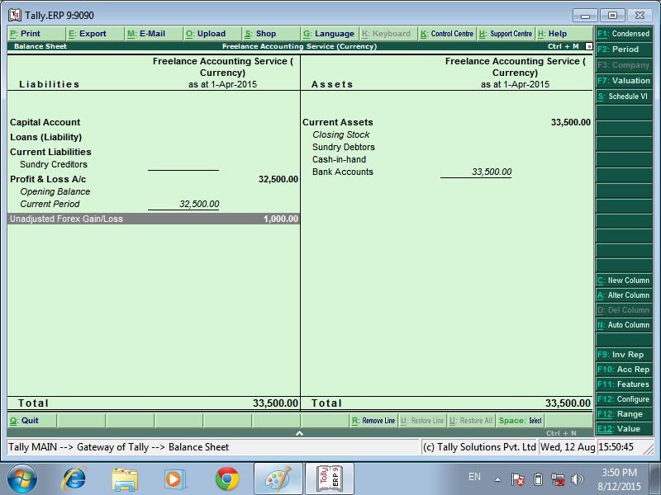
GO TO GATEWAY OF TALLY – BALANCE SHEET SHOW THE UNADJUSTED FOREX GAIN/LOSS

Slide 8
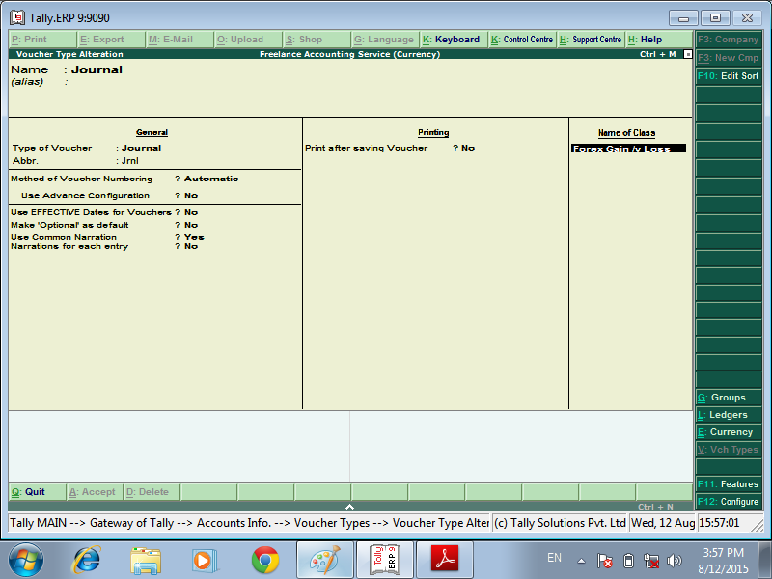
CREAT THE VOUCHER CLASS
CREAT OF CLASS
GO TO GATWAY OF TALLY ACCOUNTS INFO VOUCHER TYPE
ALTER
JOURNAL
SAVE VOUCHER CLASS

Slide 9
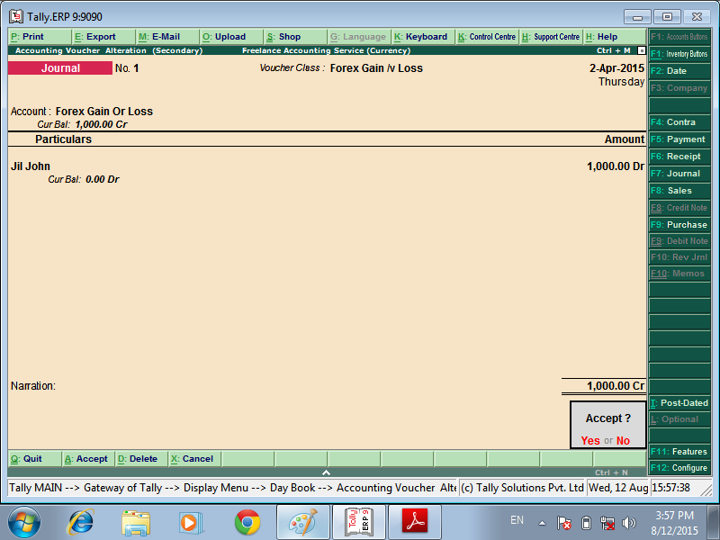
GO TO ACCOUNTING VOUCHER – PRESS F7
SELECT VOUCHER CLASS ADJUSTED – UNADJUSTED AMOUNT
SAVE

Slide 10
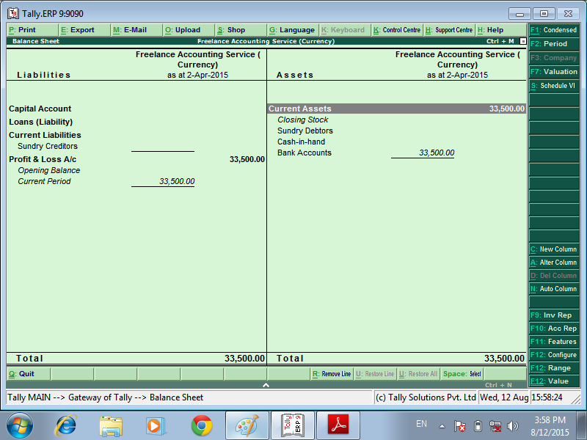
NOW ADJUSTED

Slide 11
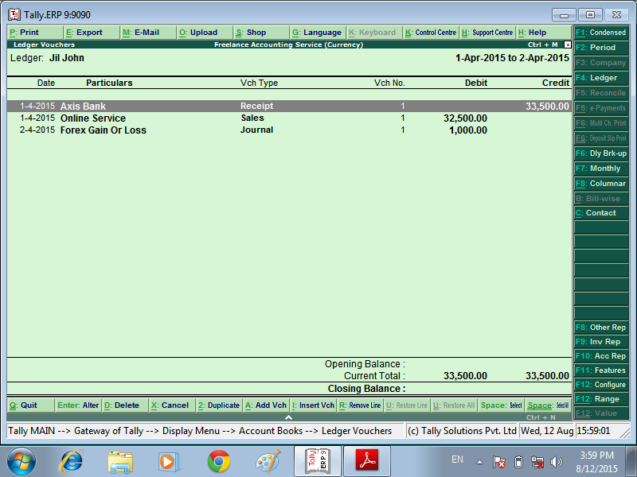
NOW SEE DEBTORS LEDGER ACCOUNT

Slide 12


