Slide 1
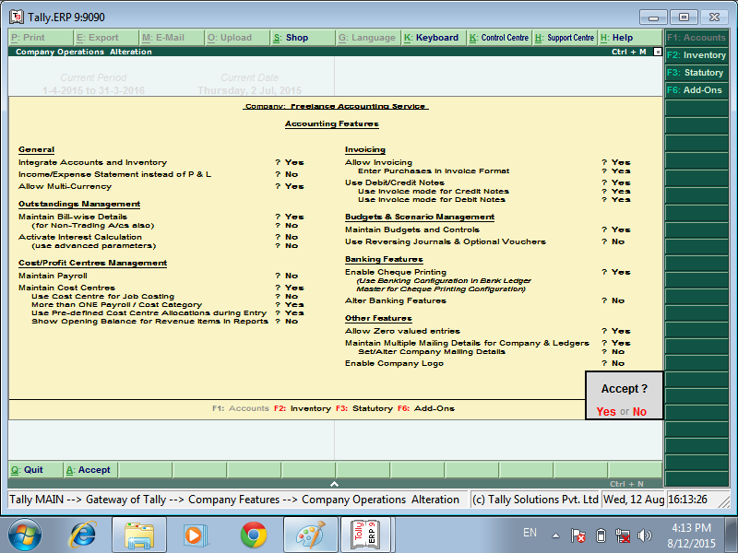

FIRST Go to F11 Features > Accounting Features > Set Maintain Budgets and Controls to Yes

Slide 2
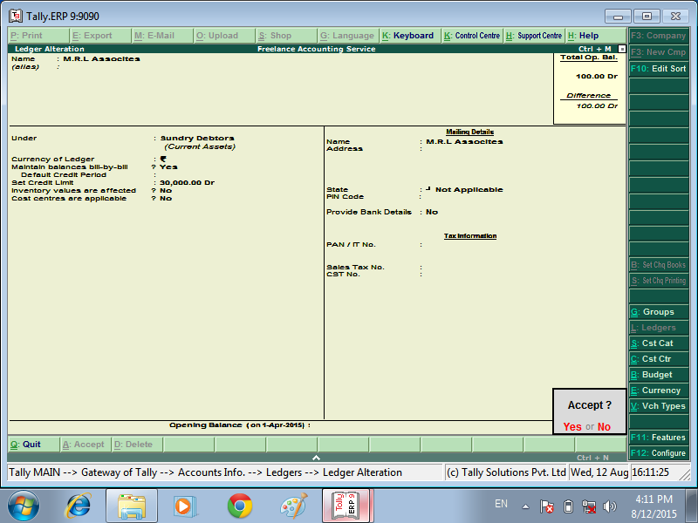
Setting Credit Limits
Go to Gateway of Tally> Accounts Info> Ledgers> Create > SET CREDIT LIMITS
ACCEPT

Slide 3
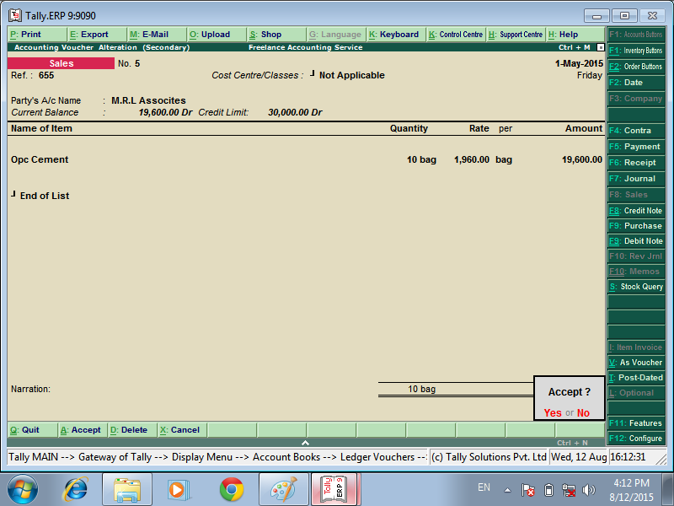
SALES VOUCHER SCREAT HOW THE CREDIT LIMIT
ACCEPT THE VOUCHER (CREDIT LIMIT VALUE ACCET THE VOUCHER)

Slide 4
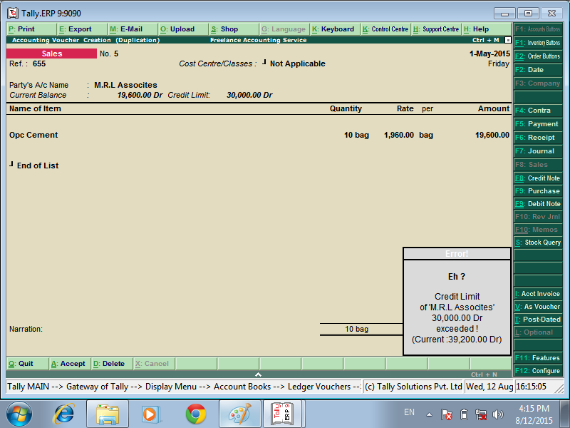
CREDIT LIMIT EXCEEDED NOT ACCEPT THE VOUCHER SHOW THE ERROR MESSAGE

Slide 5


