Slide 1
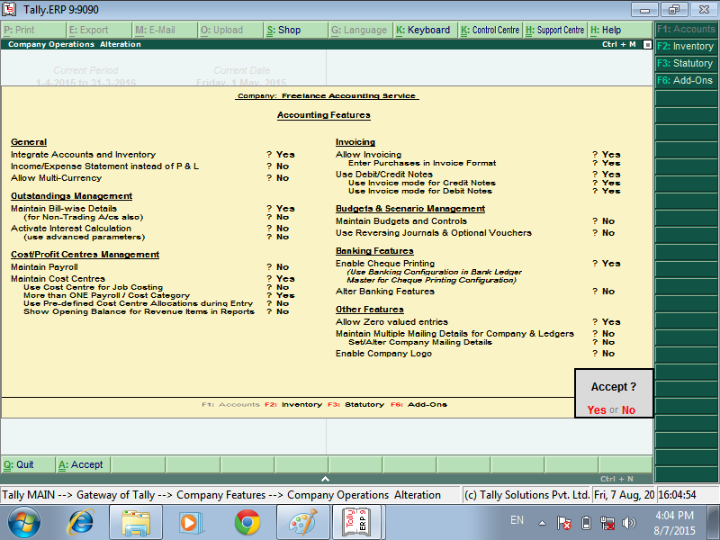



Go TO GATEWAY OF TALLY – PRESS F3 – COMPANY FEATURE – ENABLE MAINTAIN COST CENTRES

Slide 2
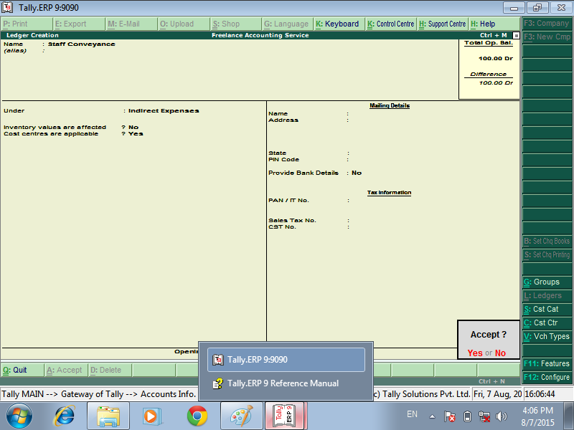

GO TO GATEWAY OF TALLY – ACCOUNTS INFO -- LEDGER – CREATE EXPENSES LEDGER – ENABLE COST CENTRES ARE APPLICABLE

Slide 3
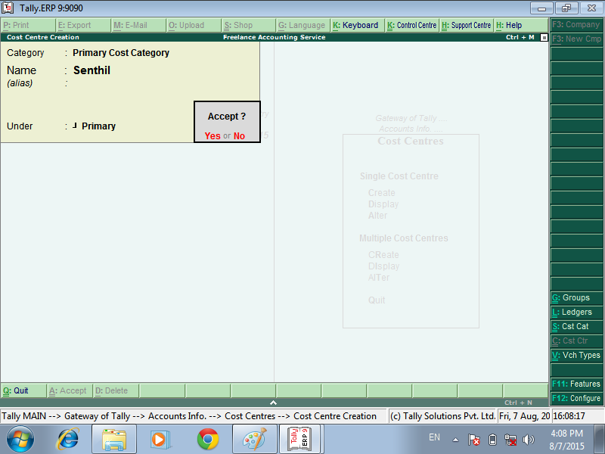
CREAT THE COST CENTRE
GO TO ACCOUNT INFO – COST CENTRES – COST CENTRE CREATION

Slide 4
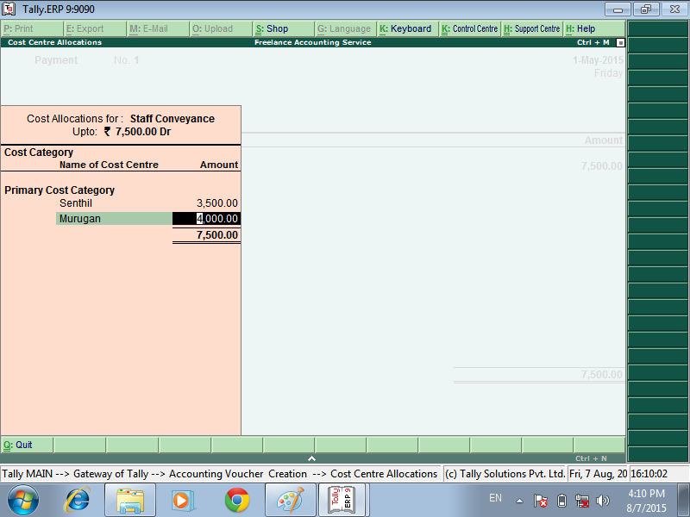
COST EXPENSES VOUCHER CREATION
GO TO ACCOUNTING VOUCHER – PRESS F5 PAYAMENT VOURCHER
SELECT DR BANK OR CASH EXPENSES PAID - CR EXPENSES LEDGER – SHOW THE COST ALLOCATIONS EXPENSES - GO SET COST CENTRE

Slide 5
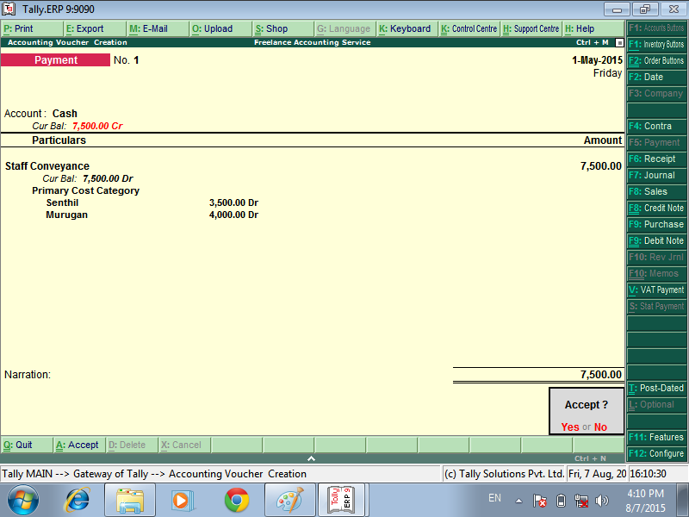
COST ALLOCATED
ACCEPT THE VOUCHER

Slide 6
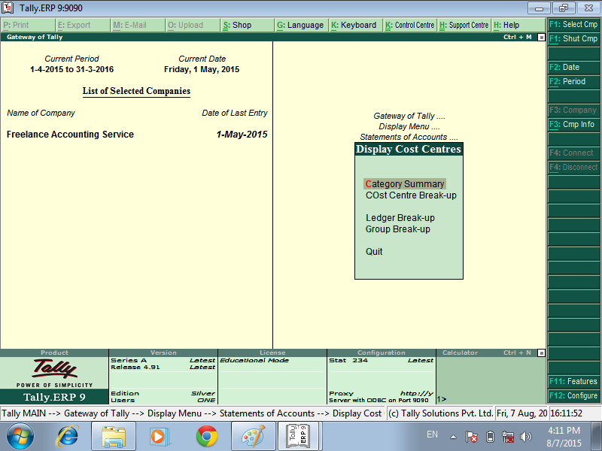
GO TO GATWAY OF TALLY
DISPLY MENU
STATEMENTS OF ACCOUNTS
DISPLAY COST CENTRES

Slide 7
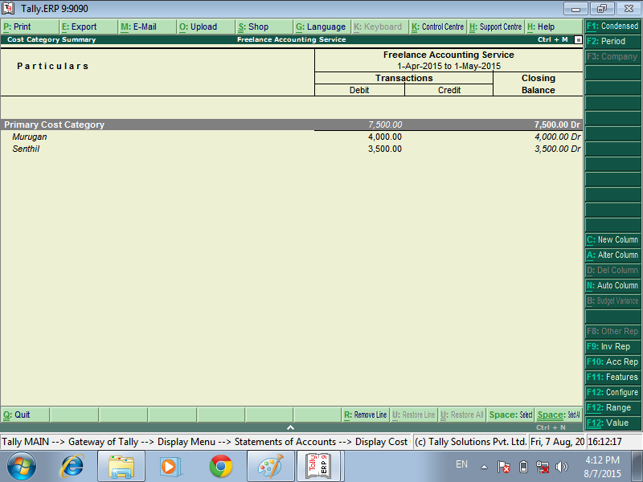
SHOW THE COST CENTRE SUMMARY

Slide 8
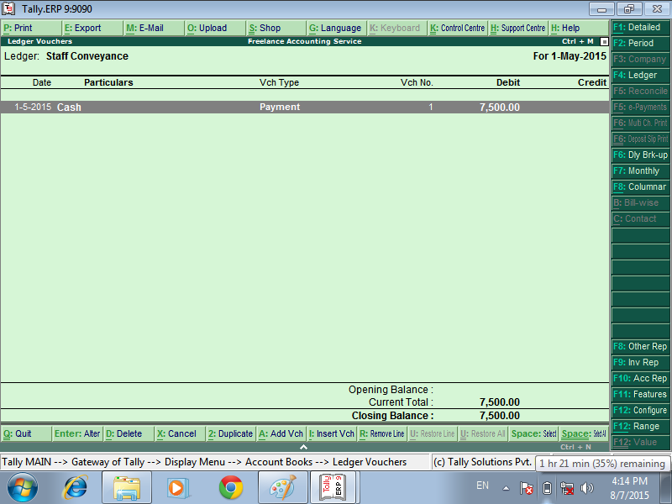
GO TO EXPENSES LEDGER – SHOW THE LEDGER

Slide 9


