Slide 1
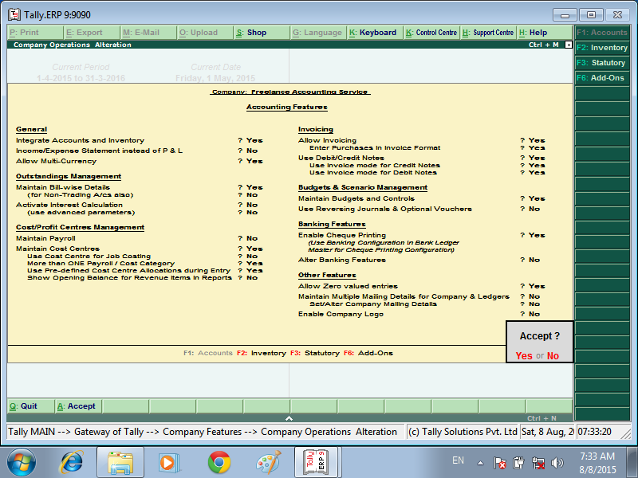

ACTIVATION BUDGETS FEATURE

Slide 2
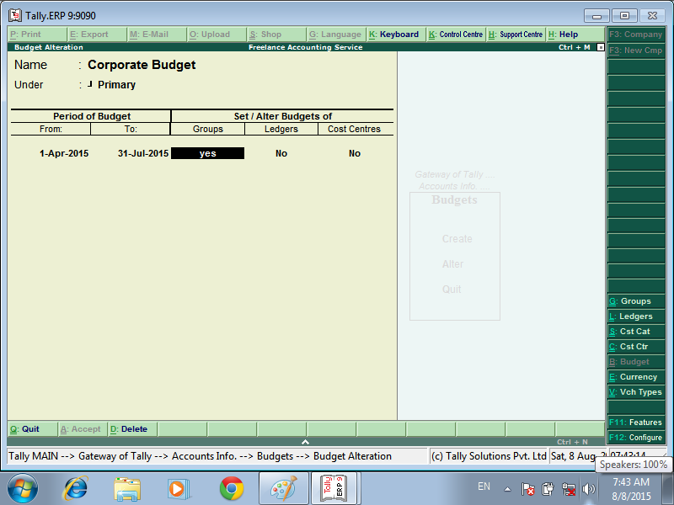
Creating Budget for Groups

Slide 3
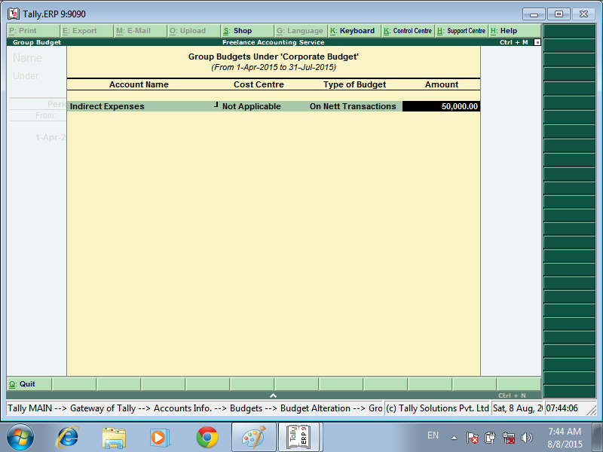
Enter the budget amount in the Amount field

Slide 4
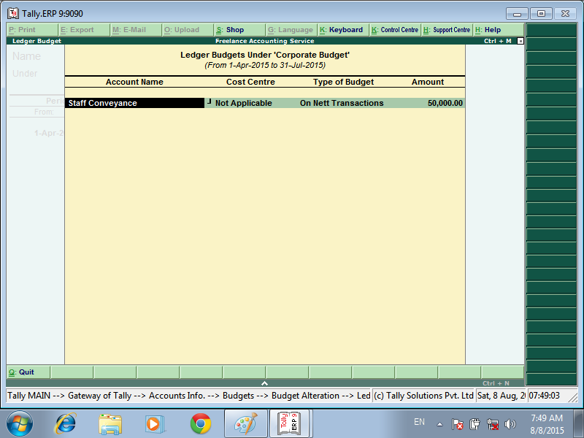
Creating Budget for Ledger AMOUNT

Slide 5
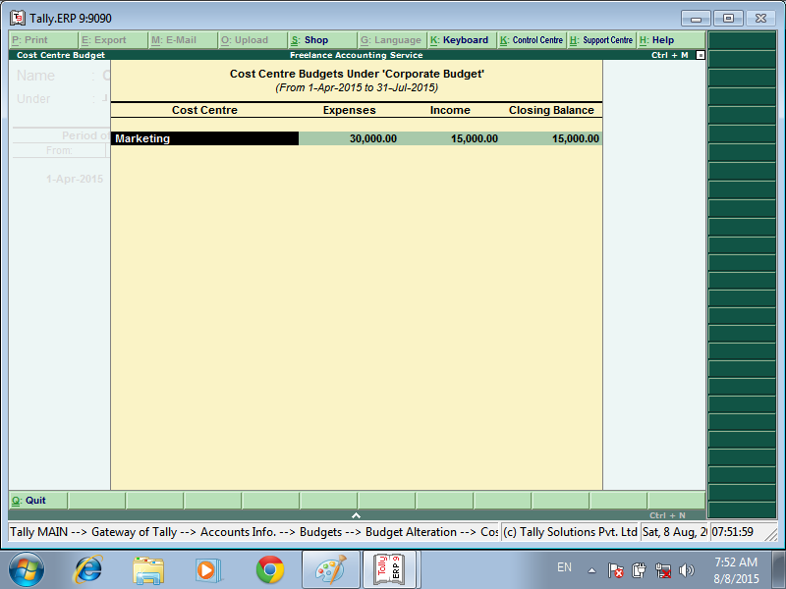
Creating Budgets for Cost Centres

Slide 6
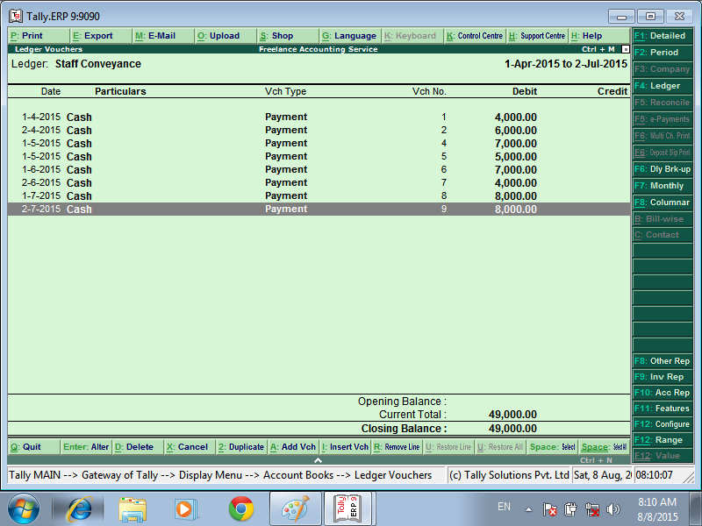
GO TO ENTER EXPENSES AND INCOME VOUCERS

Slide 7
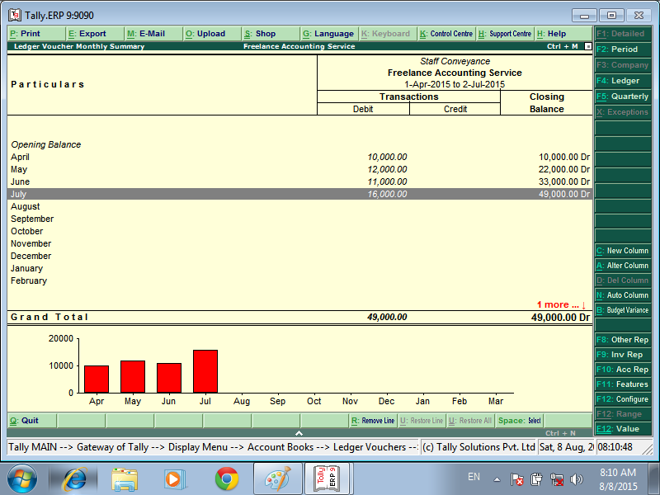
GO TO LEDGER VOCHERS – PRESS ALT + B BUDGER VARIANCE
CLICK HERE

Slide 8
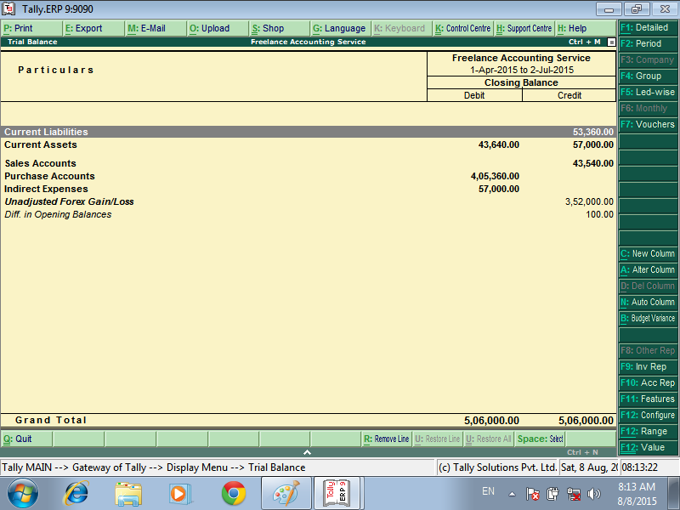
TRIAL BALANCE BUDGET VARIANCE
CLICK HERE

Slide 9


