Slide 1
RELATED PARTY AND THEIR DISCLOSURE
-BY
VISHAL KUMAR

Slide 2
AS-18 Related Party Disclosures
Need of AS on Related Party Transactions
There is general presumption that transaction reflected in the financial statements are executed on arm’s-length basis between independent parties. However that presumption may not be valid when related party relationship exist because related parties may enter into transactions which unrelated parties would not enter into.
**Arm's Length transaction means a transaction with related party like associate enterprise or branch deal as to with unrelated party. Hence there is no conflict of interest.

Slide 3
Objective of AS-18

Slide 4
Definitions under AS-18
Related Party: Parties are considered to be related if at any time during the reporting period one party has the ability to control the other party or exercise significant influence over the other party in making financial and/or operating decisions.

Slide 5
Control | Significant Influence
Ownership, directly or indirectly, of more than one half of the voting power of an enterprise, or Control of the composition of the board of directors in the case of a company or of the composition of the corresponding governing body in case of any other enterprise, or A substantial interest in voting power and the power to direct, by statute or agreement, the financial and/or operating policies of the enterprise. | Significant Influence- participation in the financial and/or operating policy decisions of an enterprise, but not control of those policies.

Slide 6
Related party transaction
Para 10 of AS 18 defines Related Party Transactions - A transfer of resources or obligations between related parties, regardless of whether or not price is charged.
Examples of Related Party Transactions:
Purchase or Sale of Goods
Purchase or Sale of Fixed Assets
Rendering or receiving of services.

Slide 7
Examples of Related Party Transactions:
Leasing or Hire Purchase Agreements
Transfer of Research and Development
Financing Transaction
Management services provided by one company to another.
Group Branding or advertising without any cost.
Use of common infrastructures such as premises, vehicles, etc. without any cost.

Slide 8
Disclosures:
Para 21
Name of the related party and nature of the related party relationship where control exists should be disclosed irrespective of whether or not there have been any transactions between the related parties.

Slide 9
Disclosures:
If there have been transactions between related parties, during the existence of a related party relationship, the reporting enterprise should disclose the following:
The name of the transacting related party;
A description of the relationship between the parties
A description of the nature of the transactions;

Slide 10
Volume of the transactions either as an amount or as an appropriate proportion
Any other elements of the related party transactions necessary for an understanding of the financial statements;
The amount or appropriate proportions of outstanding items pertaining to related parties at Balance Sheet date and provisions for the doubtful debts due from such parties at that date
Amount written off or written back in the period in respect of debts due from or to the related parties.

Slide 11
RPT AS PER COMPANIES ACT 2013
Section 188 is applicable to both private as well as public companies and is applicable with effect from 01.04.2014.
Section 188 requires a company to obtain approval of the Board and of the members, in certain situations, prior to entering of any transaction or agreement with a related party

Slide 12
MEANING OF RELATED PARTY
“Related party”, with reference to a company, means—
a director or his relative;
a key managerial personnel or his relative;
a firm, in which a director, manager or his relative is a partner;

Slide 13
a private company in which a director or manager is a member or director;
a public company in which a director or manager is a director or holds along with his relatives, more than 2% of its paid-up share capital;
any body corporate whose Board of Directors, managing director or manager is accustomed to act in accordance with the advice, directions or instructions of a director or manager;
a director or key managerial personnel of the holding company or his relative

Slide 14
any person on whose advice, directions or instructions a director or manager is accustomed to act:
Provided that nothing in sub-clauses (vi) and (vii) shall apply to the advice, directions or instructions given in a professional capacity;
any company which is—
A holding, subsidiary or an associate company of such company; or
A subsidiary of a holding company to which it is also a subsidiary;

Slide 15
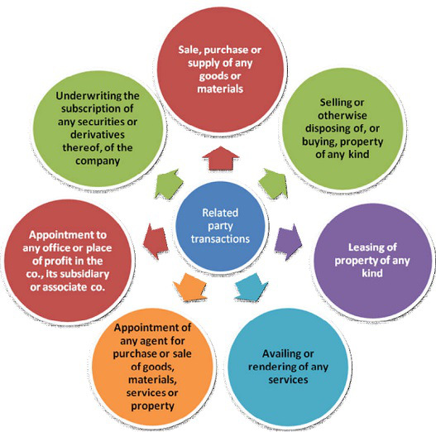
TYPES OF TRANSACTIONS

Slide 16
APPROVALS
Approval of Board of Directors
Every company needs to seek the approval of its Board of Directors for entering into any related party transaction, as listed above, irrespective of the capital of the company or the value of the transaction.
As per Rule 15 of the Companies (Meeting of Board and its powers) Rules, 2014, where any director is interested in any contract or arrangement with a related party, such director shall not be present at the meeting during discussions on the subject matter of the resolution relating to such contract or arrangement.

Slide 17
PRIOR APPROVAL OF B.O.D
In the following circumstances, in addition to approval of Board of Directors, prior approval of members by means of a special resolution must also be sought before entering into any related party transaction:
All related party transactions in case of a company having a paid-up share capital of Rs. 10 Crores or more,
Sale, purchase or supply of any goods or materials directly or through appointment of agents exceeding 25% of the annual turnover.

Slide 18
Availing or rendering of any services directly or through appointment of agents exceeding 10% of the net worth.
Appointment to any office or place of profit in the company, its subsidiary company or associate company at a monthly remuneration exceeding Rs. 2.5 Lakhs.
Remuneration for underwriting the subscription of any securities or derivatives thereof of the company exceeding 1% of the net worth.

Slide 19
Selling or otherwise disposing of, or buying, property of any kind directly or through appointment of agents exceeding 10% of net worth.
Leasing of property of any kind exceeding 10% of the net worth or exceeding 10% of turnover.

Slide 20
U/S 40A(2)b
40A(2)(a) Where the assessee incurs any expenditure in respect of which payment has been or is to be made to any person referred to in clause (b) of this sub-section, and the [Assessing] Officer is of opinion that such expenditure is excessive or unreasonable having regard to the fair market value of the goods, services or facilities for which the payment is made or the legitimate needs of the business or profession of the assessee or the benefit derived by or accruing to him there from, so much of the expenditure as is so considered by him to be excessive or unreasonable shall not be allowed as a deduction.

Slide 21
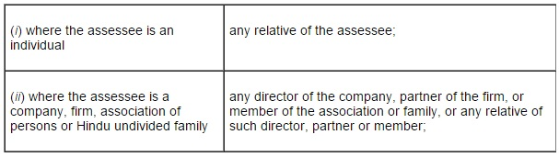
(b) The persons referred to in clause (a) are the following, namely :-
(iii) any individual who has a substantial interest in the business or profession of the assessee, or any relative of such individual;

Slide 22
(iv) a company, firm, association of persons or Hindu undivided family having a substantial interest in the business or profession of the assessee or any director, partner or member of such company, firm, association or family, or any relative of such director, partner or member;
(v) a company, firm, association of persons or Hindu undivided family of which a director, partner or member, as the case may be, has a substantial interest in the business or profession of the assessee; or any director, partner or member of such company, firm, association or family or any relative of such director, partner or member;

Slide 23
(vi) any person who carries on a business or profession,—
(A) where the assessee being an individual, or any relative of such assessee, has a substantial interest in the business or profession of that person; or
(B) where the assessee being a company, firm, association of persons or Hindu undivided family, or any director of such company, partner of such firm or member of the association or family, or any relative of such director, partner or member, has a substantial interest in the business or profession of that person.

Slide 24
THANKYOU

