Slide 1
Earnings per Share
(2001)
accounting standard 20
By:-
SHREEGANESH.S

Slide 2
OBJECTIVE
To prescribe principals for the determination and presentation of EPS.
To improve comparability
    among different enterprises for the same accounting period
    among different accounting periods for the same enterprise.
Focus is on the Denominator.

Slide 3
POTENTIAL EQUITY SHARES
A Potential Equity Share is a financial instrument or other contract that entitles, or may entitle, its holder to equity shares.
Examples:-
  Convertible debentures or preference shares
  Share warrants
  Options such as ESOP
  Shares issuable upon satisfaction of certain conditions

Slide 4
APPLICABILITY
This statement should be applied by enterprises whose :-
Equity shares or potential equity shares are listed on a recognized stock exchange in India.
An enterprise whose equity shares or potential equity shares are not listed, but which discloses earnings per share.
In the case of consolidated financial statements it should be determined & presented based on consolidated information

Slide 5
PRESENTATION
An enterprise should present on the face of Statement of P&L for each class of equity shares :-
  Basic EPS - wrt equity shares
  Diluted EPS - wrt equity and potential equity shares
Disclosure to be made for all periods presented
Both the amounts to be disclosed with equal prominence.
The information is to be presented even if the amounts disclosed are negative (a loss per share)

Slide 6
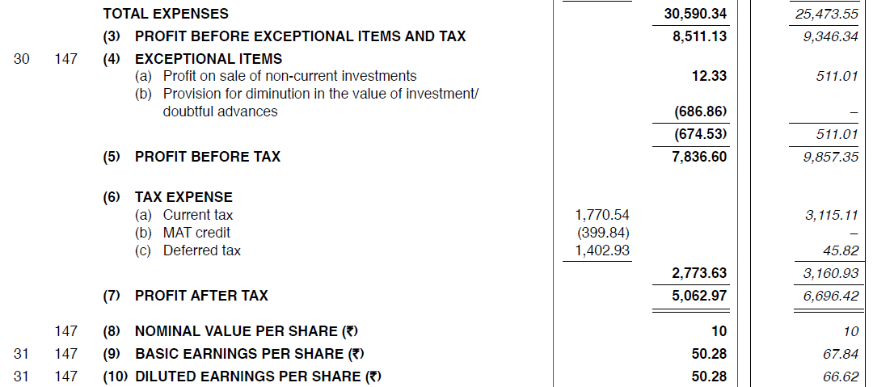

Slide 7
MEASUREMENT
Net Profit/Loss for the Period attributable to Equity Shareholders (A)
Basic EPS=
Weighted average number of equity shares outstanding during the period (B)
Where; A = Profit for the period – Preference Dividend and any attributable tax thereto.
B = Adjusted by the shares bought back or issued during the period multiplied by the time weighting factor.

Slide 8
Preference Dividend deducted for the period is:
Dividend on non-cumulative preference share provided for during the period.
The full amount on Cumulative PS for the period, whether provided for or not.
It does not include amount on Cumulative PS paid or declared during the current period in respect of previous periods.

Slide 9
Time weighting factor is the number of days for which the specific shares are outstanding as a proportion to total number of days in the period.
If an enterprise has more than one class of equity shares, net profit or loss for the period is apportioned over the different classes of shares in accordance with their dividend rights.

Slide 10
List of shares issued | Weight to be considered from
Equity shares issued in exchange of cash | Date of cash receivable
As a result of conversion of debt instrument | Date of conversion
In lieu of Interest or principal of any financial Instruments | Interest ceases to accrue
For settlement of a liability | Settlement becomes effective
Acquisition of assets | Acquisition is recognized
Rendering of services | When services are rendered
Amalgamation - Purchase | ??

Slide 11
Compute weighted average number of equity shares.
 |  | No. of shares
1st April 2013 31st Aug 2013 1st Feb 2014 31st Mar 2014 | Balance of equity shares ES issued for cash ES bought back Balance of ES | 7200 2400 1200 8400
Solution:
(7200 X 5/12) + (9600 X 5/12) + (8400 X 2/12) = 8400 shares

Slide 12
The weighted average no. of ES outstanding during the period and for all periods presented should be adjusted for events, other than conversion of potential equity shares, that have changed the number of equity shares outstanding, without a corresponding change in resources.
For example :
Matters | How addressed
Bonus Issue or Share split | Adjust weighted average to earliest period reported, as if the event had occurred at the beginning of the earliest reported period
Conversion of potential equity shares | No bonus element, since shares would have been issued for full value.
Bonus element in Rights Issue | Calculate rights factor

Slide 13
Compute Basic and Adjusted EPS:
Bonus issue on 1st Jan, 2013 – 1 equity share for each equity share O/S as at 31st Dec, 2012.
(May 2012, IPCC)
Solution:
Basic EPS 2011-12 = ₹11,40,000/5,00,000 shares = ₹2.28
Basic EPS 2012-13 = ₹22,50,000/10,00,000 shares = ₹2.25
Adjusted EPS 2011-12 = ₹11,40,000/(5,00,000+5,00,000) shares = ₹1.14
Since the bonus issue is an issue without consideration, the issue is treated as if it had occurred prior to the beginning of the year 2011-12, the earliest period reported.
Net profit for 2011-12 | ₹ 11,40,000
Net profit for 2012-13 | ₹ 22,50,000
No. of ES outstanding (31/12/2012) | ₹ 5,00,000

Slide 14
Rights Issue
Theoretical ex-right fair value per share:
Aggregate fair value of share immediately prior to the exercise of the right + Proceeds from exercise of the right
Number of shares outstanding immediately after the exercise of rights
Adjustment Factor:
Fair Value per share immediately prior to exercise of rights
Theoretical ex – rights fair value per share

Slide 15
Net profit for the year 2011 - ₹ 11,00,000
Net profit for the year 2012 - ₹ 15,00,000
No. of shares outstanding prior to rights issue – 5,00,000 shares
Rights issue price - ₹ 15
Last date to exercise rights – 1st March, 2012
Rights issue is One new share for each five outstanding (i.e. 1,00,000 new shares)
Fair value of one equity share immediately prior to exercise of rights on 1st March 2012 was ₹ 21.
Compute Basic EPS.
Solution:
Theoretical ex-rights fair value per share :
(₹ 21 X 5,00,000 shares) + (₹ 15 X 1,00,000 shares)
5,00,000 + 1,00,000
= ₹ 20

Slide 16
Computation of adjustment factor:
Fair Value per share immediately prior to exercise of rights
Theoretical ex – rights fair value per share
₹ 21
₹ 20
1.05
Original EPS for 2011- ₹11,00,000/5,00,000 shares = ₹2.20
Restated EPS for 2011 after rights issue = ₹11,00,000/(5,00,000shares X 1.05)
= ₹2.10
EPS for 2012 after rights issue:
(5,00,000 X 1.05 X 2/12) + (6,00,000 X 10/12) = 5,87,500 shares
EPS = ₹15,00,000/5,87,500 = ₹2.55

Slide 17
MEASUREMENT
Diluted Net Profit/Loss for the Period attributable to Equity Shareholders (C)
Diluted EPS=
Weighted average number of equity shares outstanding during the period (B) +
Weighted average number of equity shares which would be issued on conversion of all the dilutive potential ES (D)

Slide 18
(C) - Net Profit/Loss for the Period attributable to Equity Shareholders is adjusted for the following :
  any dividend on dilutive potential equity shares which has been deducted in arriving at net profit/loss.
  any interest relating to dilutive potential equity shares
  any other changes in expense or income that would result from the conversion of dilutive potential equity shares.
(D) - The number of contingently issuable shares included in this case in computing the diluted earnings per share is based on the number of shares that would be issuable if the end of the reporting period was the end of the contingency period.
      Dilutive Potential Equity shares shall be treated as such only when their conversion to equity shares would decrease net profits per shares from continuing ordinary operations.

Slide 19
Fair value is the amount for which an asset could be exchanged, or a liability settled, between knowledgeable, willing parties in an arm’s length transaction.

Slide 20
Net profit for 2012 - ₹24,00,000
Weighted Average number of ES Outstanding during the year 2012 – 10,00,000
Average Fair Value of 1 ES during the year 2012 – ₹25
Weighted Average number of shares under option during the year 2012 – 2,00,000
Exercise price for shares under option - ₹20
Compute Basic and Diluted EPS. (May 2013, IPCC)
Solution:
The earnings have not been increased as the total no. of shares has been increased only by the number of shares (40,000) deemed for the purpose of computation to have been issued for no consideration.
 | Earnings | Shares | EPS
Net profit for 2012 Weighted average no. of shares outstanding during the year 2012 Basic EPS Number of shares under option Number of shares that would have been issued at fair value : (2,00,000 X 20)/25 Diluted EPS | ₹24,00,000 ₹24,00,000 | 10,00,000 2,00,000 (1,60,000) 10,40,000 | ₹ 2.4 ₹2.31

Slide 21
RESTATEMENT
If there is a change in ES or PES outstanding due to:
bonus issue
share split
consolidation
These changes if occur after the Balance Sheet date but before the adoption of accounts by the BOD, the per share calculations for those and prior period should be based on the new number of shares.
    This fact should be disclosed in the Notes.

Slide 22
DISCLOSURE
The amount used as numerators and If the same is not reported as a line item in the P&L Account, a reconciliation should be provided.
The weighted average number of equity shares used as denominators for basic and diluted EPS and a reconciliation of those to each other.
The nominal value along with EPS figures.
Disclosure of basic and diluted EPS also to be made on the basis of earnings excluding extraordinary items (net of tax expense)
If an enterprise wishes to disclose more information, it must be as per Weighted average number of ES Outstanding.
Both EPS and Diluted EPS is to be disclosed with equal prominence.

Slide 23
THANK
YOU

