Slide 1

A Presentation on
BOOK-KEEPING
JAYANT SETHIA
C.A.Finalist

Slide 2

WHAT IS BOOK-KEEPING?

Slide 3

BOOK-KEEPING
The main aim of every business is to earn profit. Profit is
nothing but the excess of Income over expenditure. So to
calculate profit the businessman must record the
incomes and expenditure related to his business, this
recording of business transactions is called book
keeping. Thus book-keeping means recording, classifying
and summarizing business transaction systematically so
that the businessman may be able to know his profit or
Loss during a specified period.

Slide 4
BOOK-KEEPING
It is the recording, on a day-today basis of the financial transactions and information pertaining to a business. It is concerned with ensuring that records of those individual financial transactions are accurate, up-to-date and comprehensive. Book-keeping provides the information from which accounts are prepared but is a distinct process, preliminary to accounting. Each transaction, whether it is a question of purchase or sale, or change of loans, has to be recorded in the books.

Slide 5
BOOKKEEPING INVOLVES:
Billing for goods sold or services provided to clients.
Recording receipts from customers.
Verifying and recording invoices from suppliers.
Paying suppliers.
Processing employees' pay and the related governmental reports.
Monitoring individual accounts receivable.
Recording depreciation and other adjusting entries.
Providing financial reports.

Slide 6
WHY BOOKKEEPING?
To keep receipts or other acceptable records of every payment to and every expenditure from our business.
To summarize our income and expenditure records on some periodic basis (generally daily, weekly, or monthly).
To use our summaries to create financial reports that will tell you specific information about our business, such as how much monthly profit you're making or how much your business is worth at a specific point in time.

Slide 7
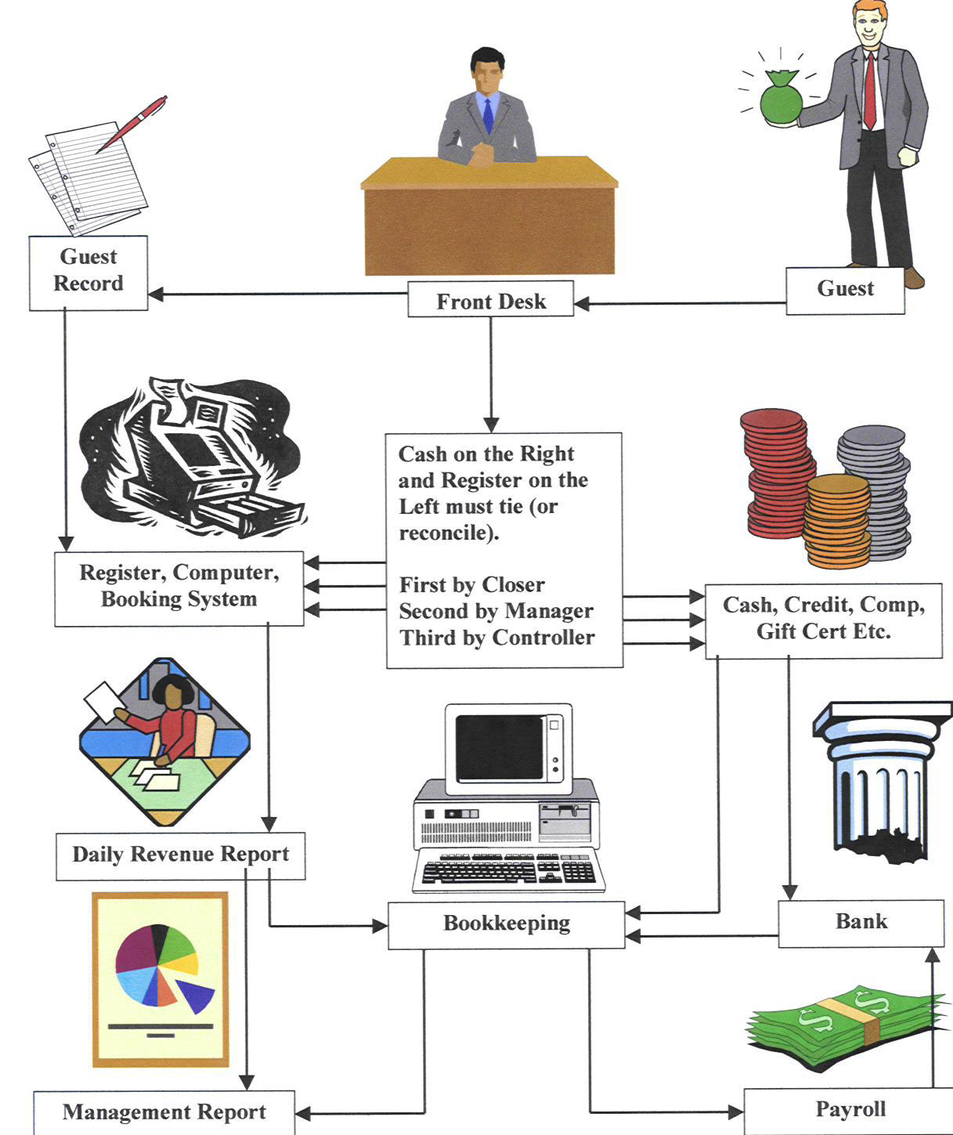
EXAMPLE OF BOOK-KEEPING CYCLE

Slide 8
TYPES OF BOOKKEEPING SYSTEMS
BOOKKEEPING SYSTEMS
SINGLE ENTRY SYSTEM
DOUBLE ENTRY SYSTEM

Slide 9
SINGLE-ENTRY SYSTEM
A Single-entry Bookkeeping System is a method of bookkeeping relying on a one sided accounting entry to maintain financial information.
Single-entry Bookkeeping System is commonly used for small businesses with very little or minimal transactions. It is often referred to as simple, practical and informal way of recording. Usually, it only maintains a record of cash disbursement, cash receipts, sales and purchases. All the rest of the accounting records, such as inventory, equipment, capital, etc., are only recorded in the form of memorandum or notes.

Slide 10
DOUBLE-ENTRY SYSTEM
A Double-entry Bookkeeping system is a set of rules for recording financial information in a financial accounting system in which every transaction or event changes at least two different nominal ledger accounts.
Double-entry bookkeeping, in accounting, is a system of bookkeeping so named because every entry to an account requires a corresponding and opposite entry to a different account.

Slide 11
METHODS OF BOOKKEEPING
BOOKKEEPING METHODS
MANUAL BOOKKEPING
COMPUTERIZED BOOKKEEPING

Slide 12
MANUAL BOOKKEEPING
Manual bookkeeping is the paper-based and traditional way of bookkeeping. Business transactions are recorded manually by hand using manual or paper book of accounts, such as journals books, ledger books and worksheets.
This method of bookkeeping is still widely used especially by small businesses with less complex transactions. Many opt to manual bookkeeping because it is cheaper and easier to maintain. However, the recording process is more tedious than computerized bookkeeping.

Slide 13
COMPUTERIZED BOOKKEEPING
Computerized bookkeeping is the new and innovative way of recording business transactions. With the use of accounting and bookkeeping software, the bookkeeping process has been made easier, faster and more convenient.
Keep in mind that principles and concepts of traditional bookkeeping process are still implemented and followed in computerized bookkeeping. It only eliminated the tedious tasks involved in manual bookkeeping, thus, it made recording and reporting of business transaction a lot faster and easier.

Slide 14
ELEMENTS OF BOOK-KEEPING
BOOKS
LEDGERS
TRIAL BALANCE

Slide 15
BOOKS INCLUDES:
JOURNAL
CASH BOOK
PURCHASES BOOK
SALES BOOK
PURCHASE RETURNS BOOK
SALES RETURNS BOOK
BILLS RECEIVABLES BOOK
BILLS PAYABLES BOOK

Slide 16
JOURNAL
When a small business makes a financial transaction, they make a journal entry in their accounting journal in order to record that transaction. The transaction is recorded in the general journal or one of the special journals for the most active accounts
Journal entries are an integral part of the accounting process for a small business. Without them, you have no cohesive record of your day-to-day financial transaction. You can't follow the money. You can't satisfy the tax authorities. You won't know your cash flow or profit. Daily journal entries are some of the most important financial records you have.

Slide 17
CASH BOOK
A financial journal that contains all cash receipts and payments, including bank deposits and withdrawals. Entries in the cash book are then posted into the general ledger. The cash book is periodically reconciled with the bank statements as an internal method of auditing.

Slide 18
PURCHASES BOOK
The Purchase Day Book records all the invoices it
receives under the following headings:
  date
  supplier
  purchase ledger folio (reference to the page number of the purchase ledger, in a manual system)
  total amount invoiced
  purchases
  analysis of purchases (e.g. telephone, electricity, etc….)
  The invoice number is not recorded because this is a record of other people’s invoices, which will have all different numbers.

Slide 19
SALES BOOK
This is the book of prime entry for credit sales, where all credit sales of the day are listed and totaled. The total is then used as a single posting entry to the sales ledger and also posted to a sales control account in a single total to tally with the underlying sales ledger. However, individual debits are posted separately in the respective sales ledger (or debtors or receivables ledger accounts).

Slide 20
PURCHASE RETURNS BOOK
This records goods which the business sends back to its suppliers. The business might also receive cash refunds. In the meantime, a debit note might be issued to the supplier. Headings for the purchases returns book would be:
date
supplier
goods
purchase ledger folio
amount

Slide 21
SALES RETURNS BOOK
When goods are returned, for whatever
reason, this is recorded in the sales returns
book. It’s headings might be:
  date
  customer
  goods returned
  sales ledger folio
  amount

Slide 22
BILLS RECEIVABLES BOOK
Definition and Explanation:
Bills payable book is used to record bill accepted by us. When a bill drawn by our creditor is accepted particulars of the same are recorded in this book.
Posting:
In the ledger, the account of each person whose bill has been accepted is debited with the amount of the bill. The monthly total of the bills accepted is credited to the bills payable account ledger.

Slide 23
BILLS PAYABLES BOOK
Definition and Explanation:
Bills receivable book is used to record the bills received from debtors. When a bill is received, details of it are recorded in the bills receivable book.
Posting:
In the ledger the account of the person from whom each bill is received is credited with the amount of that bill and the periodical total of the book is posted to the debit of bills receivable account.

Slide 24
LEDGERS
The book, which contains accounts, is known as the ledger also called the Principal Book. Ledger provides necessary information regarding various accounts. Personal accounts in ledger show how much money firm owes to the creditors and the amount it can recover from its debtors. The real accounts show the value of properties and also the value of stock. Nominal accounts reflect the sources of income and also the amount spent on various items. The financial position of the business concern can be ascertained easily at any time with the help of ledger.

Slide 25
TRIAL BALANCE
After posting the accounts in the ledger, a Statement is
prepared to show separately the debit and credit
balances such a statement is known as Trial Balance.
There are mainly two methods of preparing Trial
Balance :
1. The Totals Method – in this method the totals of each side of the account is entered in Dr. and Cr. Column of the Trial Balance
2. The Balance Method – in this method only the Dr. or Cr. Balances are entered in two columns.

Slide 26
BOOK-KEEPING
VS
ACCOUNTING

Slide 27
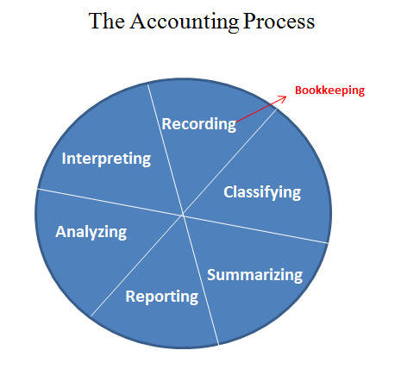
BOOK-KEEPING IS A PART OF ACCOUNTING

Slide 28
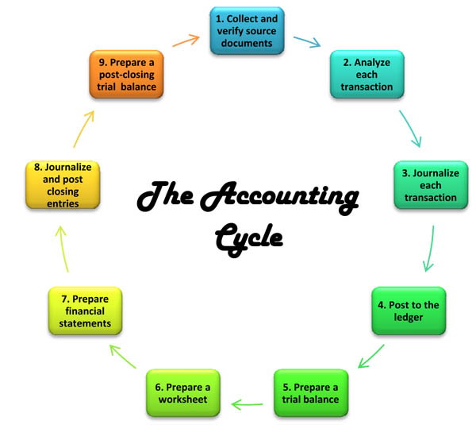

Slide 29


JAYANT SETHIA
Contact: +91-9782297977
Whatsapp:+91-8505854213
Facebook: www.facebook.com/jackysethia
E-mail: jayantsethia18@gmail.com

