Slide 1


PRESENTATION ON REVISED SCH VI
CA MANISH PANDEY
+91-9903559137
manishpandey177@gmail.com

Slide 2
REVISED SCHEDULE VI OF COMPANIES ACT,1956
[Section 211]

Slide 3

Background and legal standing
Need for enhancing disclosures, harmonising with proposed Indian Accounting Standards.
Not applicable to insurance or banking company, or any company engaged in the generation or supply of electricity.
Sec. 211 of the Act – “in the form set out in Part I of Schedule VI or as near thereto as circumstances admit”. Modifications to format possible to suit industry specific disclosures.
Notification No. S.O. 447(E), dated 28th February 2011
  Applicability period mentioned as “For the F.Y. 2010-2011”
  Lack of clarity and difficulty in application

Slide 4
Background and legal standing
Amendment to Notification No. S.O. 447(E) by way of Notification No. S.O. 653(E) dated 30th March 2011
  Deletion of applicability line and clarity in applicability criteria.
  Revised Schedule VI shall now come into force for the Balance Sheet and Profit and Loss Account to be prepared for the financial year commencing on or after 1.4.2011
Clarification vide General Circular no.62/2011 dated 5th September 2011
  Limited purpose of IPO/FPO during 2011-2012, old Schedule VI may be applied.
  For periods beyond March 2012, new Schedule VI to mandatorily take effect.

Slide 5
Background and legal standing
Interim results of listed companies – SEBI has issued new format of disclosure of interim results on 16th April 2012 in line with Revised Schedule VI.
Guidance Note to the Revised Schedule VI to the Companies Act,1956 by ICAI – Finalised Dec 2011.

Slide 6
STRIKING DISTINCTIONS
“Format” of Profit & Loss Account introduced. Horizontal format of BS, PL no longer permitted.
Current and non-current classification introduced for presentation of assets and liabilities – Liquidity based approach vis-à-vis security based approach.
Appropriations not reflected in P&L. Instead to be disclosed as a part of Reserves and Surplus.
Overriding status of AS clearly laid down. Definitions to be drawn from AS.

Slide 7
STRIKING DISTINCTIONS cont….
Concept of Schedules for break up of amounts done away with, referencing in Notes to Accounts introduced.
“Each” item in the BS, PL to be cross referenced with “any” related information. Balance to be maintained while making disclosures.
Explicit requirement that same unit of measurement be used in BSPL and Notes.
Materiality to be considered in making disclosures.

Slide 8
Particulars | Note No | Figures as at the end of current reporting period | Figures as at the end of the previous reporting period
I. EQUITY AND LIABILITIES
(1) Shareholder's Funds
(a) Share Capital
(b) Reserves and Surplus
(c) Money received against share warrants
(2) Share application money pending allotment
(3) Non-Current Liabilities
(a) Long-term borrowings
(b) Deferred tax liabilities (Net)
(c) Other Long term liabilities
(d) Long term provisions
(4) Current Liabilities
(a) Short-term borrowings
(b) Trade payables
(c) Other current liabilities
(d) Short-term provisions
Total

Slide 9
II. Assets
(1) Non-current assets
(a) Fixed assets
(i) Tangible assets
(ii) Intangible assets
(iii) Capital work-in-progress
(iv) Intangible assets under development
(b) Non-current investments
(c) Deferred tax assets (net)
(d) Long term loans and advances
(e) Other non-current assets
(2) Current assets
(a) Current investments
(b) Inventories
(c) Trade receivables
(d) Cash and cash equivalents
(e) Short-term loans and advances
(f) Other current assets
Total

Slide 10
Balance sheet - liabilities
SHARE CAPITAL
Details of authorised, issued, subscribed, paid up capital, par value per share
Reconciliation of opening and closing balances
Rights, preferences, restrictions attached to each class
Shares held by holding or subsidiaries of holding company
Names of shareholders holding shares > 5%
Shares reserved for issue under options etc.
For five years immediately preceding the date as at which the Balance-Sheet is prepared
  Details of Bonus shares, shares for non-cash consideration
  Details of shares bought back.
Terms of any securities convertible into equity/preference shares
Calls unpaid by Directors and officers and Forfeited shares

Slide 11
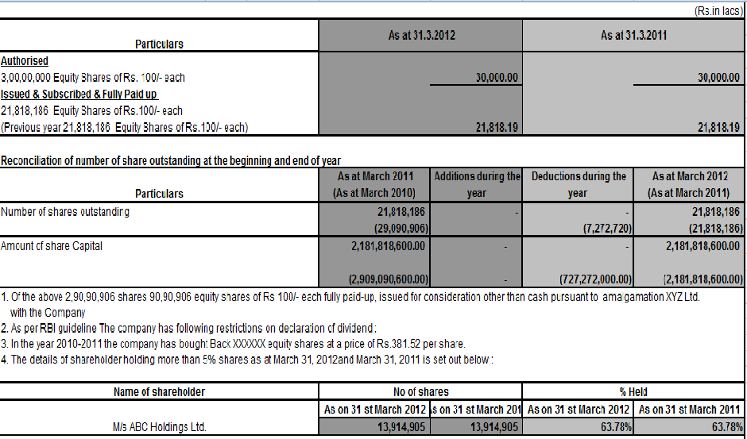
Balance sheet - liabilities

Slide 12
Balance sheet - liabilities
RESERVES AND SURPLUS
Classified into and additions / deductions since last balance sheet in:
Capital Reserves
Capital Redemption Reserve
Securities Premium Reserve
Debenture Redemption Reserve
Revaluation Reserve
Share Options Outstanding Account
Other Reserves – specifying the nature, purpose and amount
Surplus i.e. balance in Profit & Loss account disclosing allocations and appropriations
A reserve specifically represented by earmarked investments shall be termed as a ‘fund’
Debit balance of profit and loss to be shown as a negative figure under ‘Surplus’. Balance of ‘Reserves and Surplus’, after adjusting negative balance of surplus, if negative, shall still be shown under ‘Reserves and Surplus’

Slide 13
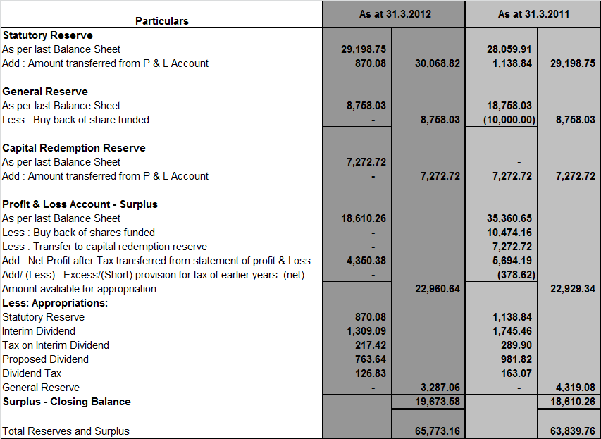

Slide 14
Balance sheet - liabilities
MONEY RECEIVED AGAINST SHARE WARRANTS
Share Warrants – Financial instruments that give the holder the right to acquire equity shares.
Ultimately would form part of Share Capital, but disclosed separately
SHARE APPLICATION MONEY PENDING ALLOTMENT
Not exceeding issued capital and to the extent not refundable to be disclosed here.
Following disclosures also required
  Terms and conditions of issue, number of shares, premium amount.
  Period before which shares are to be allotted.
  Whether the company has enough authorised capital to cover the new shares.
  Period for which application money is pending with reasons for the same.

Slide 15
NORMAL OPERATING CYCLE
  Operating Cycle – time between acquisition of assets for processing and their realisation in cash or cash equivalent. May overlap with normal working capital cycle.
  “Normal operating cycle” – In case of abnormal economic conditions, uneven business variations, classification criteria should not change. Classifications based on normal / ordinary economic conditions.
  Where normal operating cycle cannot be identified, it is assumed to have a duration of 12 months. Management has to make reasonable judgment about operating cycle.
  Multiple businesses – Normal operating cycle separately identified for every line of business.

Slide 16
Current assets / liabilities
CURRENT LIABILITIES
If any of the following is satisfied
  Expected to be settled in the company’s normal operating cycle;
  Held primarily for the purpose of being traded;
  Due to be settled within 12 months after the reporting date;
  No unconditional right to defer settlement at least 12 months from reporting date.
  Settlement in equity will not affect classification.
CURRENT ASSETS
If any of following is satisfied
  Expected to be realised or intended to be held for sale or consumption in the company’s normal operating cycle
  Held primarily for the purpose of being traded;
  Expected to be realised within twelve months after the reporting date;
  It is cash or cash equivalent unless restricted for atleast 12 months from the reporting date

Slide 17
Balance sheet - liabilities
NON-CURRENT LIABILITIES →LONG TERM BORROWINGS
Classified into-
  Bonds/debentures (alongwith details of ROI, redemption dates etc)
    Presented in descending order of maturity, farthest first and so on.
    Particulars of redeemed bonds with power to reissue to be disclosed.
  Term loans – From Banks and other parties – Terms of repayment to be stated
  Deferred payment liabilities.
  Deposits
  Loans and advances from related parties
  Long term maturities of finance lease obligations
  Other loans and advances (specify nature)
Borrowings shall further be sub-classified as secured and unsecured. Nature of security (i.e. Mortgage, Pledge & Hypothecation) shall be specified separately in each case.

Slide 18
Balance sheet - liabilities
NON-CURRENT LIABILITIES → LONG TERM BORROWINGS
Aggregate amount of loans guaranteed by Directors or others to be separately disclosed. (not restricted to related parties, but any person)
Period and amount of continuing default as on BS date to be stated in each case of repayment of loans. No need to disclose other defaults.
NON-CURRENT LIABILITIES → OTHER LONG TERM LIABILITIES.
To be classified into Trade Payables and Others
NON-CURRENT LIABILITIES → LONG TERM PROVISIONS
To be classified into Provisions for Employee Benefits and others

Slide 19
Balance sheet - liabilities
CURRENT LIABILITIES → SHORT TERM BORROWINGS
Short-term borrowings shall be classified as:
  Loans repayable on demand – From Banks and other parties
  Loans and advances from related parties.
  Deposits.
  Other loans and advances (specify nature).
Borrowings shall further be sub-classified as secured and unsecured. Nature of security (i.e. Mortgage, Pledge & Hypothecation) shall be specified separately in each case.
Aggregate amount of loans guaranteed by Directors and others to be separately disclosed.
Period and amount of default as on BS date to be stated in each case of repayment of loans.

Slide 20
Balance sheet - liabilities
CURRENT LIABILITIES → TRADE PAYABLES
Classified as trade payables if it is in respect of the amount due on account of goods purchased or services received in the normal course of business.
CURRENT LIABILITIES → OTHER CURRENT LIABILITIES
Current maturities of long term debt
Current maturities of finance lease obligations
Interest accrued but not due on borrowings
Interest accrued and due on borrowings
Income received in advance
Unpaid dividends
Application money for allotment of securities due for refund
  Meaning of “advances towards allotment” is unclear.
  Terms of issue, number of shares, premium, period before which shares will be allotted to be disclosed.
  Disclosure of sufficiency of authorised capital to cover the share application

Slide 21
Balance sheet - liabilities
CURRENT LIABILITIES → OTHER CURRENT LIABILITIES
Application money for allotment of securities due for refund
  Period and reasons for which share application money is pending to be disclosed.
  Share application money not exceeding issued capital to form part of Equity, over and above should form part of current liabilities.
Unpaid Matured deposits and interest accrued thereon
Unpaid Matured debentures and interest accrued thereon
Other payables disclosing its nature.
CURRENT LIABILITIES → SHORT TERM PROVISIONS
Provision for employee benefits
Others disclosing its nature – Prov. For income tax, Prov. For warranties etc.

Slide 22
Balance sheet - ASSETS
NON-CURRENT ASSETS → FIXED ASSETS
Tangible Assets – to be classified as:
  Land
  Building
  Plant and Equipment
  Furniture and Fixtures
  Vehicles
  Office Equipment
  Others (nature to be disclosed)
Intangible Assets – to be classified as:
  Goodwill
  Brands /trademarks.
  Computer software
  Mastheads and publishing titles
  Mining rights.
  Copyrights, patents and other IPR, services and operating rights.
  Recipes, formulae, models, designs and prototypes.
  Licenses and franchise
  Others (specify nature)

Slide 23
Balance sheet - ASSETS
NON-CURRENT ASSETS → FIXED ASSETS
Within tangible Assets, assets under lease to be disclosed separately for each class.
For both, tangible and intangible assets
  Reconciliation of carrying amounts at the beginning and at the end of the reporting periods to be given.
  Additions, disposals, acquisitions through business combinations, other adjustments, depreciation/amortisation and impairment losses /reversals to be disclosed
  Sums written off or added on revaluation of assets to be disclosed by way of a note for first 5 years subsequent to the date of such increase / decrease.

Slide 24
Balance sheet - ASSETS
NON-CURRENT ASSETS → NON CURRENT INVESTMENTS
Non-current investments shall be classified as trade investments and other investments and further classified as:
  Investment property
  Investments in Equity Instruments
  Investments in preference shares
  Investments in Government or trust securities
  Investments in debentures or bonds
  Investments in Mutual Funds
  Investments in partnership firms
  Other non-current investments (specify nature)
Names of bodies corporate in which investments are made to be disclosed – indicating if these are subsidiaries, JVs or controlled SPEs. Names of firms in which investments made also to be disclosed along with names of all partners.
Separate disclosure of investments carried at other than cost and its basis.
Aggregate amount of quoted investments and its market value, unquoted investments and provision for diminution in value to be separately disclosed.

Slide 25
Balance sheet - ASSETS
NON-CURRENT ASSETS → LONG-TERM LOANS AND ADVANCES
Long-term loans and advances shall be classified as:
  Capital Advances
  Security Deposits
  Loans and advances to related parties (giving details thereof);
  Other loans and advances (specify nature).
Separately classification of above items into Secured, considered good, Unsecured, considered good and Doubtful also to be made.
Allowance for bad and doubtful loans and advances shall be disclosed under the relevant heads separately.
Loans and advances due by directors or other officers of the company or any of them either severally or jointly with any other persons or amounts due by firms or private companies respectively in which any director is a partner or a director or a member should be separately stated.

Slide 26
Balance sheet - ASSETS
NON-CURRENT ASSETS → OTHER NON-CURRENT ASSETS
Other non-current assets to be classified as:
  Long term trade receivables
  Others disclosing its nature
Separately classification of long term trade receivables into Secured, considered good, Unsecured, considered good and Doubtful also to be made.
Allowance for bad and doubtful loans and advances shall be disclosed under the relevant heads separately.
Debts due by directors or other officers of the company or any of them either severally or jointly with any other persons or debts due by firms or private companies respectively in which any director is a partner or a director or a member should be separately stated.

Slide 27
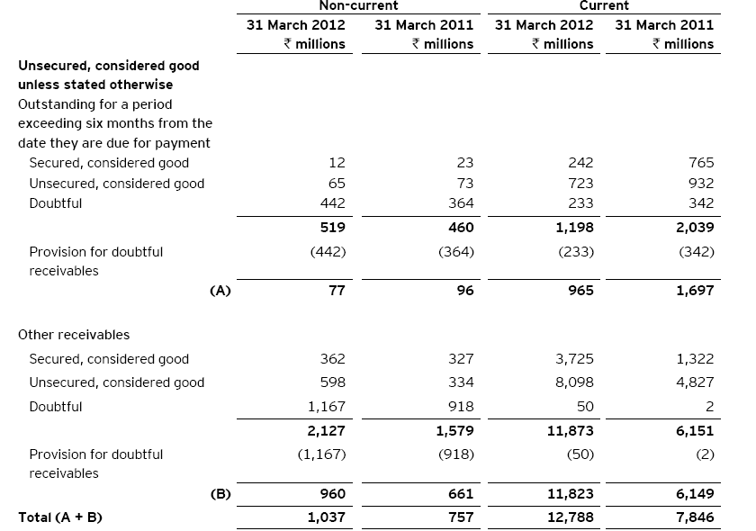

Slide 28
Balance sheet - ASSETS
CURRENT ASSETS → CURRENT INVESTMENTS
Current investments shall be classified as:
  Investments in Equity Instruments
  Investments in preference shares
  Investments in Government or trust securities
  Investments in debentures or bonds
  Investments in Mutual Funds
  Investments in partnership firms
  Other non-current investments (specify nature)
Names of bodies corporate in which investments are made to be disclosed – indicating if these are subsidiaries, JVs or controlled SPEs. Names of firms in which investments made also to be disclosed along with names of all partners.
Separate disclosure of basis of valuation of individual investments to be made.
Aggregate amount of quoted investments and its market value, unquoted investments and provision for diminution in value to be separately disclosed.

Slide 29
Balance sheet - ASSETS
CURRENT ASSETS → INVENTORIES
Inventories to be classified as
  Raw materials
  Work in progress
  Finished goods
  Stock-in-trade (for trading business)
  Stores and spares
  Loose tools
  Others
For all above heads, goods in transit, if any, to be disclosed separately.
Mode of valuation of inventories to be stated.

Slide 30
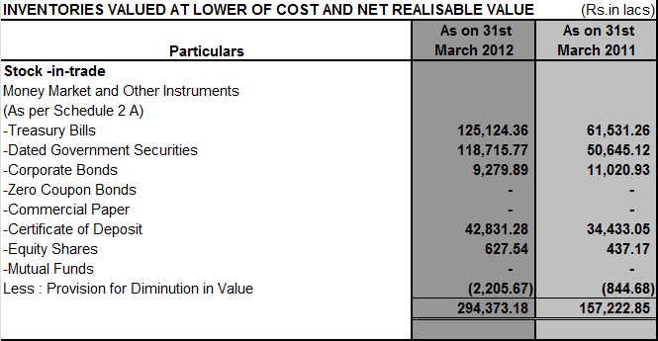

Slide 31
Balance sheet - ASSETS
CURRENT ASSETS→TRADE RECEIVABLES
Aggregate amount of Trade Receivables outstanding for a period exceeding six months from the date they are due for payment should be separately stated.
Separately classification of trade receivables into Secured, considered good, Unsecured, considered good and Doubtful also to be made.
Allowance for bad and doubtful loans and advances shall be disclosed under the relevant heads separately.
Debts due by directors or other officers of the company or any of them either severally or jointly with any other persons or debts due by firms or private companies respectively in which any director is a partner or a director or a member should be separately stated.

Slide 32
Balance sheet - ASSETS
CURRENT ASSETS→CASH AND CASH EQUIVALENTS
Cash and cash equivalents shall be classified as:
  Balances with banks
  Cheques, drafts on hand
  Cash on hand
  Others (specify nature).
Earmarked balances with banks (for example, for unpaid dividend) shall be separately stated.
Balances with banks to the extent held as margin money or security against the borrowings, guarantees, other commitments shall be disclosed separately.
Repatriation restrictions, if any, in respect of cash and bank balances shall be separately stated.
Bank deposits with more than 12 months maturity shall be disclosed separately.

Slide 33
Balance sheet - ASSETS
CURRENT ASSETS→ SHORT-TERM LOANS AND ADVANCES
Short-term loans and advances shall be classified as:
  Loans and advances to related parties (giving details thereof);
  Other loans and advances (specify nature).
Separately classification of above items into Secured, considered good, Unsecured, considered good and Doubtful also to be made.
Allowance for bad and doubtful loans and advances shall be disclosed under the relevant heads separately.
Loans and advances due by directors or other officers of the company or any of them either severally or jointly with any other persons or amounts due by firms or private companies respectively in which any director is a partner or a director or a member should be separately stated.
CURRENT ASSETS→ OTHER CURRENT ASSETS

Slide 34
Balance sheet – OTHER DISCLOSURES
CONTINGENT LIABILITIES AND COMMITMENTS
Contingent liabilities shall be classified as
  Claims against the company not acknowledged as debt
  Guarantees
  Other money for which the company is contingently liable
Commitments shall be classified as
  Estimated amount of contracts remaining to be executed on capital account and not provided for
  Uncalled liability on shares and other investments partly paid
  Other commitments (specify nature).
Disclosure about dividends proposed for equity and preference shareholders and related amount per share to be made.
Details of unutilised amounts as at Balance Sheet date from an issue of securities to be disclosed

Slide 35
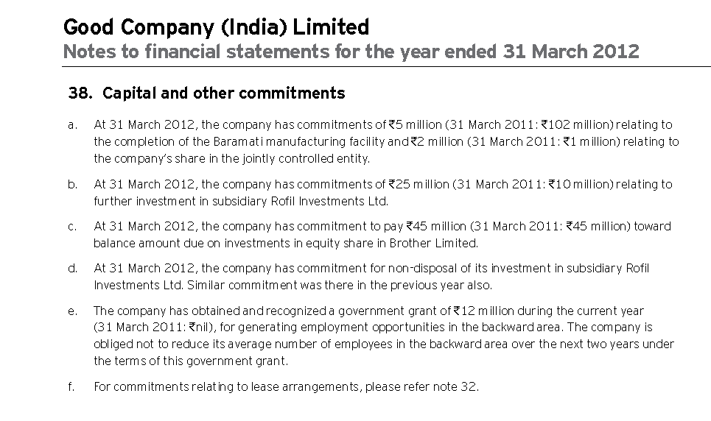
Example - OTHER commitments

Slide 36
 | STATEMENT OF PROFIT AND LOSS
 | Profit and Loss statement for the year ended 31st March, _______
 | Particulars | Note No | Figures as at the end of current reporting period | Figures as at the end of previous reporting period
 | I. Revenue from operations
 | II. Other Income
 | III. Total Revenue (I +II)
 | IV. Expenses:
 | Cost of materials consumed
 | Purchase of Stock-in-Trade
 | Changes in inventories of finished goods, work-in-progress and Stock-in-Trade
 | Employee benefit expense
 | Financial costs
 | Depreciation and amortization expense
 | Other expenses
 | Total Expenses
 | V. Profit before exceptional and extraordinary items and tax (III - IV)
 | VI. Exceptional Items
 | VII. Profit before extraordinary items and tax (V - VI)
 | VIII. Extraordinary Items
 | IX. Profit before tax (VII - VIII)

Slide 37
X. Tax expense:
(1) Current tax
(2) Deferred tax
XI. Profit(Loss) from the period from continuing operations (VII-VIII)
XII. Profit/(Loss) from discontinuing operations
XIII. Tax expense of discounting operations
XIV. Profit/(Loss) from Discontinuing operations (XII - XIII)
XV. Profit/(Loss) for the period (XI + XIV)
XVI. Earning per equity share:
(1) Basic
(2) Diluted

Slide 38
STATEMENT OF PROFIT & LOSS
REVENUE
Separate disclosure for
Revenue from operations of a company other than a finance company
  Sale of products
  Sale of services
  Other operating revenues
  Less: Excise duty
Revenue from operations of a finance company
  Interest; and
  Other financial services
OTHER INCOME
Other income to be classified as
  Interest Income (in case of a company other than a finance company)
  Dividend Income
  Net gain/loss on sale of investments
  Other non-operating income (net of expenses directly attributable)

Slide 39
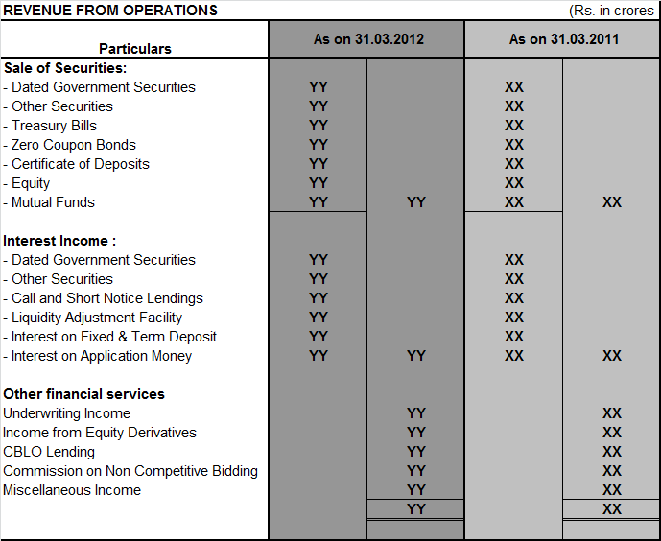
Finance company - illustration

Slide 40
STATEMENT OF PROFIT & LOSS
COST OF MATERIAL CONSUMED
Applicable for manufacturing companies
Includes Raw materials, packing materials and intermediaries consumed
PURCHASE OF STOCK IN TRADE
Includes those purchased for the purpose of resale
CHANGES IN INVENTORIES
Separate disclosures w.r.t finished goods, WIP and stock in trade.
FINANCE COSTS
Finance costs shall be classified as
  Interest expense
  Other borrowing costs
  Applicable net gain/loss on foreign currency transactions and translation

Slide 41
STATEMENT OF PROFIT & LOSS
EMPLOYEE BENEFITS EXPENSE
Salaries and wages, contribution to provident and other funds, expense on ESOP and ESPP, staff welfare expenses
OTHER EXPENSES
Expenditure incurred on following items, separately for each item:-
  Consumption of stores and spare parts
  Power and fuel
  Rent
  Repairs to buildings
  Repairs to machinery
  Insurance
  Rates and taxes, excluding, taxes on income
  Miscellaneous expenses
Any item of income or expenditure which exceeds one per cent of the revenue from operations or Rs.1,00,000, whichever is higher.

Slide 42
STATEMENT OF PROFIT & LOSS
ADDITIONAL INFORMATION FOR ALL COMPANIES
Net gain/ loss on sale of investments
Adjustments to the carrying amount of investments
Net gain or loss on foreign currency transaction and translation (other than considered as finance cost)
Payments to the auditor as
  Auditor
  for taxation matters
  for company law matters
  for management services
  for other services
  for reimbursement of expenses
Details of items of exceptional and extraordinary nature
Prior period items
Tax Expense – Current tax and Deferred Tax

Slide 43
STATEMENT OF PROFIT & LOSS
ADDITIONAL INFORMATION - SPECIFIC TYPES OF COMPANIES
In case of manufacturing companies
  Raw materials under broad heads
  goods purchased under broad heads
In the case of trading companies
  purchases in respect of goods traded in by the company under broad heads.
In the case of companies rendering or supplying services
  gross income derived form services rendered or supplied under broad heads.
In the case of other companies, gross income derived under broad heads.
Work in progress under broad heads wherever applicable.

Slide 44
STATEMENT OF PROFIT & LOSS
FURTHER ADDITIONAL INFORMATION - ALL COMPANIES
Material amounts set aside or to be set aside to reserve other than provisions made to meet any specific liability
Any amounts withdrawn from such reserves, if material
Material amounts set aside to provisions made for meeting specific liabilities
Amounts withdrawn from such provisions as no longer required if material
Subsidiary companies:
  Dividends from subsidiary companies.
  Provisions for losses of subsidiary companies.

Slide 45
STATEMENT OF PROFIT & LOSS
ADDITIONAL INFORMTION IN NOTES
Value of imports- C.I.F basis during the financial year in respect of
  Raw materials
  Components and spare parts
  Capital goods
Expenditure in foreign currency during the financial year on account of royalty, know-how, professional and consultation fees, interest, and other matters
Total value if all imported / indigenous raw materials, spare parts and components consumed during the year and the percentage of each to the total consumption

Slide 46
STATEMENT OF PROFIT & LOSS
ADDITIONAL INFORMTION IN NOTES
The amount remitted during the year in foreign currencies on account of dividends with a specific mention of the total number of non-resident shareholders, the total number of shares held by them on which the dividends were due and the year to which the dividends related – disclosure on cash basis.
Earnings in foreign exchange classified under the following heads, namely:
  Export of goods calculated on F.O.B. basis
  Royalty, know-how, professional and consultation fees
  Interest and dividend
  Other income, indicating the nature thereof

Slide 47
STATEMENT OF PROFIT & LOSS
PROFIT / LOSS FROM DISCONTINUING OPERATIONS
Disclosure required in line with AS-24 of ICAI
On the face of the statement of profit and loss
Tax expense / credit in relation to discontinuing operations disclosed separately
EARNINGS PER SHARE
Disclosure required in line with AS-20 of ICAI.
Basic and diluted EPS to be disclosed
Even if negative, loss per share to be disclosed
Nominal value per share also to be disclosed.

Slide 48
DISCLOSURES NO LONGER REQUIRED
Disclosures relating to managerial remuneration and computation of net profits for calculation of commission
Information relating to licensed capacity, installed capacity and actual production
Information on investments purchased and sold during the year
Investments, sundry debtors and loans & advances pertaining to companies under the same management
Maximum amounts due on account of loans and advances from directors or officers of the company
Commission, brokerage and non-trade discounts

Slide 49
Thank you…

