Slide 1
REVISED SCHEDULE VI

Slide 2
Structure of Presentation
    Setting the Context
    Structure of Revised Schedule VI
    Component of Balance Sheet
    Component of Statement of Profit & Loss
    Key Changes & New Disclosures
    General Issues
    Comparison

Slide 3
SETTING THE CONTEXT
    APPLICABILITY:
    Applicable to all Companies
    (except Banking, Insurance & Electricity Companies)
    Applicability date : Financial years commencing on or after 1 April, 2011
    Requirement of Act and/ or notified Accounting Standard will prevail over the Schedule.

Slide 4
Ind-AS/IFRS
Harmonize and synchronize the disclosure requirements with International formats & in the direction of Ind – AS (IFRS converged AS)
For e.g. Certain concepts like current / non–current classification of assets and liabilities, Elimination of concept of schedule and such information will now be provided in the notes to accounts.

Slide 5
Setting the Context
(A) No option to use horizontal format for presentation of BS
(B) No option to use functional classification of expenses
(C) Each item of the face of the BS and P&L shall be cross referenced
to any related information in notes to accounts
(D) Revised Schedule VI has flexibility
  Addition, deletion, amendment, substitution, modification of line /sub–line items
  AS / Act override Revised Schedule VI
  Balance between providing excessive detail or excessive aggregation
(E) The terms used will carry the meaning as defined in applicable AS

Slide 6
Setting the Context -Format
(F) Materiality threshold for disclosure in Revised schedule VI:
    Items of income or expense (earlier only expenses)
    Which exceeds 1% of the revenue from operations (earlier total revenue) or
    Rs. 1,00,000 (earlier Rs.5,000)
which ever is higher.
(G) Rounding-off options have been changed
    Now only two slabs of Turnover prescribed i.e. Less than Rs 100 Cr & Rs 100 Cr OR More [Earlier three slabs: (i) Less than Rs 100 Cr (ii) Rs 100 Cr OR more but less than 500 Cr & (iii) More than Rs 500 Cr]
    Schedule VI states that the figures “….May be rounded off” as per specific rules. Is it mandatory or optional to apply rounding off?

Slide 7
Setting the Context –Format (cont’d)
Structure of Revised Schedule VI
    General Instructions
    Part I – Form of Balance Sheet
    General Instructions for preparation of Balance Sheet
    Part II – Form of Statement of Profit and Loss
    General Instructions for preparation of statement of Profit and Loss
Structure of Existing Schedule VI
    Part I – Form of Balance Sheet
    General Instructions for preparation of Balance Sheet
    Part II – Requirements as to Profit and Loss
    Part III – Interpretation – for the purpose of Parts I and II of Schedule VI unless the context otherwise requires
    Part IV – BS abstract and Company’s general business profile

Slide 8
Structure

Slide 9
Balance Sheet –Revised Format
(Rupees in…………)
Particulars | Note No. | current reporting period | previous reporting period
I. EQUITY AND LIABILITIES
1) Shareholders’ funds
a) Share capital |  | XX | XX
b) Reserves and surplus |  | XX | XX
c) Money received against share warrants |  | XX | XX
2) Share application money pending allotment |  | XX | XX
3) Non–current liabilities
a) Long–term borrowings |  | XX | XX
b) Deferred tax liabilities (Net) |  | XX | XX
c) Other long term liabilities |  | XX | XX
d) Long–term provisions |  | XX | XX
4) Current liabilities
a) Short–term borrowings |  | XX | XX
b) Trade payables |  | XX | XX
c) Other current liabilities |  | XX | XX
d) Short–term provisions |  | XX | XX
TOTAL |  | XX | XX

Slide 10
Balance Sheet –Revised Format
(Rupees in…………)
Particulars | Note No. | current reporting period | previous reporting period
II.ASSETS
1) Non–current assets
a) Fixed assets
i) Tangible assets |  | XX | XX
ii) Intangible assets |  | XX | XX
iii) Capital work–in–progress |  | XX | XX
iv) Intangible assets under development |  | XX | XX
b) Non–current investments |  | XX | XX
c) Deferred tax assets (net) |  | XX | XX
d) Long–term loans and advances |  | XX | XX
e) Other non–current assets |  | XX | XX
2) Current assets
a) Current investments |  | XX | XX
b) Inventories |  | XX | XX
c) Trade receivables |  | XX | XX
d) Cash and cash equivalent |  | XX | XX
e) Short–term loans and advances |  | XX | XX
f) Other current assets |  | XX | XX
TOTAL |  | XX | XX
See accompanying notes to the financial statements

Slide 11
STATEMENT OF PROFIT LOSS – REVISED FORMAT
(Rupees in…………)
Particulars | Note No. | current reporting period | previous reporting period
I. Revenue from operations |  | XX | XX
II. Other income |  | XX | XX
III. Total Revenue (I+II) |  | XX | XX
IV. Expenses:
-Cost of raw materials consumed |  | XX | XX
-Purchases of Stock–in–Trade |  | XX | XX
-Changes in inventories of finished goods work–in–progress and Stock–in-Trade |  | XX | XX
-Employee benefits expense |  | XX | XX
-Finance costs |  | XX | XX
-Depreciation and amortization expense |  | XX | XX
-Other expenses |  | XX | XX
Total Expenses |  | XX | XX
V. Profit before exceptional and extraordinary items and tax (III–IV) |  | XX | XX
VI. Exceptional items |  | XX | XX
VII. Profit before extraordinary items and tax (V–VI) |  | XX | XX

Slide 12
STATEMENT OF PROFIT OR LOSS – REVISED FORMAT
(Rupees in…………)
Particulars | Note No. | current reporting period | previous reporting period
VII. Profit before extraordinary items and tax (V–VI) |  | XX | XX
VIII. Extraordinary items |  | XX | XX
IX. Profit before tax (VII–VIII) |  | XX | XX
X. Tax Expense: |  | XX | XX
1) Current tax |  | XX | XX
2) Deferred tax |  | XX | XX
XI. Profit/(Loss) for the period from continuing operations (IX–X) |  | XX | XX
XII. Profit/(loss) from discontinuing operations |  | XX | XX
XIII. Tax expense of discontinuing operations |  | XX | XX
XIV. Profit/(loss) from Discontinuing operations (after tax) (XII–XIII) |  | XX | XX
XV. Profit/(Loss) for the period |  | XX | XX
XVI. Earnings per equity share: |  | XX | XX
1)Basic |  | XX | XX
2) Diluted |  | XX | XX
See accompanying notes to the financial statements

Slide 13
Important Definitions
Current / Non Current asset –An asset is classified as current when it satisfies any of the following criteria:
    It is expected to be realized in, or is intended for sale or consumption in, the company’s normal operating cycle;
    It is held primarily for the purpose of being traded;
    It is expected to be realized within twelve months after the reporting date; or
    It is cash or cash equivalent unless it is restricted from being exchanged or used to settle a liability for at least twelve months after the reporting date.
Current/Non Current liability–A liability shall be classified as current when it satisfies any of the following criteria:
    It is expected to be settled in the company’s normal operating cycle;
    It is held primarily for the purpose of being traded;
    It is due to be settled within twelve months after the reporting date; or
    The company does not have an unconditional right to defer settlement of the liability for at least twelve months after the reporting date.

Slide 14
Important Definitions
Operating Cycle
It is the time between the acquisition of assets for processing and their realization in cash or cash equivalents. Where the normal operating cycle cannot be identified, it is assumed to have a duration of 12 months
Will the operating cycle need to be determined based on each business unit, segment, cash generating unit, contract level or at the overall entity level?
Should the operating cycle be calculated for each item separately, say for debtors, inventory or for the company as a whole?
How is an operating cycle determined in the case of a finance company?

Slide 15
Equity and Liability Classification

Slide 16
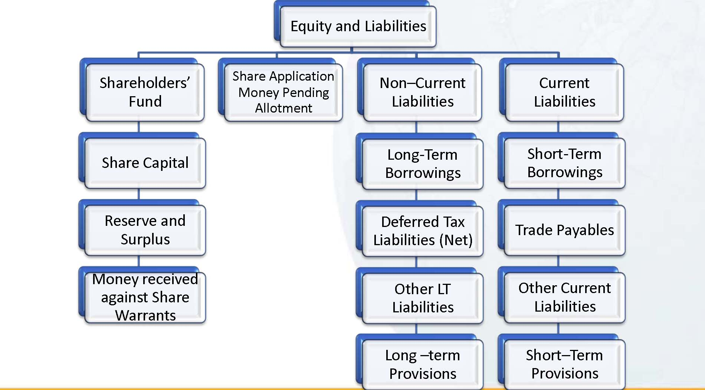
Equity and Liability Classification

Slide 17
SHAREHOLDER’S FUND
Additional Disclosures
    Reconciliation of no. of shares outstanding at beginning and end of reporting period
    Rights, preferences and restrictions of each class of shares including restrictions on distribution of dividends and repayment of capital
    Details of shareholders holding more than 5% shares
    Details of shares issuable under options and contracts / commitments
    Unpaid calls by directors and officers shall be shown separately
For 5 years immediately preceding the date of BS disclose aggregate number & class of shares:
    pursuant to contract(s) without payment being received in cash (previously to be disclosed throughout the life of the Company)
    Bonus shares (previously to be disclosed throughout the life of the Company)
    Bought back (previously no such disclosure required)

Slide 18
Key Issues –Share Capital
Share Capital
Shareholder holding more than 5% shares
    Will disclosure apply if a shareholder was holding more than 5% shares during the year; but not at year – end?
    Whether disclosure is required for each class of shares?
How should outstanding ADRs / GDRs be considered when disclosing shareholders holding more than 5% shareholding?
Whether reconciliation of the number of shares outstanding at the beginning and at the end of the reporting period should be provided for authorised capital as well?
Should calls unpaid be shown as a reduction in new Schedule VI?

Slide 19
RESERVES & SURPLUS
    Additions and deductions since last Balance Sheet to be shown under each specific head
    Debit balance in Statement of Profit & Loss to be shown as negative figure under the head “Surplus”

Slide 20
SHARE APPLICATION MONEY PENDING ALLOTMENT
    Disclosed between “Shareholder’s Fund” and “Non current liabilities ”
    Does not include share application money which are refundable and above authorized capital and to be shown under “ Other Liabilities”

Slide 21
LONG TERM BORROWINGS
Long term borrowing shall be classified as :
Bonds/debentures;
Term loans
• from banks;
• from other parties;
Deferred payment liabilities;
Deposits;
Loans and advances from related parties;
Long term maturities of finance lease obligations;
Other loans and advances (specify nature).

Slide 22
LONG TERM BORROWINGS
Disclosure requirement :
Nature of security for each type of borrowing to be specified
Period and nature of continuing default as on Balance sheet date
Terms of repayment – period of maturity, installment due, rate of interest etc
Current maturities of long term debts –under “other current liabilities”
Where loans have been guaranteed by directors or others, the aggregate amount of such loans under each head shall be disclosed.

Slide 23
LONG TERM BORROWINGS-Key Issues
Can the current maturities of long- term debt be carved out of the total long-term borrowings, instead of under every line item of para. 6.C of the Revised Schedule VI Notification?
A company has taken a three-year loan specifically for a business whose operating cycle is four years. Hence, it needs to classify the three -year loan as current liability. This gives rise to the following issues:
(a) Should the loan be classified in the balance sheet under the head “long-term borrowing”, “short-term borrowing” or “current maturities of long-term debt”?
(b) Does the company need to make all the disclosures required for long-term borrowings for this loan also?
Should unsecured loans taken from shareholders / directors with no fixed terms, be classified as “current” or “non-current”?
Whether breach of debt covenant affect the current/ non current classification?

Slide 24
OTHER LONG TERM LIABILITIES
Other long term liabilities classified into:
- Trade payables;
Others
Trade Payable
A payable shall be classified as a ‘Trade Payable’ if it is in respect of the amount due on account of goods purchased or services received in the normal course of business
Old Schedule VI- Sundry Creditors includes amount due in respect of goods purchased or services received or in respect of other contractual obligation as well.

Slide 25
OTHER LONG TERM LIABILITIES
Questions:
The company has received security deposit from its customers / dealers. Either the company or the customer / dealer can terminate the agreement by giving two months notice. The deposits are refundable within one month of termination. However, based on past experience, it is noted that deposits refunded in a year are not material, with 1% to 2% of the amount outstanding. The intention of the company is to continue long-term relationship with its customers /dealers. Can the company classify such security deposits as non-current liability?

Slide 26
LONG TERM PROVISIONS
Long term provisions can be into:
- Provisions for Employee benefits;
Others
How should a company classify the assets and liabilities arising from post-employment benefit obligations as current/non-current in the Balance Sheet?

Slide 27
POST RETIREMENT BENEFIT OBLIGATION
Funded plans
Net liability- amount due for payment to the fund created for this purpose within twelve months should be treated as “current” liability.
Unfunded plans
Normally, the Actuary should determine the amount of current and non-current liability for unfunded post-employment benefit obligations based on the definition of current and non-current liabilities in the Revised Schedule VI.

Slide 28
OTHER EMPLOYEE BENEFITS
How should a company present the assets and liabilities arising from other employee benefit obligations?

Slide 29
OTHER EMPLOYEE BENEFITS
Liability toward bonus, etc., payable within one year from the Balance Sheet date should be classified as “current”.
Accumulated leave outstanding as on the reporting date – for employees who have earned the right to unconditionally avail the leave at any time during the year immediately following the Balance Sheet date, the liability needs to be classified as “current” even though the same is measured as ‘other long-term employee benefit’ as per AS 15 Employee Benefits.
However, where the right to defer the employee’s leave is available unconditionally with the Company, the same needs to be evaluated on a case to case basis – based on the terms of Employee Contract and Leave Policy, Employer’s right to postpone/deny the leave, restriction to avail leave in the next year for a maximum number of days, etc.
In case of such complexities, the amount of non-current and current portions of leave obligation should normally be determined by a qualified Actuary.

Slide 30
CURRENT LIABILITIES
Current liabilities can be classified as:
Short term borrowing
Trade payable
Other current liabilities
Short term provisions

Slide 31
OTHER CURRENT LIABILITIES
Other Current liabilities may include:
Current maturities of long-term debt;
Current maturities of finance lease obligations;
Interest accrued but not due on borrowings;
Interest accrued and due on borrowings;
Income received in advance;
Unpaid dividends;
Application money received for allotment of securities and due for
refund and interest accrued thereon;
Unpaid matured deposits and interest accrued thereon;
Unpaid matured debentures and interest accrued thereon;
Other payables (specify nature).Short term borrowing

Slide 32
CURRENT LIABILITIES
Should dues to employees be treated as trade payables or other payables?
Retention – Payments are withheld from sub-contractors and are payable on completion of the Defect Liability period (DLP) / agreed terms. Various sub-contractors are involved in a single project, their scopes are different and the time periods are also different. Should the current / non-current classification be based on term of each project or terms with each sub-contractor?
Should Provision for warranty be classified as “current”?
Whether liability for purchase of fixed assets should be classified as Trade Payable / Other current liabilities?

Slide 33
Assets Classification

Slide 34
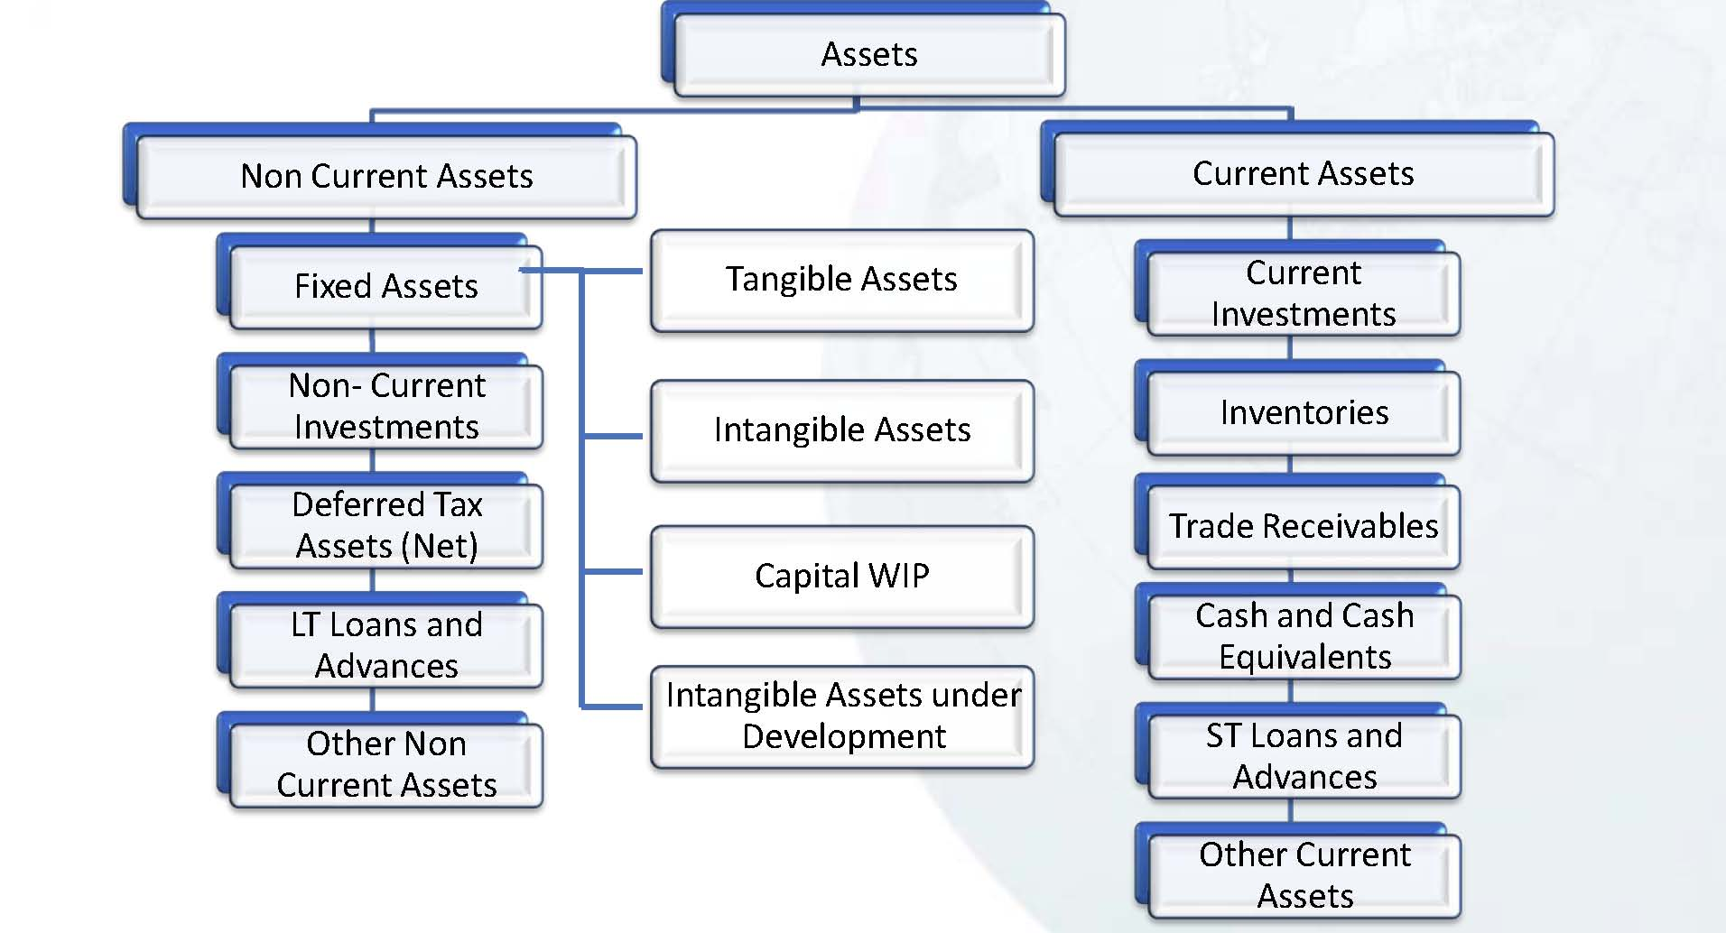
Assets Classification

Slide 35
FIXED ASSETS
Fixed Assets includes:
Land;
Buildings;
Plant and Equipment;
Furniture and Fixtures;
Vehicles;
Office equipment;
Others (specify nature).
Assets under lease shall be separately specified under each class of asset.

Slide 36
FIXED ASSETS
Reconciliation of gross and net carrying amount of each class of assets at the beginning and end of the reporting period
Additions, disposals, acquisitions through business combination shall be disclosed separately for each class of assets
Depreciation and impairment losses/ reversal for each class of assets shall be disclosed separately for each class of assets
Other adjustments (like capitalization of exchange differences for options as per AS 11/ borrowing cost capitalized under AS 16) should be disclosed separately for each class of assets
Capital Advance no longer under CWIP- to be shown under Long term loans & Advances

Slide 37
NON CURRENT INVESTMENTS
Classified as –
- Trade Investment
- Other
Further classified under each category-
- Investment property;
- Investments in Equity Instruments
- Investments in preference shares;
- Investments in Government or trust securities;
- Investments in debentures or bonds;
- Investments in Mutual Funds;
- Investments in partnership firms;
- Other non-current investments (specify nature).

Slide 38
NON CURRENT INVESTMENTS
Under each category details of body corporate where Investment made needs to be disclosed
If carried other than cost – such basis to separately disclosed
Further disclosure –
Aggregate value of quoted investment and market value thereof
Aggregate value of unquoted investment
Aggregate provision for diminution in value of Investment
How should investments be classified into current and non-current in the Balance Sheet? Will the resultant classification be similar to the classification required under AS 13 Accounting for Investments (i.e. current and long-term)?

Slide 39
LONG TERM LOANS AND ADVANCES
Long Term loans and advances shall be classified as:
Capital Advances;
Security Deposits;
Loans and advances to related parties (giving details thereof);
Other loans and advances (specify nature).
The above shall also be separately sub-classified as:
Secured, considered good;
Unsecured, considered good;
Doubtful.
Dues by directors or other officers to be separately disclosed
Allowance for bad and doubtful loans and advances shall be disclosed under the relevant heads separately.

Slide 40
INVENTORIES
Inventories shall be classified as :
Raw materials;
Work-in-progress;
Finished goods;
Stock-in-trade (in respect of goods acquired for trading);
Stores and spares;
Loose tools;
Others (specify nature).
Goods-in-transit shall be disclosed under the relevant sub-head of inventories.
How should a slow moving stock of stores and spares be classified when it will neither be consumed within the normal operating cycle nor will be sold within 12 months from the balance sheet date?

Slide 41
DISCLOSURE –INVENTORIES
Manufacturing companies | Raw materials under broad heads Goods purchased under broad heads
Trading companies | Purchases of goods traded under broad heads
Companies rendering or supplying services | Gross income derived from services rendered under broad heads
Company that falls in more than one category | It will be sufficient compliance with the requirements, if purchases, sales and consumption of raw material and the gross income from services rendered are shown under broad heads

Slide 42
TRADE RECEIVABLES
Classification of more than/ less than six month from the date they are due from payment
Old Schedule VI required presentation of debtors based on billing date
Whether provisioning policy of the Company needs to align accordingly?
Whether a Trade Receivable which has been provided for in the books can be considered as Current in the financial statements?
Whether “Provision for bad and doubtful debts” also need to be classified as current and non current?

Slide 43
TRADE RECEIVABLES
Classification of receivables exceeding six months is from the due date. How would the due date be determined in a case where the invoice is paid after acceptance / certification from client?
The Company has already delivered the goods and also rendered the services but the commercial invoices can be raised only after certain milestone is achieved. The Company earlier used to record the same as Unbilled Debtors/ Revenue under “Sundry Debtors”.
Whether the same needs to be grouped under Other Current Assets or under Trade Receivables under the Revised Schedule VI? The Guidance Note has suggested classifying “Unbilled revenue” under Other Current Assets?

Slide 44
CASH & CASH EQUIVALENTS
Revised Schedule VI Vs AS 3
According to AS-3 Cash Flow Statements, Cash is defined to include cash on hand and demand deposits with banks. Cash Equivalents are defined as short term, highly liquid investments(maturity less than three months) that are readily convertible into known amounts of cash and which are subject to an insignificant risk of changes in value.
How to disclose:
- Fixed Deposits with maturity more than 3 months/ one year
Balances/ fixed deposits held as margin money which are not available for use of Company
Investment in liquid mutual fund- whether part of cash & cash equivalent

Slide 45
COMPONENT OF STATEMENT OF PROFIT & LOSS

Slide 46
Statement of Profit & Loss
Revenue from operations is to be separately disclosed in the notes, showing revenue from:
Sale of products
(b) Sale of services
(c) Other operating revenues
(d) Less: Excise duty
AS-9 “Revenue Recognition”, the above disclosure in respect of Excise Duty needs to be shown on the face of the Statement of Profit and Loss
Accounting Standards override Revised Schedule VI- needs to disclosed on the face of Statement of Profit & Loss

Slide 47
Statement of Profit & Loss
How Indirect taxes such as Sales tax, Service tax, Purchase tax etc are disclosed in the Statement of Profit & Loss ? Whether revenue should be presented gross or net?

Slide 48
Statement of Profit & Loss
What is the difference between ‘other operating income’ as contemplated by Clause 41 of the Listing Agreement and ‘other operating revenue’ as contemplated by the Revised Schedule VI?

Slide 49
Statement of Profit & Loss
‘Other income’ is to be disclosed as follows:
(a) Interest Income (in case of a company other than a finance company);
(b) Dividend Income;
(c) Net gain / loss on sale of investments;
(d) Other non-operating income (net of expenses directly attributable to such income).

Slide 50
Statement of Profit & Loss
Dividend
    Existing Schedule VI required the parent company to recognize dividend declared by subsidiary companies even after the date of the balance sheet if they were pertaining to the period ending on or before the balance sheet date. Such requirement no longer exists in Revised Schedule VI
    Whether the dividend recognized in the previous year needs to be derecognized and the previous year financial statement to be restated?

Slide 51
Statement of Profit & Loss
    Share of Profit or loss in Partnership Firm:
    Query:
    Accounting and disclosure of share of profit / loss on Investments in Partnership Firms (required in Old Schedule VI)
    Response:
Share of profit or loss in a partnership firm accrues the moment the same is computed and credited or debited to the Capital/Current/any other account of the company in the books of the partnership firm. Hence, the same should be accordingly accounted for in the books of the company.

Slide 52
Statement of Profit & Loss
    Expenses:
Aggregate of the following expenses are to be disclosed on the face of the Statement of Profit and Loss:
Cost of materials consumed
Purchases of Stock-in-Trade
Changes in inventories of finished goods, work in progress and stock in trade
Employee benefits expense
Finance costs
Depreciation and amortization expense
Other expenses

Slide 53
Statement of Profit & Loss
Cost of material consumed:
Internally manufactured components- when can be disclosed as “Finished Products” and when can be disclosed as “WIP”/ “Semi finished Products”.
Purchases of Stock in Trade:
Stock-in-trade refers to goods purchased normally with the intention to resell or trade in.

Slide 54
Statement of Profit & Loss
Changes in inventories of finished goods, work-in-progress and stock-in-trade
To be disclosed separately for finished goods, work in progress and stock in trade.
Finance cost
Interest expense
Other borrowing costs
Applicable net gain/loss on foreign currency transactions and translation
Note:
Interest on shortfall in payment of advance income-tax is in the nature of finance cost and hence should not be clubbed with the Current tax.

Slide 55
Statement of Profit & Loss
Other Expenses:
Consumption of stores and spare parts;
Power and fuel;
Rent;
Repairs to buildings;
Repairs to machinery;
Insurance;
Rates and taxes, excluding taxes on income;
Miscellaneous expenses.

Slide 56
Key Changes
No more required in Revised Schedule VI:
Profit and Loss Account
    Commission, brokerage and non – trade discounts
Balance Sheet
    Investments purchased and sold during the year
    Investments, sundry debtors and loans & advances pertaining to companies under the same management
    Break up of Bank Balances between Scheduled & Other Banks, Breakup between current account, call account & deposit accounts, Details of names, amount, maximum amounts with non scheduled banks
Notes
    Managerial remuneration and computation of net profits for calculation of commission
    Licensed capacity, installed capacity and actual production
    Balance sheet Abstract & Company’s General Profile under Part IV

Slide 57
New Disclosures
Commitments
    Requires disclosure of all commitments (including commitments other than capital commitments)
Loan Defaults
    Requires disclosure of all defaults in repayment of loans and interest
    Currently, CARO requires only defaults in repayment of dues to financial institutions, banks and debenture holders to be specified
    Terms of repayment of term loans & other loans to be disclosed (earlier only debentures)
Shares of each class held by:
    Holding Company
    Ultimate Holding Company
    Subsidiaries or Associates of Above 2

Slide 58
General Issues
Comparative Information
Whether required in the first year of its application?
Whether subsequent event should be considered for reclassification of previous years figures?

Slide 59
General Issues
Commitments
Earlier Schedule VI – only “capital commitments”. Revised Schedule VI requires the disclosure of all commitments ,i.e., including “other commitments.” What is the nature of “commitments” that will get covered under this disclosure requirement?
Disclosure of unamortized Expenses
Disclosure of unamortized portion of expense items such as share issue expenses, ancillary borrowing cost and discount or premium relating to borrowings?

Slide 60
Differential Comparison
Sr No | Area | Existing Schedule VI | Revised Schedule VI
1 | Net Working Capital | Current assets and Liabilities are shown together under application of funds. Net Working Capital appears on balance sheet | Assets & Liabilities are to be bifurcated into current & Non–current and shown separately. Hence, Net Working Capital will not be appearing in Balance sheet
2 | Fixed Assets | No bifurcation required into Tangible & Intangible assets | Fixed assets to be shown under non–current assets and it has to be bifurcated in to Tangible & Intangible assets
3 | Borrowings | Short term & long term borrowings are grouped together under the head Loan funds sub–head Secured/ Unsecured | Long term borrowings to be shown under non current liabilities and short term borrowings to be shown under current liabilities with separate disclosure of secured/ unsecured loans. Period and amount of continuing default as on the balance sheet date in repayment of loans and interest to be separately specified

Slide 61
Differential Comparison
Sr No | Area | Existing Schedule VI | Revised Schedule VI
4 | Finance lease obligation | Finance lease obligations are included in current liabilities | Finance lease obligations are to be grouped under the head non–current liabilities
5 | Deposits | Lease deposits are part of loans & advances | Lease deposits to be disclosed as long term loans & advances under the head non–current assets
6 | Investments | Both current & non–current investments to be disclosed under the head investments | Current and non–current investments are to be disclosed separately under current assets & non–current assets respectively
7 | Loans & Advances | Loans & Advance are disclosed along with current assets Loans & Advance to subsidiaries & others to be disclosed separately | Loans & Advances to be broken up in long term & short term and to be disclosed under non–current & current assets respectively. Loans & Advance from related parties & others to be disclosed separately.

Slide 62
Differential Comparison
Sr No | Area | Existing Schedule VI | Revised Schedule VI
8 | DTA/ DTL | Deferred Tax assets/ liabilities to be disclosed separately | DTA/ DTL to be disclosed under non–current assets/ liabilities as applicable
9 | Cash & Bank Balances | Bank balance to be bifurcated in scheduled banks & others | Bank balances in relation to earmarked balances, held as margin money, deposits with more than 12 months maturity, each to be shown Separately.
10 | Profit & Loss (Dr Balance) | P&L debit balance to be shown under the head Miscellaneous expenditure & losses | Debit balance of Profit and Loss Account to be shown as negative figure under the head Surplus. Therefore, reserve & surplus balance can be negative

Slide 63
Differential Comparison
Sr No | Area | Existing Schedule VI | Revised Schedule VI
11 | Other current liabilities | No separate disclosure of Current maturities of long term debt. No separate disclosure of Current maturities of finance lease Obligation | Current maturities of long term debt to be disclosed under other current liabilities. Current maturities of finance lease obligation to be disclosed
12 | Purchases | Purchases, Opening & closing stock, giving break up in respect of each class of goods traded in indicating the quantities thereof | Goods traded in by the company to be disclosed in broad heads in notes. Disclosure of quantitative details of goods is much diluted.
13 | Expense Classification in P&L A/c | Function wise & Nature wise | Classification based on nature of expenses
14 | Finance Cost | To be classified in fixed loans & other loans | To be classified as interest expense, other borrowing costs & Gain/ Loss on forextransactions/ translations.
15 | Foreign exchange gain/ loss | Gain/ Loss on foreign currency transaction to be shown under finance cost | Gain/ Loss on foreign currency transaction to be separated into finance costs and other expenses

Slide 64


