Slide 1
AS-26
INTANGIBLE ASSETS

Slide 2
DEFINITIONS
  Intangible asset:
Identifiable non-monetary asset,
Without physical substance,
Held for use in-
  The production or
  Supply of goods or
  Services, for rental to others or
  For administrative purposes.

Slide 3
DEFINITIONS
Monetary Asset:
Money held and assets
to be realised in fixed amounts of money.
Non- Monetary Asset:
Other than Monetary Asset.

Slide 4
Recognition Criteria
Probable future economic benefits must flow to the enterprise
Cost of Intangible asset can be measured reliably.
Intangible Asset should be measured initially at cost

Slide 5
Intangible Asset may be of
Acquired
Self-generated
Unidentifiable
Identifiable
Self Generated Intangible Assets like Goodwill, should not be recorded/recognised in books of accounts

Slide 6
Acquired Intangible Asset
by way of cash
In Exchange for another Asset
by way of Government Grant
by way of Amalgamation
by way of issue of shares or other securities
Cost =
Purchase Cost
+ Import Duty + Non Refundable Taxes
+ Directly Attributable cost
- Trade Discount
- Rebates
follow AS -10
Refer AS -12
Refer AS -14
fair market value of the Asset or Securities
issued which is more clearly evident

Slide 7
Cost of Self Generated Intangible Asset
Expenditure on materials or services
Add:
  Salaries, Wages and other employment related costs of personnel
  Any directly attributable expenditure
  Specific Overheads and reasonable allocation of general Overheads.
Less:
  Selling, administrative expenses, and other general overhead expense.
  Expenditure on training staff

Slide 8
Important points
Para 50:
  Internally generated brands, mastheads, publishing titles, customer lists and items similar in substance should not be recognised as intangible assets.
Reason Para 51:
  Such items cannot be distinguished from the cost of developing the business as a whole.

Slide 9
Some Important issues with respect to Acquisition by way of Amalgamation
See whether recognition criteria is met at the time of amalgamation. If so, an Intangible Asset can be recognised by the transferee even if that intangible asset had not been recognised by the transferor
2. If the cost of an intangible asset cannot be measured reliably, it is not recognised by transferor but it is included in goodwill
3. Unless there is an active market for an intangible asset acquired in an amalgamation in the nature of purchase, the cost initially recognised for the intangible asset is restricted to an amount that does not create or increase any capital reserve arising at the date of amalgamation

Slide 10
Internally generated Intangible Asset
Research Phase
Expensed
Development Phase
Capitalised
(Only if the criteria of Para 44 is satisfied)

Slide 11
Conditions for Recognizing Intangible Asset arising from Development stage
If and only if, an enterprise can demonstrate the following
The technical feasibility of completing the intangible asset so that it will be available for use or sale;
Its intention to complete the intangible asset and use or sell it.
Its ability to use or sell the intangible asset.

Slide 12
How the intangible asset will generate probable future economic benefits.
The availability of adequate technical, financial and other resources to complete the development and to use or sell the intangible asset, and
Its ability to measure the expenditure attributable to the intangible asset during its development reliably.

Slide 13
Para 56
In some cases, expenses are incurred to provide future economic benefits, but Intangible asset cannot be recognised-
  Expense on research
  Expenses on start up activities [legal and secretarial cost, preopening/ operating cost] unless included in fixed asset as per AS-10
  Expenditure on training activities
  Expenditure on advertising and promotional activities
  Expenditure on relocating or re-organizing part or all of an enterprise

Slide 14
Important issues
) Whether Past expensed item can be rebooked as Intangible Asset?
) Expenditure on an intangible item that was initially recognised as an expense by a reporting enterprise in previous annual financial statements or interim financial reports should not be recognised as part of the cost of an intangible asset at a later date.

Slide 15
) After initial recognition, can the subsequent expenditure be capitalised or expensed?
) Capitalised – Only if the asset generates greater FEB & Cost can be measured reliably. If not, expense it.

Slide 16
Measurement Subsequent to Initial Recognition
Cost XXX
Less:
  Accumulated Amortisation (XX)
  Accumulated Impairment Loss (XX)
                XXX

Slide 17
How would amortization be carried out?
Allocate on a systematic basis over the best estimate of its useful life.
Does not exceed the period beyond 10 years unless it is justified.

Slide 18
What is the recommended method of amortization?
The method followed should reflect the pattern in which the asset’s economic benefits are consumed by the enterprise.
If that pattern cannot be determined reliably, then straight line method should be used

Slide 19
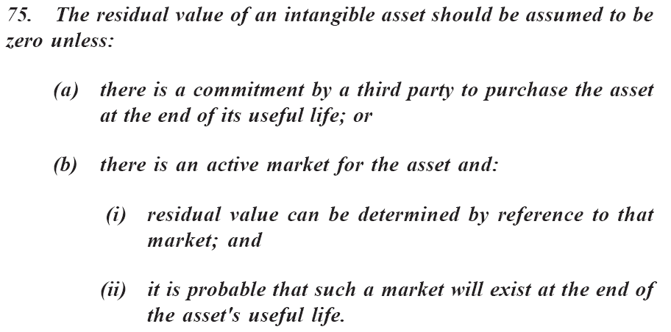
For arriving at depreciable amount of IA, what is to be considered for RV?

Slide 20
Can review of amortization period & Method possible?
The amortisation period and the amortisation method should be reviewed at least at each financial year end.
If the expected useful life of the asset is significantly different from previous estimates
  The amortisation period should be changed accordingly.
If there has been a significant change in the expected pattern of economic benefits from the asset
  The amortisation method should be changed to reflect the changed pattern.
Such changes should be accounted for in accordance with AS 5- Net Profit or Loss for the Period, Prior Period Items and Changes in Accounting Policies.

Slide 21
Retirement and Disposal
An intangible asset should be derecognized-
  on disposal (or)
  when no future economic benefits are expected from its use and subsequent disposal.
Gain or loss on disposal of Intangible Asset will be recognised in P & L a/c.

