Slide 1


COST leadership
PRESENTED BY:-
Roshan Jadhav - 18
Pragya Jain - 22
Aarti Joshi - 24

Slide 2

WHAT IS COST
Cost, the value of money
Result of decision
Examples:- Rent to landlord, wages to labor, Interest to the capital, Raw Material, Power, Fuel, Transportation, etc.

Slide 3

TYPES OF COST
Actual Cost and Opportunity Cost
Fixed Costs and Variable Costs
Explicit Cost and Implicit Cost
Total Cost, Average Cost and Marginal Cost
Historical Costs and Replacement Costs
Accounting Costs and Economic Costs
Short Run Cost and Long Run Cost

Slide 4
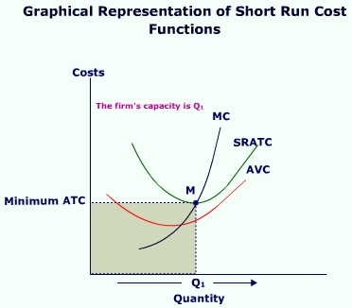
SHORT RUN COST FUNCTION

Slide 5
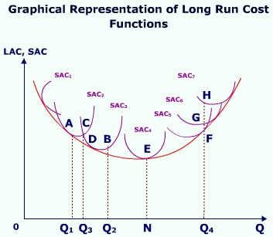
LONG RUN COST FUNCTION

Slide 6
COST LEADERSHIP STRATEGY
PRICE = $10
PRICE = $8
PROFIT = $5
PROFIT = $6
COST = $5
COST = $2
INDUSTRY
AVERAGE
COST
LEADERSHIP
Notes:
The cost leader increases profit to above average levels by lowering costs.
However, low cost does not always lead to low price. Producers could price at competitive parity, exploiting the benefits of a bigger margin than competitors. Some organizations, such as Toyota, are very good not only at producing high quality autos at a low price, but have the brand and marketing skills to use a premium pricing policy.

Slide 7
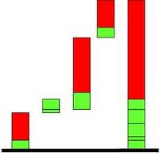

COST LEADERSHIP STRATEGY
Actions are integrated and designed to produce or deliver goods or services at the lowest cost, relative to that of competitors, with features that are acceptable to customers.
Firms seeking competitive advantage through this business-level strategy often sell no-frills, standardized goods and services to the industries typical customers
Successful implementation requires a consistent focus on driving costs lower, relative to competitors’ costs.
Notes:
Not about providing low cost – not cheap products
Source of value: the ability to produce and deliver products at the lowest cost relative to competitors
In the value chain, look for ways to continually reduce costs
No frills, standardized
A company’s goal in pursuing cost leadership is to out-perform competitors by producing goods and services at a lower cost. One advantage with this generic strategy is that when all companies in the industry charge the same price for their products, the cost leader makes higher profits because its costs are lower.
How do firms derive competitive advantage with this strategy?

Slide 8

CHARACTERISTICS OF A
COST LEADERSHIP
Usually make investments in efficient-scale facilities
Maintain tight cost and overhead control
Usually minimize costs in areas such as service offerings, labor force, and R&D
  Minimizing costs in the labor force is NOT giving away management and family labor
Typically have standardized processes, limited variety, supply chain mentality, and a frugal culture
Notes:
The successful low cost strategy puts all these together.
Continuous efforts to lower costs relative to competitors is necessary in order to successfully be a cost leader. This can include:
Building state of art efficient facilities (may make it costly for competition to imitate)
Maintain tight control over production and overhead costs
Minimize cost of sales, R&D, and service.

Slide 9



Cost Leadership Strategy: Advantages
Higher profits resulting from charging prices below that of competitors, because unit costs are lower
Increase market share and sales by reducing the price below that charged by competitors (assuming price elasticity of demand)
Ability to enter new markets by charging lower prices
Is a barrier to entry for competitors trying to enter the industry

Slide 10


Cost Leadership Strategy: Disadvantages
Technological advancement makes the low cost advantage outdated.
Imitation ability of competitors.
Lose sight of changes in customers’ tastes

Slide 11

COST LEADERSHIP AND THE VALUE CHAIN
Analysis of the value chain identifies where cost savings can be made in the various parts and links
With a cost leadership strategy, the value chain must be organized to:
  Reduce per unit costs by copying, rather than original design, using cheaper resources, producing basic products, reducing labor costs and increasing labor productivity
  Achieve economies of scale by high-volume sales
  Using high-volume purchasing to get discounts
  Locating where costs are low

Slide 12

COST LEADERSHIP AND PRICE ELASTICITY OF DEMAND
Cost leadership strategy is best used in a market or segment when demand is price elastic, OR
When charging a similar price to competitors at the same time as increasing advertising to increase sales

Slide 13


SOURCES OF COST LEADERSHIP STRATEGY
Economies of scales and Diseconomies of scales
Learning curve effect
Internationalization
Technological acquisition and improvement
Access to low cost inputs
Knowledge management
Cost conscious organizational culture

Slide 14

COST LEADERSHIP STRATEGY AND THE FIVE FORCES
Threat of New Entrants
Threat of New Entrants
Bargaining Power of Suppliers
Rivalry Among Competing Firms in Industry
Bargaining Power of Buyers
Threat of Substitute Products
Notes:
Be very brief with this. Just let them know there is a connection back to the external analysis material here.
Porter's 5 Forces Model
In other lectures we discussed Porter's Five Forces Model. A cost leadership strategy may help to remain profitable even with: rivalry, new entrants, suppliers' power, substitute products, and buyers' power.
Rivalry – Competitors are likely to avoid a price war, since the low cost firm will continue to earn profits after competitors compete away their profits (Airlines).
Buyers – Powerful customers that force firms to produce goods/service at lower profits may exit the market rather than earn below average profits leaving the low cost organization in a monopoly positions. Buyers then loose much of their buying power.
Suppliers – Cost leaders are able to absorb greater price increases before it must raise price to customers.
Entrants – Low cost leaders create barriers to market entry through its continuous focus on efficiency and reducing costs.
Substitutes – Low cost leaders are more likely to lower costs to entice customers to stay with their product, invest to develop substitutes, purchase patents.

Slide 15
5 FORCES AND PROFIT
Force | Profitability will be higher if: | Profitability will be lower if:
Bargaining power of suppliers | Weak suppliers | Strong suppliers
Bargaining power of buyers | Weak buyers | Strong buyers
Threat of new entrants | High entry barriers | Low entry barriers
Threat of substitutes | Few possible substitutes | Many possible substitutes
Competitive rivalry | Little rivalry | Intense rivalry

Slide 16
Summary …
As rivalry among competing firms intensifies, industry profits decline, in some cases to the point where an industry becomes inherently unattractive.

Slide 17




EXAMPLES OF COST LEADERSHIP
Southwest Airlines
Wal-Mart
Nucor Steel
McDonalds
Notes:
What are the components of Nissan’s cost-leadership strategy? To keep its costs and prices lower than other Japanese and U.S. car manufacturers, Nissan started its low-cost strategy for its Altima car at the design stage. First, its engineers designed the Altima to be easy and inexpensive to manufacture. Then Nissan limited the number of different models that it would produce to keep costs low: a basic version or a luxury-equipped version. Finally, Nissan focused its marketing on the amount of quality and luxury in the car, given its low price, to present to customers a high-quality/low-cost image of the car. The results were astonishing as sales exceeded even Nissan’s optimistic projections.
Southwest is a flowing a low cost strategy.
Use a single aircraft model (Boeing 737)
Use secondary airports
Fly short routes
No meals
15 minute turnaround time
No reserved seats
No travel agent reservations

Slide 18





STRATEGIC COST MINIMIZATION
Cost Leadership — Ryan Air, Wal-Mart
Reduction in materials costs
Process Re-engineering
Use of IT to reduce costs—Enterprise Resource Planning (ERP)-integration of CRM, SCM, Sales & Marketing and Accounting functions
Foreign Sourcing of Inputs (Asia) countries (SE Asia, E. Relocation to Lower-cost Europe)
New International Economies of Scale
Layoffs and Plant closings

Slide 19


