Slide 1


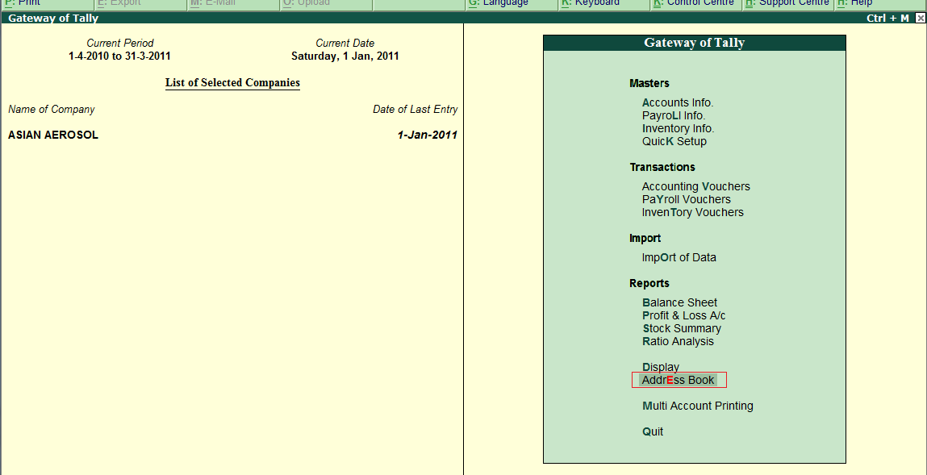
On Gateway Of Tally You will get Key Item Address Book

Slide 2
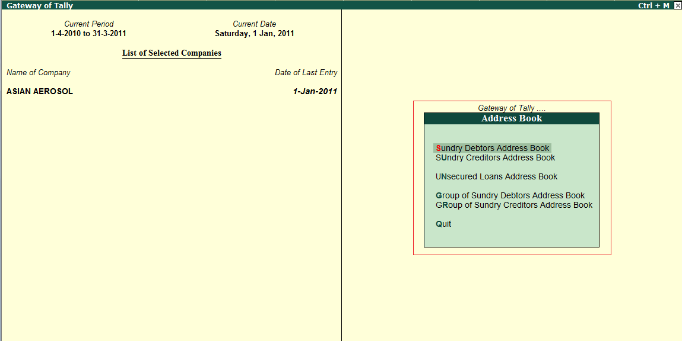
In That Key Item you will Get Key Items as Under

Slide 3
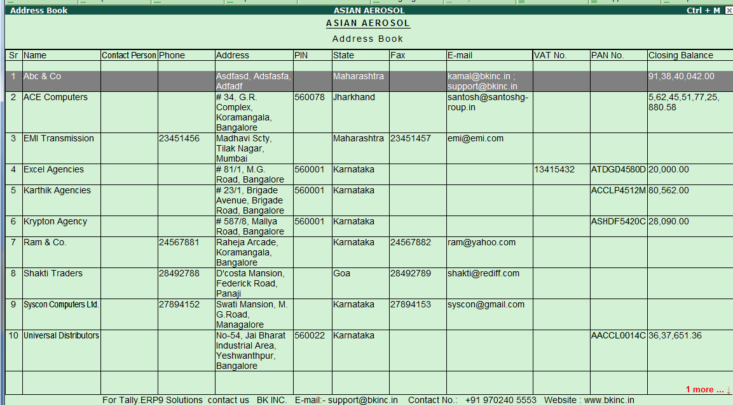
When we will go to report we will get report as given below…………… We can go to ledger by pressing Enter and we can go to master alteration by pressing Ctrl + Enter from this report.

Slide 4
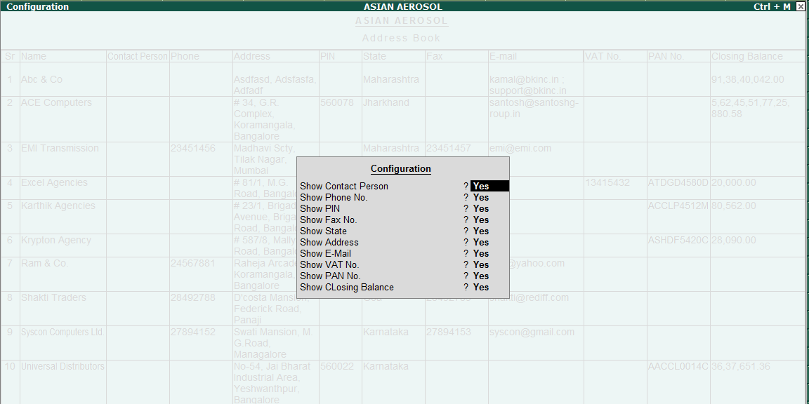
we can configure that report as we want to generate by pressing F12

Slide 5
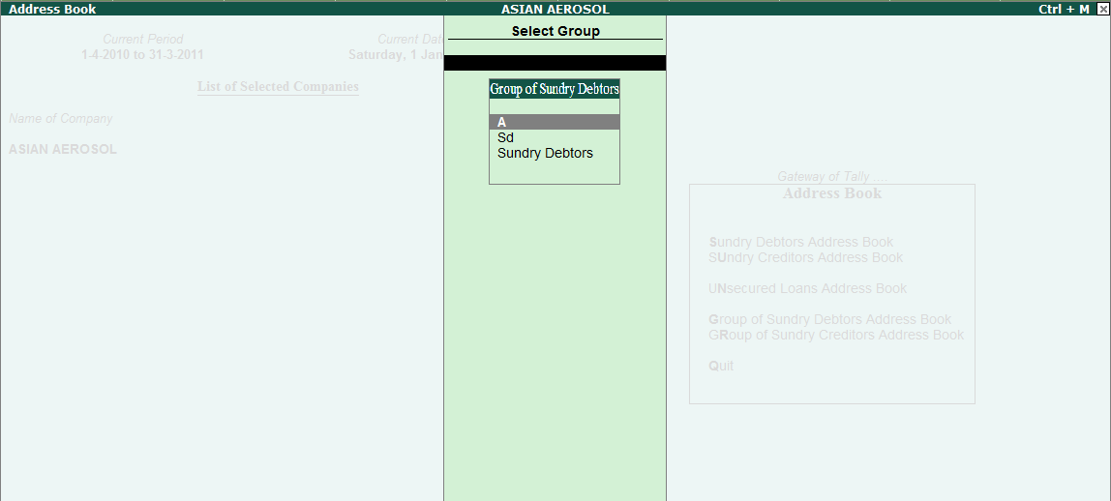
Group of Sundry Debtor Address book and Group of Sundry Creditor Address book for Trigger to group or sub-group of Debtor/Creditors……….. It will gives you a filtered report

