Slide 1
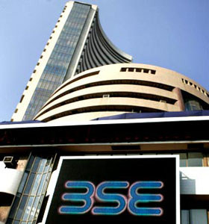
ACCOUNTING FOR FINANCIAL
INSTRUMENTS COVERING
CALL , PUT AND FORWARD CONTRACT
GUIDANCE NOTE ON

Slide 2

INTRODUCTION
STOCK MARKET
DERIVATIVES
Assets whose value is determined from the value of
some underlying asset. (Equity, commodity, currency)
FORWARD CONTRACT
Agreement between two parties.
Traded privately
FUTURE CONTRACT

Slide 3
OPTIONS
CALL OPOTION
WRITE TO BUY
BUT NOT OBLIGATION
PUT OPTION
WRITE TO SELL
BUT NOT OBLIGATION

Slide 4
COMPARISION
OPTION BUYER
MARGIN
PREMIUM
PROFIT
LIMITED LOSS
LIMITED RISK
OPTIOIN WRITER
MARGIN
PREMIUM
LIMITED PROFIT
UNLIMITTED LOSS (CALL)
UNLIMITED RISK

Slide 5

Example of call option
Mr. Sahil buys the call option from Mr. Mitesh details as follows ;
Date of purchase 10-06-2010
Type of option Call
Expiry date 30-08-2010
Contract for no. of units 100
Strike price/Exercise price 200
Premium per unit 10

Slide 6
Estimated Share Prices on stock market
(Call Option) Buyers point of view
180
200
220
NO
YES
NO
GAIN/LOSS
Rs. 20*100
=2000
NIL
NIL

Slide 7
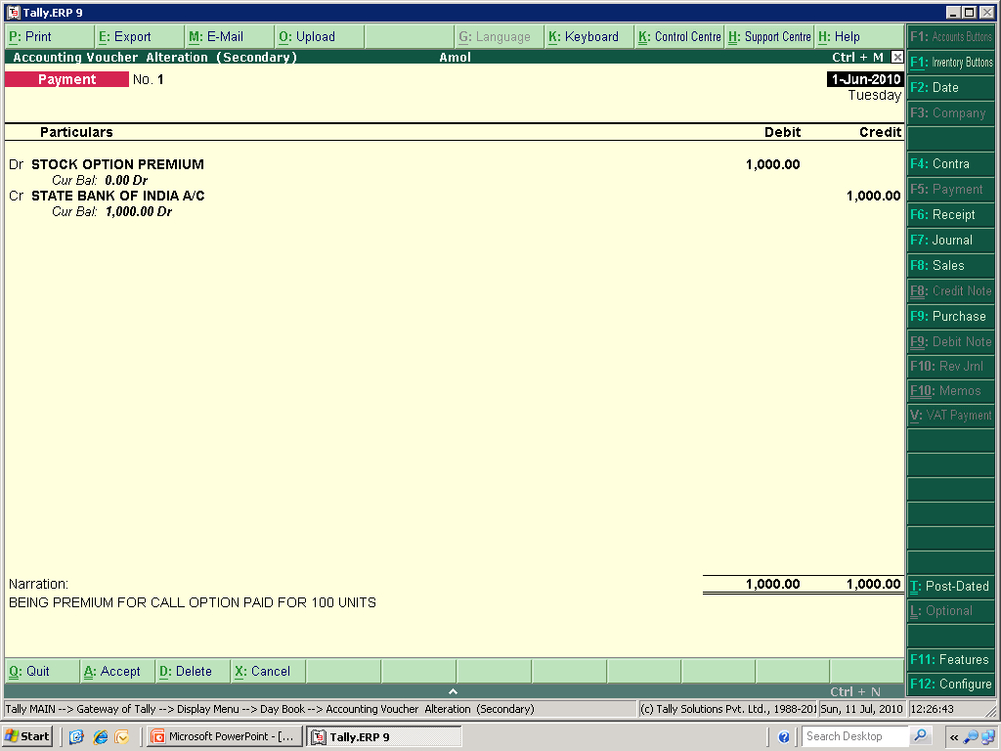
PREMIUM PAID ON CALL OPTION

Slide 8
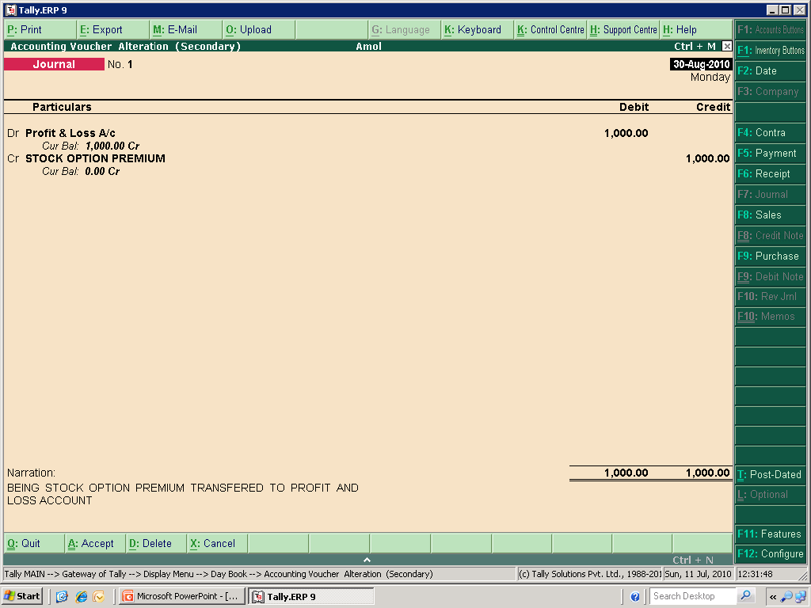
RECOGNATION OF EXPENSES OF PREMIUM PAID

Slide 9
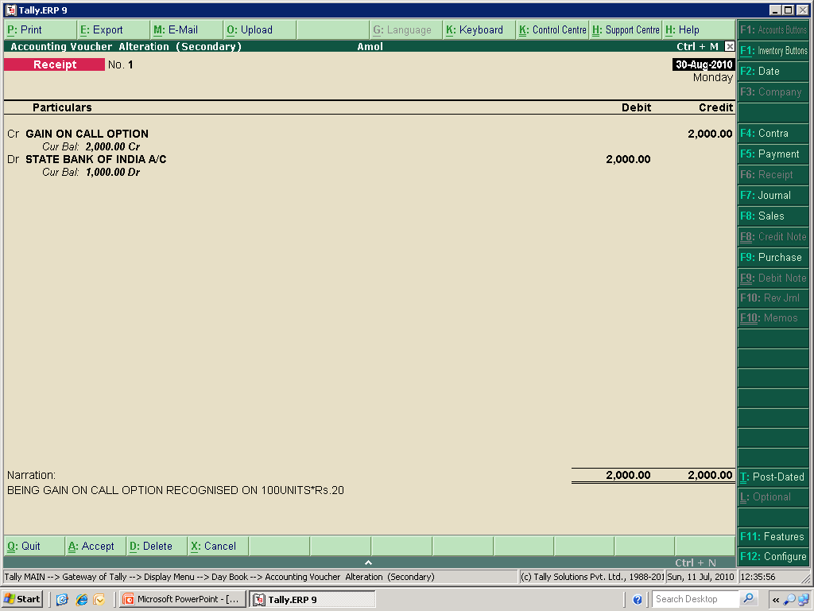
GAIN ON CALL OPTION RECOGNISED

Slide 10
Example of put option
Mr. Jayant buys the put option from Mr. Mangesh details as follows
Date of purchase 10-06-2010
Type of option Put
Expiry date 30-08-2010
Contract for no. of units 100
Strike price/Exercise price 200
Premium per unit 10

Slide 11
Estimated Share Prices on stock market
(Put Option) Buyers point of view
180
200
220
NO
YES
NO
Rs. 20*100
= Rs. 2000
NIL
NIL

Slide 12
Calculation of provision to be made
(Concept of Prudence)
Sr. No. | Particulars | P | Q | R
 |  | Rs. | Rs. | Rs.
A | OPTION BOUGHT
i | PREMIUM PAID | 200000 | 100000 | 100000
ii | PREMIUM PREVAILING ON B/S DATE | 300000 | 50000 | 80000
iii | GAIN/(LOSS) | 100000 | (50000) | 20000
B | OPTION SOLD (WRITER)
i | PREMIUM RECEIVED | 100000 | 300000 | 100000
ii | PREMIUM PREVAILING ON B/S DATE | 250000 | 200000 | 150000
iii | GAIN/(LOSS) | (150000) | 100000 | (50000)
C | NET GAIN/(LOSS) | (50000) | 50000 | (70000)

Slide 13
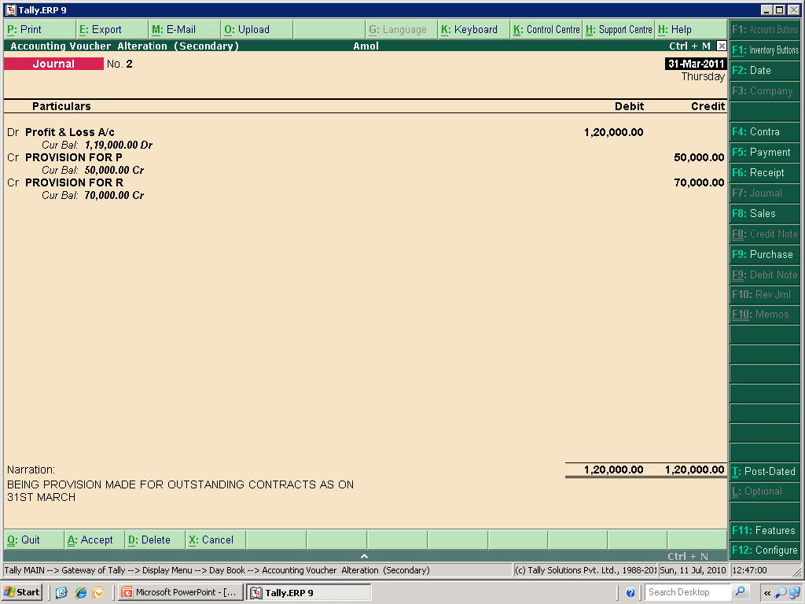
PROVISION FOR NOTIONAL LOSS

Slide 14
- AMOL A. BHUREWAR
THANK YOU

