Slide 1
Material : Definition
Material refers to all commodities those are consumed in the process of manufacture.
Material can be categorised into two:
  Direct Material : The Materials , which can be identified with the
  Individual units, are known as ‘Direct Material’.
  This material is directly identifiable as a part of the final product.
  Eg : Woods in a Furniture, Leather in Shoes
  Indirect Material : Indirect Material is considered as an object that
  uses in the creation of product but does not become part of the
  finished product.
Indirect material cost is the cost of material that is not used in making a product but, uses in other core operations of the production house to enable the production. Eg : Consumable Stores, Cleaning chemicals.

Slide 2
Why Material Control is required?
Material cost constitutes a prime part of the total cost of production of maufacring firms. They normally account nearly 60% of the cost of production.
Hence, it is necessary to put some constraints over the material, in order to get the production in desired form.
Material Control means “ the regulation of the function related to procurement, storage and usage of the materials “.

Slide 3
Objectives of Material control system
All types of materials should be available through out in desired quantity/quality.
Purchase should me made in the most economical quantities. There should be neither under stocking which hamper the production nor over stocking which involves the high cash involvement.
Purchase should be made of the right quality consistent with the standard prescribed in respect of finished goods.
Purchase should be made at the most favourable prices.
Proper storage conditions should be provided to different types of raw material in order to minimize the loss of material.
Issue of material should be properly authorized and accounted for.
There should be a system to give complete and up to date accounting information about purchase/storage/issue/availability of material.

Slide 4
Material Control Stages
Material control can be implemented in 4 Stages:
Ordering /Purchase control
Storage control
Control while Issue the material
Control Over losses

Slide 5
Controlling the purchase procedure
Purchasing procedure differs from one concern to another. Following are usual steps which should be followed in effective purchasing and receiving the material.
Purchase Requisition : a purchase requisition form is commonly used as a formal request to the purchasing department to buy specified material therein.
Such request should received from certain authorized person as, storekeeper, purchase planner, plant engineer or department head.

Slide 7
Selecting the Supplier :When purchasing department receives the purchase requisition it should –
  Invite the tender
  Compare the quotations
  Ensure for best quality, lowest possible price, delivery time lag and, other terms of purchase
  Place the order to suitable supplier

Slide 8
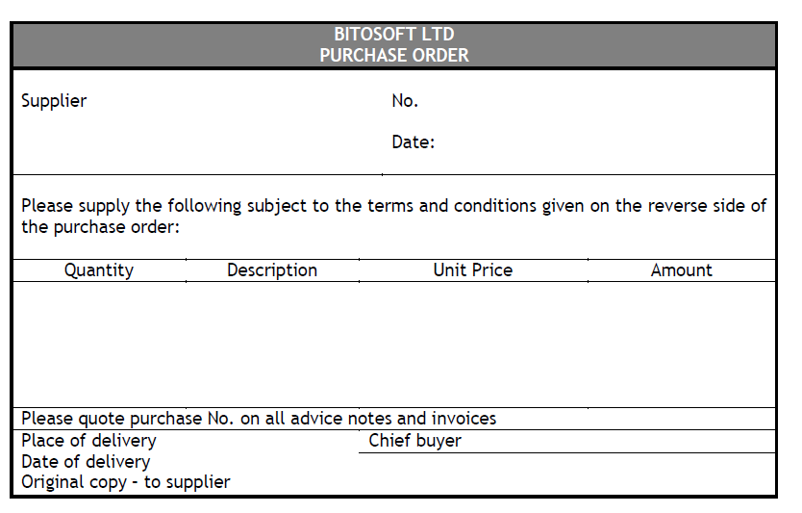
Purchase Order : Purchase order should include following particulars:
The numbers of copies of the purchase order depends on the
size of the organisation. A bigger concern usually issues 5 copies.

Slide 9
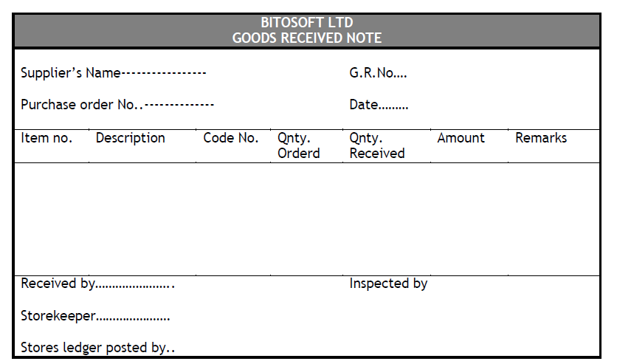
Receiving the Material & Payment : This is the function of
receiving department. Receiving officials should -
Ensure that good is as proper as per the requisition.
Entre all the details of goods in a goods received note.
Make and forward copies of the note to all departments to whom purchase order was sent.
If purchase manager finds the note in order, he will sign it and passes to accounts for the payment.

Slide 10
Important issues in Material Procurement
Economic Order Quantity
Fixation of Maximum Level
Fixation of Minimum Level
Fixation of Re-order Level

Slide 11
Storing of Material
Purchased material is sent to stores, before it is issued for production. Storekeeper is in charge of the stores, who should performs important functions as follows:
Receive material after verifying them.
Store the material in allotted places.
Maintain the record of receipt, issue and balance.
Minimize the cost of storage.
Economical utilization of space.
Protect the material from loses due to fire,theft,evoparation,
obsolesce etc.

Slide 12
Techniques of Material Storing
There are different techniques of material
storing and they differ by concern to concern
as per the requirement.
ABC System
JIT Inventory
VED Analysis
FSND Analysis

Slide 13
Issue Control
Material should be Issued with the utmost care. Following points should be
Considered while issuing the material:
Without authorization material cannot be issued.
Material requisition note should be obtained.
Material requisition note should mention quality, quantity and, requiring date.
If material is directly transferred from one site to another without returning to the store, then material transfer note should be prepared.
Pricing of the issue should be noted by a proper method like as FIFO, LIFO, HIFO, Simple Average Method, Weighted Average Method etc.
Pricing method should be followed by - production process/nature of material/market rates/ accounting practices/ level of normal loss etc.

Slide 14
Thank you !!!

