Slide 1

AS – 24
ACCOUNTING FOR
DISCONTINUING OPERATIONS
CA. VAIBHAV JAIN
vaibhav1986@gmail.com
MOBILE: 98 681 44380

Slide 2
APPLICABILITY
  Enterprises whose equity or debt securities are listed whether in India or outside India or are in process of listing.
  Banks incl. co-operative banks
  Financial Institutions
  Carrying on Insurance business
  Turnover (excl. Other Income) > Rs. 50 Crores
  Borrowings (incl. Public Deposits) > Rs. 10 Crores
  Holding or Subsidiary of any of the above

Slide 3
What is a Discontinuing Operation ?
A discontinuing operation is a component of an enterprise:
(a) that the enterprise, pursuant to a single plan, is:
(i) disposing of substantially in its entirety, such as by selling the component in a single transaction or by demerger or spin-off of ownership of the component to the enterprise's shareholders; or
(ii) disposing of piecemeal, such as by selling off the component's assets and settling its liabilities individually; or
(iii) terminating through abandonment; and
(b) that represents a separate major line of business or geographical area of operations; and 452 AS 24 (issued 2002)
(c) that can be distinguished operationally and for financial reporting purposes.

Slide 4
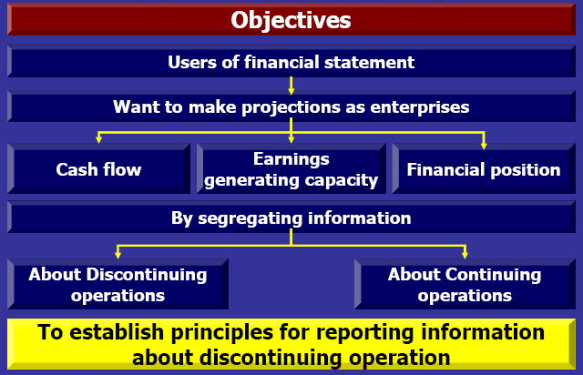

Slide 5
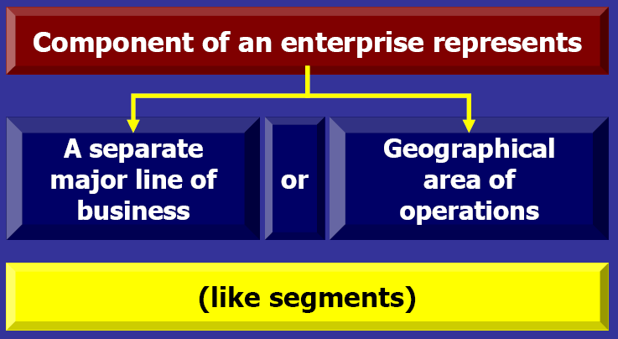

Slide 6
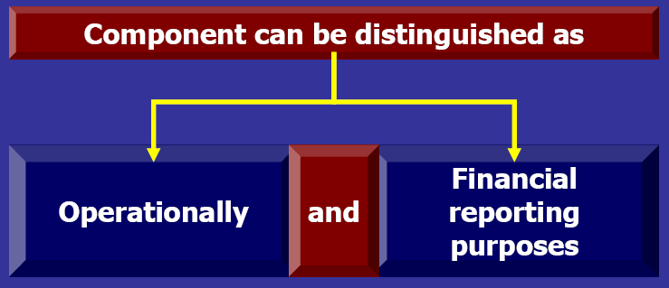

Slide 7
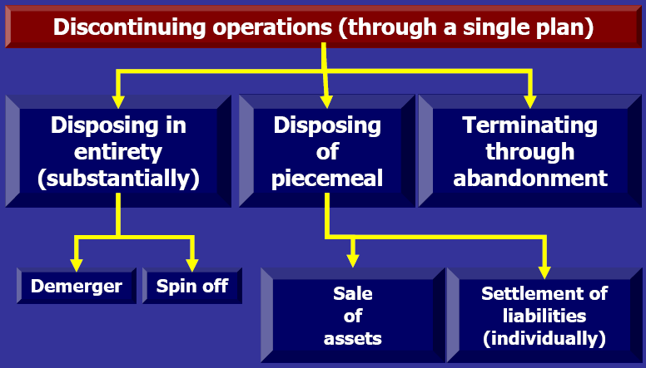

Slide 8
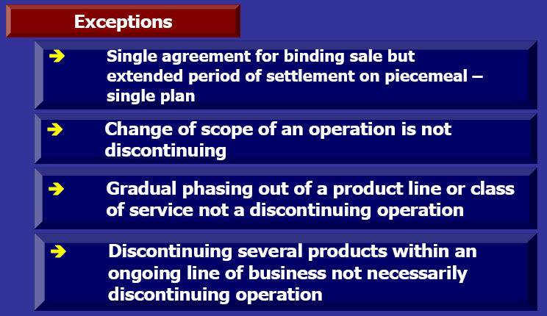

Slide 9
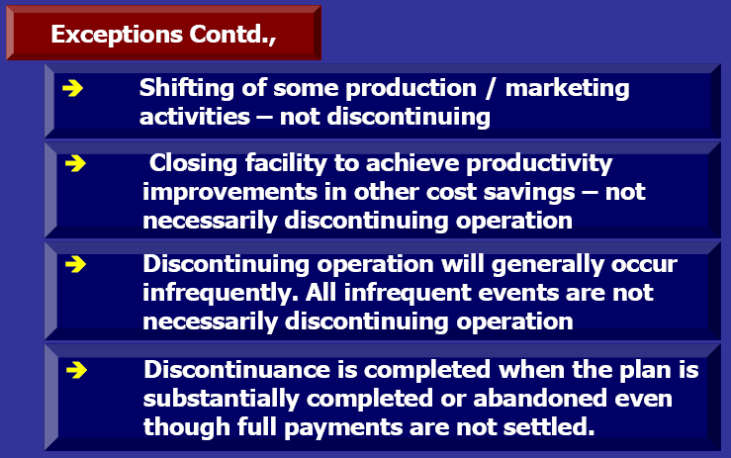

Slide 10
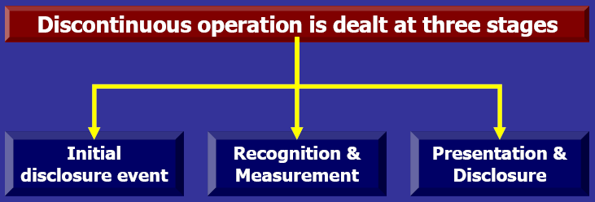

Slide 11
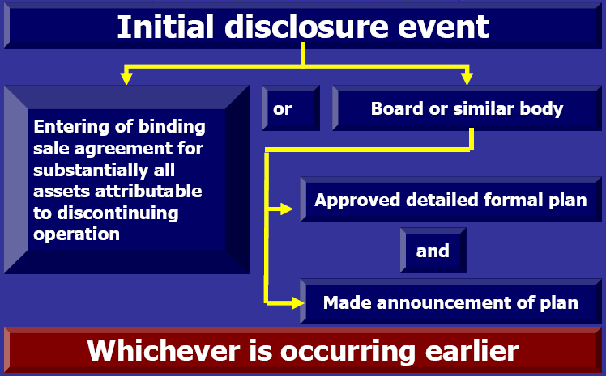

Slide 12
Initial Disclosure Event
1. the enterprise has entered into a binding sale agreement for substantially all of the assets attributable to the discontinuing operation; or
2. the enterprise's board of directors or similar governing body has both
    o approved a detailed, formal plan for the discontinuance and
    o made an announcement of the plan.
    o terminating through abandonment; and
3. that represents a separate major line of business or geographical area of operations; and
4. that can be distinguished operationally and for financial reporting purposes.

Slide 13
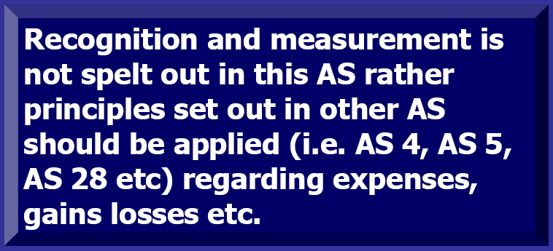
Recognition and Measurement
Recognition and measurement principles established in other accounting standards should be followed in the accounting of changes in assets, liabilities, revenue, expenses, losses, and cash flow relating to a discontinuing operation.

Slide 14
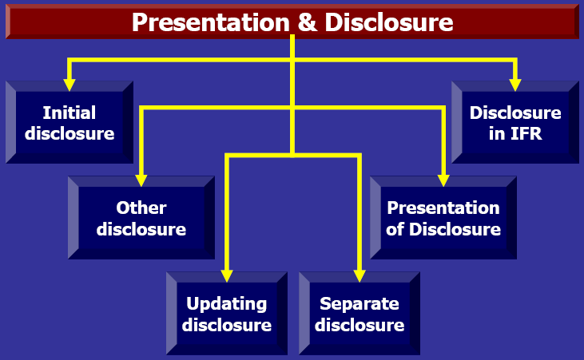

Slide 15
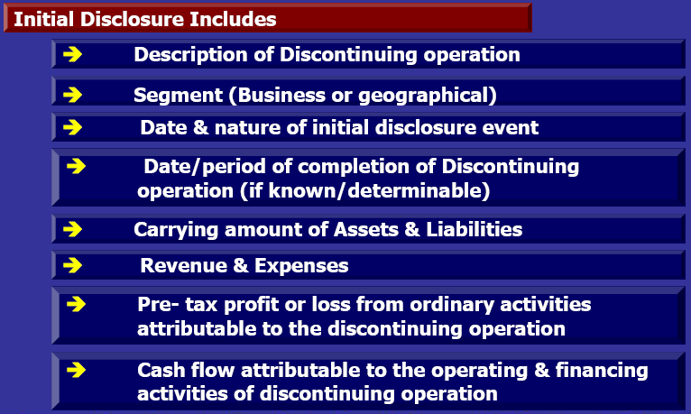
If an initial disclosure event occurs between the balance sheet date and the date of approval of accounts, disclosures as required by AS 4 - Contingencies and Events Occurring after the Balance Sheet Date, are made.

Slide 16
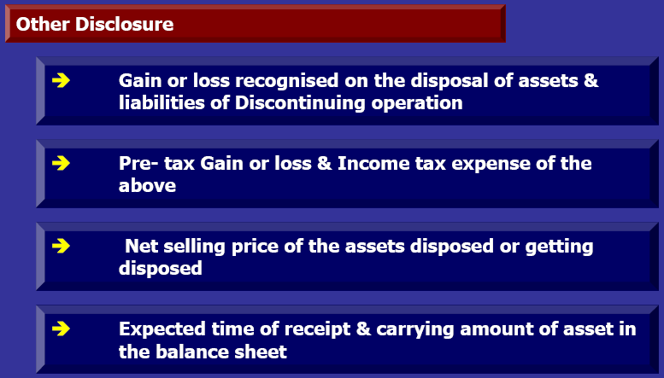
The above information pertaining to asset disposals, liability settlements, and binding sale agreements pertaining to a discontinuing operation should be included in the financial statements when the events occur

Slide 17
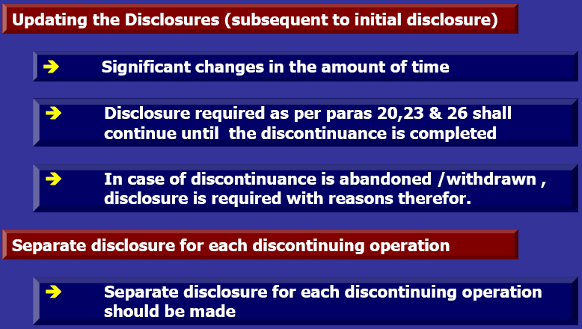

Slide 18
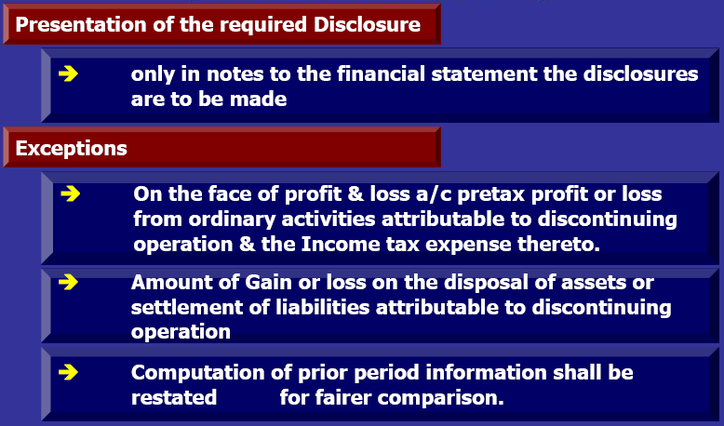

Slide 19
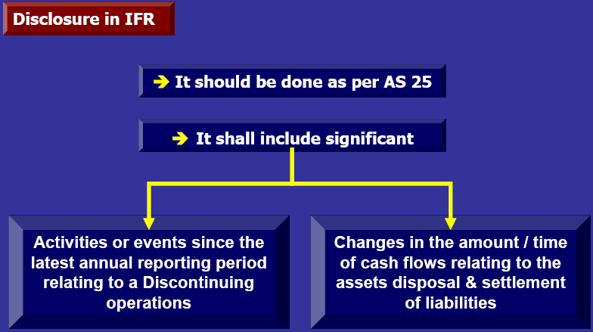

Slide 20

Questions ??
Suggestions ??
Comments ??

Slide 21

Thank You.
CA VAIBHAV JAIN
vaibhav1986@gmail.com
9868144380

